Slide 1
UNIVERSITY OF NIGERIA, NSUKKA
COLLEGE OF POSTGRADUATE STUDIES
ICT AND DATA ANALYSIS
PROF. THOMAS M. OKONKWO
Department of Food Science and Technology
E-mail: thomas.okonkwo@unn.edu.ng
Phone: +2348066567609

Slide 2
GOALS AND OBJECTIVES
At the end of the workshop the participants should be able to:
Define ICT
Appreciate uses of ICT
Define data
Appreciate sources of data
Understand the meaning and importance of data analysis
Understand ICT tools applied in data analysis
Appreciate basic concepts of SPSS
Use SPSS to analyse some data
Interpret such analysed data

Slide 3
INTRODUCTION
ICT and Data Analysis for life sciences
Purpose: provide a feel for computerized statistics for those in life sciences who do not understand or feel comfortable with tedious calculations involved in pure statistics
Agriculture, Pharmacy, Biological sciences and Veterinary sciences
Especially with students who are working in their projects
Many statistical books carry equations, which although will satisfy statistical concerns, but will discourage non-statistical & non-mathematical specialists
Many books are available but not adequate for modern day digital age
First part of this presentation deals with background on ICT & data analysis, 2nd part on software used in data analysis & 3rd part on use of SPSS to analyse data

Slide 4
ICT
WHAT IS ICT?
Information Communication Technology
Extensional term that stresses the role of unified communication and integration of Telecommunication with computers
Refers to convergence of audiovisual telephone networks with computer networks through a single cabling or link
Umbrella term that includes any communication device encompassing radio, television, cell phones, computer and network hardware, satellite system and also various services and applications with them
Covers any product that will store, retrieve, manipulate, transmit or receive information electronically
A broad subject whose concept is still evolving

Slide 5
ICT continues
Components that make up the term are Information, Communication and Technology
Information is regarded as an important source for all human activities, a product of human brain in action
Communication is a basic prerequisite of all human performance and interaction between two or more people in form of transmission of thoughts, information and commands by employing different infrastructure available
Technology is science of craft which is collection of techniques, skills, methods and processes used in production
Put together, ICT refers to technologies that provide access to information through telecommunication with or without applying software
There are three distinct strands in the development of information technology: technologies used to record and store data, technologies used to analyse data and technologies used to communicate data

Slide 6
DATA
Facts or statistics for reference or analysis
Collection of numerical quantities for inference or analysis
Pieces of information output by a sensing organ or device
Sources of data include: Observations made through
  *physical measurements (length, weight, volume, etc.)
*counts (number of products that are wrinkled, rotten, damaged, too big, too small, scratched, etc.)
*counts over time (seconds, minutes, hours, days, weeks, years, decades, etc.)
The observations, within the limits set, are called data
Data may come from selected items called sample or it can come from the entire supply called population

Slide 7
TYPES OF DATA
QUALITATIVE DATA: Measurements that are not expressed in terms of numbers but by means of natural language description
QUANTITATIVE DATA:
- Numerical measurements expressed in terms of numbers
- not all numbers are continuous or measurable e.g. identity number, staff number, social security number, etc.
- always associated with measurement through a scale
- could be discrete e.g. 1,2,3 men or continuous e.g. 5.5, 7.1, 8.9 cm
NOMINAL DATA: unordered categories such as gender, race, religion
ORDINAL DATA: -ordered categories e.g. small, medium, large, etc.
          - Attitudes e.g. agree, disagree, neutral, etc.

Slide 8
COMMON TYPES OF DISTRIBUTION OF DATA
This is the position, arrangement or frequency of occurrence of data within the population
Analysis of data cannot logically proceed without understanding the type of distribution present
There are many types of distribution in which the data may be found:
  Normal distribution Binomial distribution Poisson distribution
  T-distribution F-distribution Exponential distribution
  Weibull distribution Chi-square distribution multinomial distribution
  Hypergeometric distribution etc.
  All these types of distribution comprise of methods concerned with analysis of data subset leading to predictions or conclusions of the population or entire set
  Numerical data describing a characteristic of a population is called parameter while numerical data describing a characteristic of a sample is called statistic

Slide 9
DATA ANALYSIS
Definition
- a process of applying statistics to organize, represent, describe, evaluate, model and interpret data
- a process of evaluating data using analytical and logical reasoning for the purpose of obtaining useful information
Importance
    To provide an explanation to various concepts, theories, frameworks and methods used
    Helps at arriving at conclusions and proving hypothesis
    Helps in making useful and better decisions
    Helps in improving the performance of an establishment or business or organization

Slide 10
DATA ANALYSIS PLAN
For a successful data analysis, a plan should be put in place to:
Ensure that the questions and data analysis instruments give the required information
Align the expected report with results of analysis and interpretation
Improve reliability through consistent measures overtime
The key components of data analysis plan include:
- the purpose of evaluation
- what key questions should be asked or what key measurements to be taken
- What analytical techniques should be developed or adopted
- how would the data be presented and interpreted

Slide 11
ICT AND DATA ANALYSIS
This is the application of Information Communication Technology including its various software packages in collection, collation, analysis and interpretation of data
Several software are available for data analysis including:
- SAS/STAT - MegaSTAT
- JPM - MINITAB
- S-Plus - STATISTICA
- SPSS - MATHEMATICA
- BNDP -E-View
- Genstat - R
These software help to analyse data and plot graphs

Slide 12
SPSS
SPSS appears to be the most commonly used software by students and non-computer/non statistics professionals
SPSS is an acronym for Statistical Package for Social Sciences
It is an application software developed by IBM
It is not limited to Social Sciences but to other areas of learning
The use of SPSS will be the focus of further discussion

Slide 13
STATISTICAL PACKAGE (SPSS) ORGANIZATION
SECTIONS AND MODES:
There are two main sections: Input section and Output section
The Input Section: where data are defined and entered
  - there are two modes between which users can switch
  - ‘Variable view’ and ‘Data View”
  - users can switch between the modes by clicking on the tab on the bottom of the screen
The Output section: where results are displayed
  - opens a separate window where results are displayed
  - output data are saved as separate file to the dataset

Slide 14
VARIABLE VIEW
Contains cells known as Data entry and analysis Cells
These cells are setup by naming and defining the variables included
Variable names supplied by the operator must start with an alphabet
Variable choices with descriptions can be added using the ‘labels’ dialog box
Variables can be copied and pasted into other cells if they have similar format

Slide 15
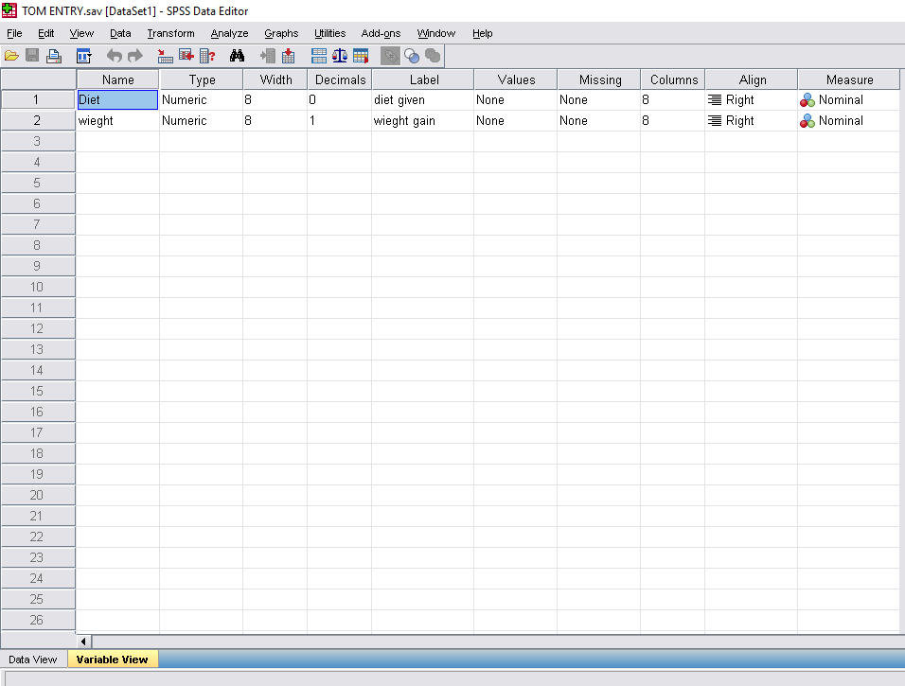

Slide 16
DATA VIEW
Resembles a spreadsheet programme
Organised in rows and columns
Variables are organised as columns
Rows represent a singles ‘case’ in the dataset containing values for variables relating to that case
Often, codes are used to enter data
Where necessary, labels can be used to describe data
Using SPSS, the defined labels will appear by clicking the dropdown list arrow on the right side of the cell. Operator can select his/her choice

Slide 17
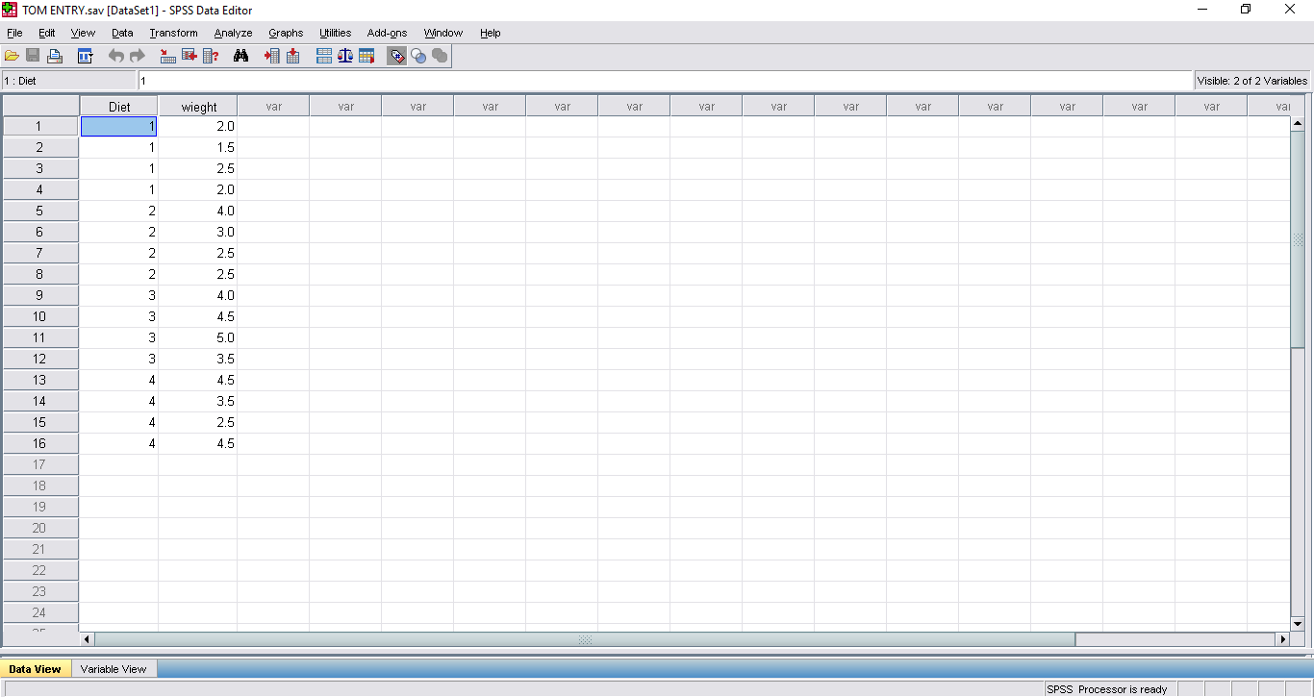

Slide 18
DATA ANALYSIS
After entering, data are crosschecked for typographical errors which may affect results
All analytical functions in SPSS can be accessed by using the Analyse menu
There could be other dialog boxes which allows the operator to use specific functions of the variable parameters
If such dialog boxes appear, they have to be filled to format the output

Slide 19
SPECIFIC ANALYTICAL CASES
DESCRIPTIVE STATISTICS
Firstly, used to get a feel of the data, secondly, used in tests themselves and thirdly, used to indicate the error associated with results and graphical output
Has to do with a method of collecting and describing a set of data to provide information on that dataset (sample)
Does not draw inferences or conclusions about a larger set of data or population
Descriptive statistics commonly used include measures of central tendency and measures of dispersion

Slide 20
Measures of Central Tendency
These are exemplified by mean, median and mode
Mean : most popular measure of an average of a number of observations
- Arithmetic mean: average of a set of data considering minus signs
-Absolute mean: average of a set of data disregarding minus signs
- Geometric mean: root of the sum of a number of observations
- Harmonic mean: sum of the inverse of each observation divided by the number of observations
Mode: the value of the measurement which occurs most frequently
Median: the value of the middle item when the items are arranged according to size

Slide 21
Measures of Dispersion
These are exemplified by range, variance, standard deviation, standard error, coefficient of variation
Range: the difference between the maximum and minimum value
Variance: the mean square deviations of all individual values from the arithmetic mean
Standard deviation: most common and best measure of spread. It is the square root of variance
Standard error: assesses how closely the sample relates to the population
Coefficient of Variation: used to determine how much variation occurs within the data set or used to compare variation between data set

Slide 22
RELATIONSHIP BETWEEN VARIABLES
CORRELATION AND REGRESSION
CORRELATION: Deals with the estimation and test of significance of the correlation coefficient r
r measures degree of association between two variables, x and y
Computation of r is based on the amount of variability in one variable that can be explained by the function of the other variable
r lies between 0 and +1 or 0 and -1. Extreme values indicate perfect association. Values between 0 and ±1 indicate degrees of association
The square of r [r²] is known as the coefficient of determination and expresses the proportion of the total variation in the values of the dependent variable (Y) which can be explained by the linear relationship with the values of the independent variable (X)
Signs (+1 and -1 ) indicate the direction of change

Slide 23
REGRESSION:
Describes the effect of one or more variables X (designated as the independent variable) on another variable, Y (dependent variable) by expressing the later as a function of the former
It is important to clearly distinguish the dependent and independent variables. Generally the character of major importance becomes the dependent variable and the factor or character that influences it becomes the independent variable.
Establishes the nature of the relationship between two variables
In linear regression for example, the functional form of the linear relationship between a dependent variable (Y) and independent variable (X) is expressed as Y = α + βX where:
Y = dependent variable; X = Independent variable; α = Intercept and β = regression coefficient or slope or amount of change in Y as a result of each unit change in X

Slide 24
T- DISTRIBUTION:
Used to compare two independent sets of data to find out if their means Ẋ₁ and Ẋ₁ show significant difference.
The null hypothesis is that Ẋ₁ = Ẋ₂ and that Ẋ₁-Ẋ₂ = 0
The probability of being true is tested by estimating the standard error of the difference and using t-test.
It is assumed that both sets of data are derived from the same population with same standard deviation.
The equality of the means is what is in doubt.
Can be used to compare the performance of two similar drug or food dispensing equipment, or any observation that is naturally paired.

Slide 25
F- DISTRIBUTION
Developed by Fisher to study the behaviour of two variances from random samples. It is also known as Fisher-Snedecor distribotion
Comparison of two variances: it is the basis of analysis of variance involving the ratio of variance estimates
Useful in Analysis of Variance (ANOVA) tests (testing the assumptions that underline many statistical tests that two population variances are equal).
Finds great relevance in statistical designs of which the simplest is one-way analysis of Variance, also known as one way classification or Completely Randomized Design (CRD).
Testing multiple correlation coefficient

Slide 26
APPENDIX 1
DATA FOR DESCRIPTIVE STATISTICS
The following data were generated during the feeding trial of albino rats.
Weight of rats(g)
2, 1.5, 2.5, 2, 4, 3, 2.5, 2.5, 4, 4.5, 5
Calculate the mean, mode, median, standard deviation, standard error and coefficient of variation

Slide 27
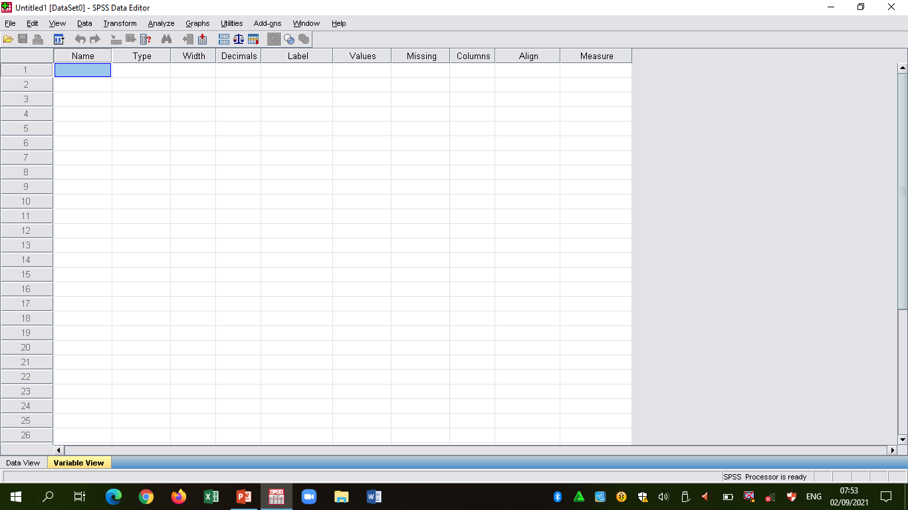

Slide 28
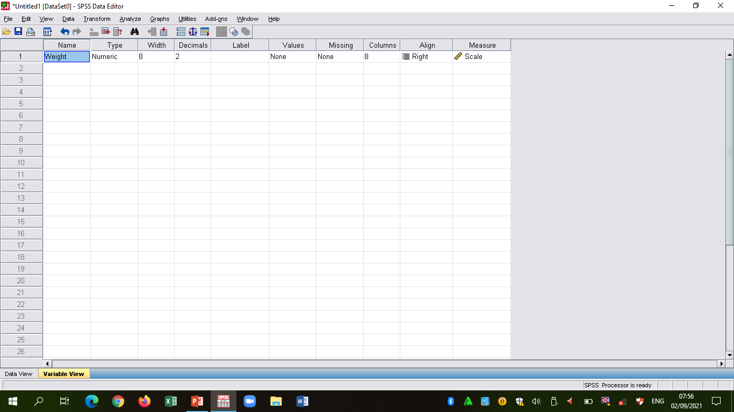

Slide 29
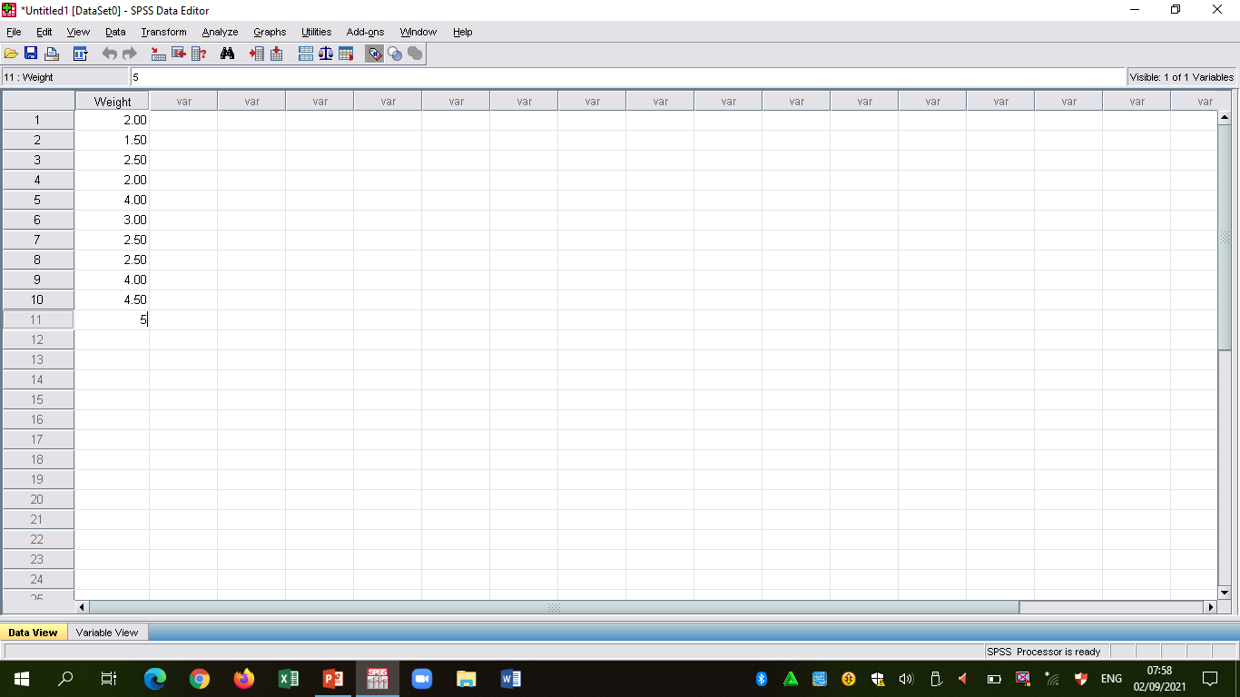

Slide 30
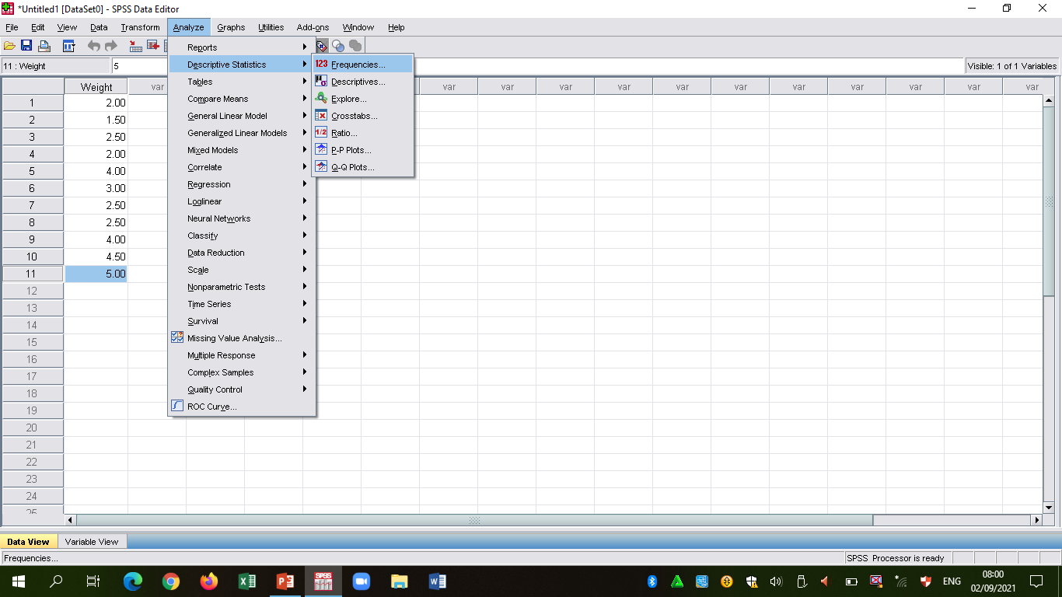

Slide 31
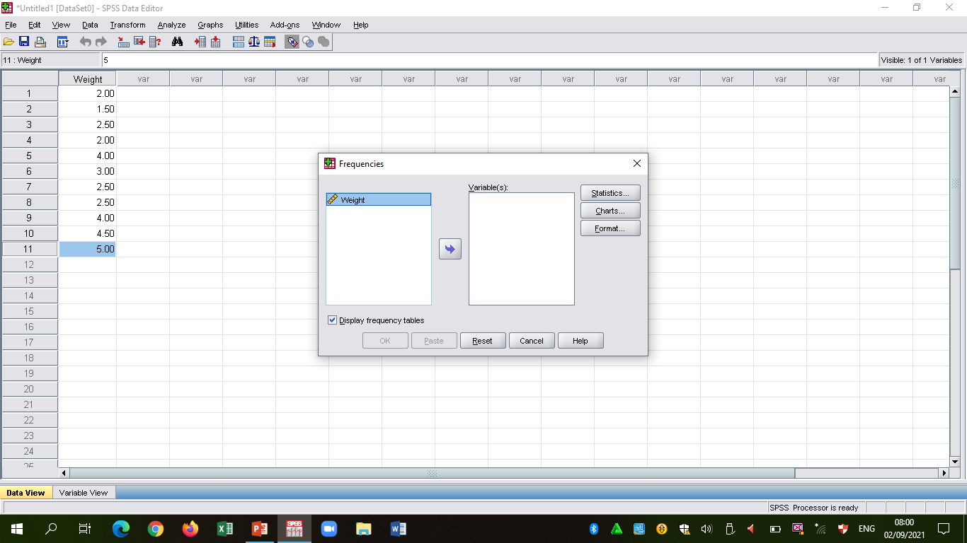

Slide 32
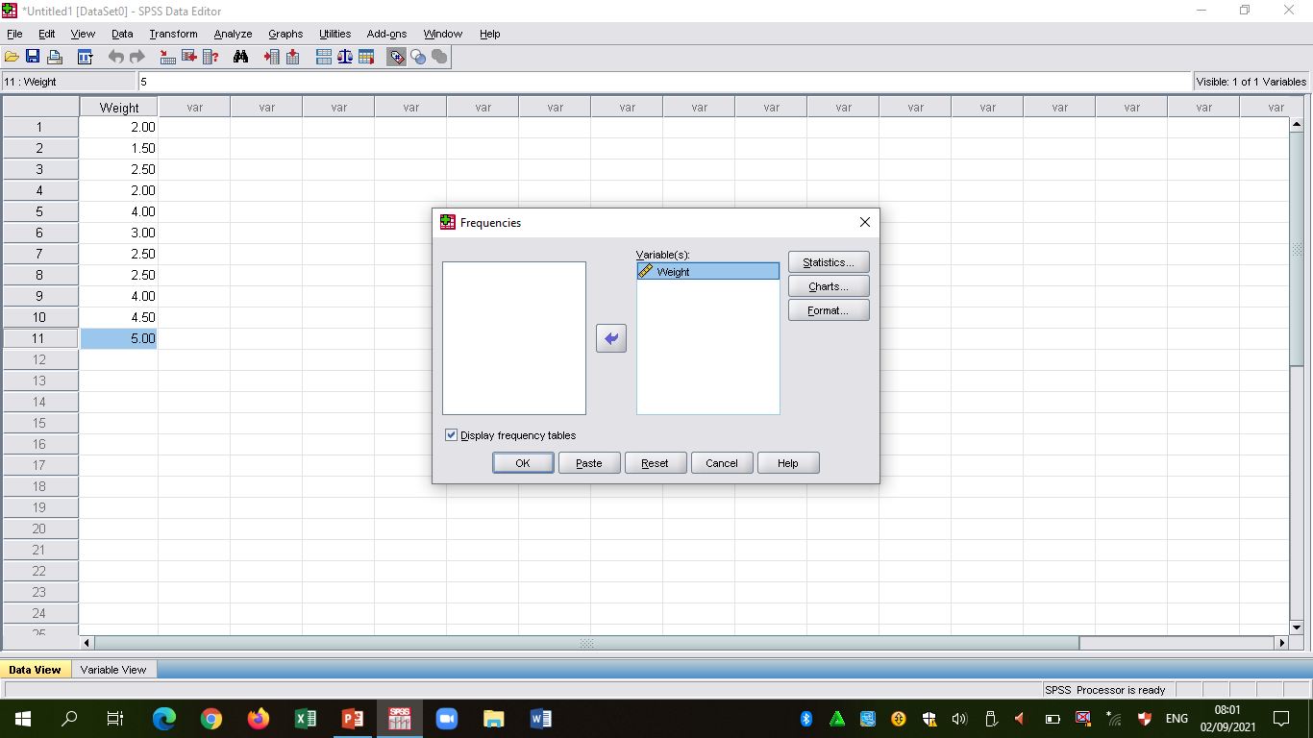

Slide 33
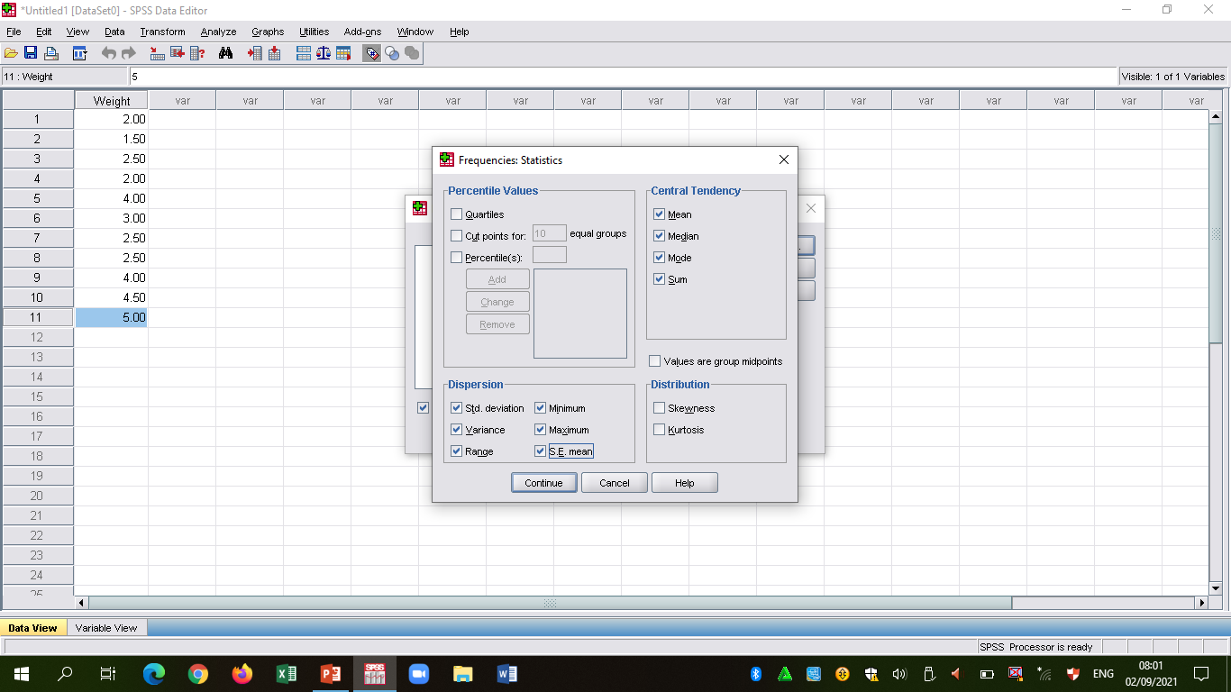

Slide 34
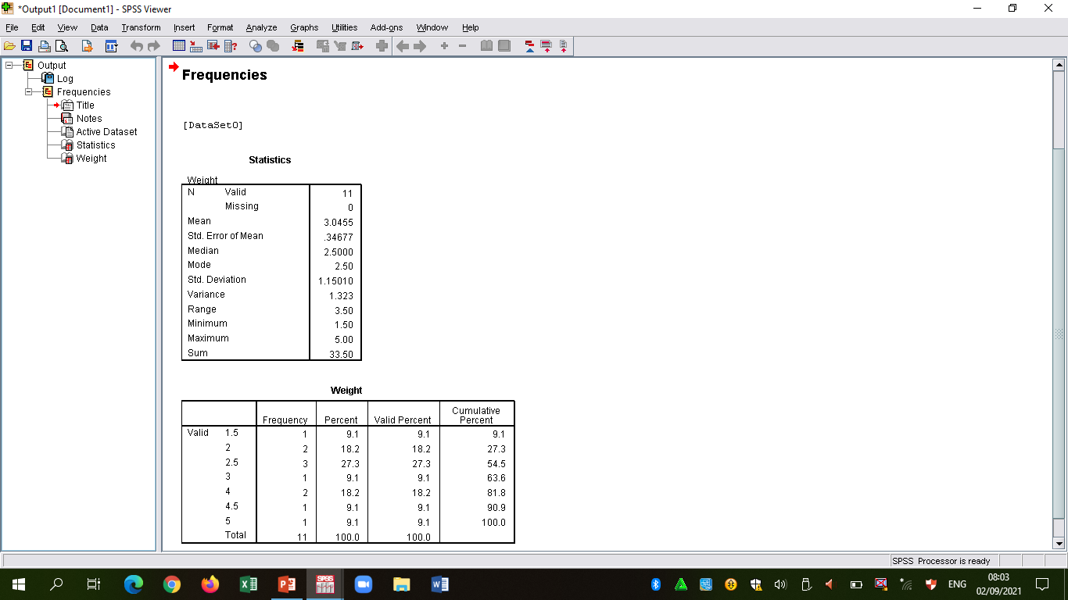

Slide 35
APPENDIX 2
DATA FOR SIMPLE LINEAR CORRELATION AND REGRESSION
The data below are to determine the relationship between pH and presence of non-protein nitrogen in stored raw meat
pH(X): 5.7 5.5 5.4 5.3 5.5 5.7 6.4 6.5 6.6
NPN(Y): 0.25 0.30 0.32 0.35 0.45 0.54 0.60 0.75 0.85
Determine the Degree and Nature of the relationship

Slide 36
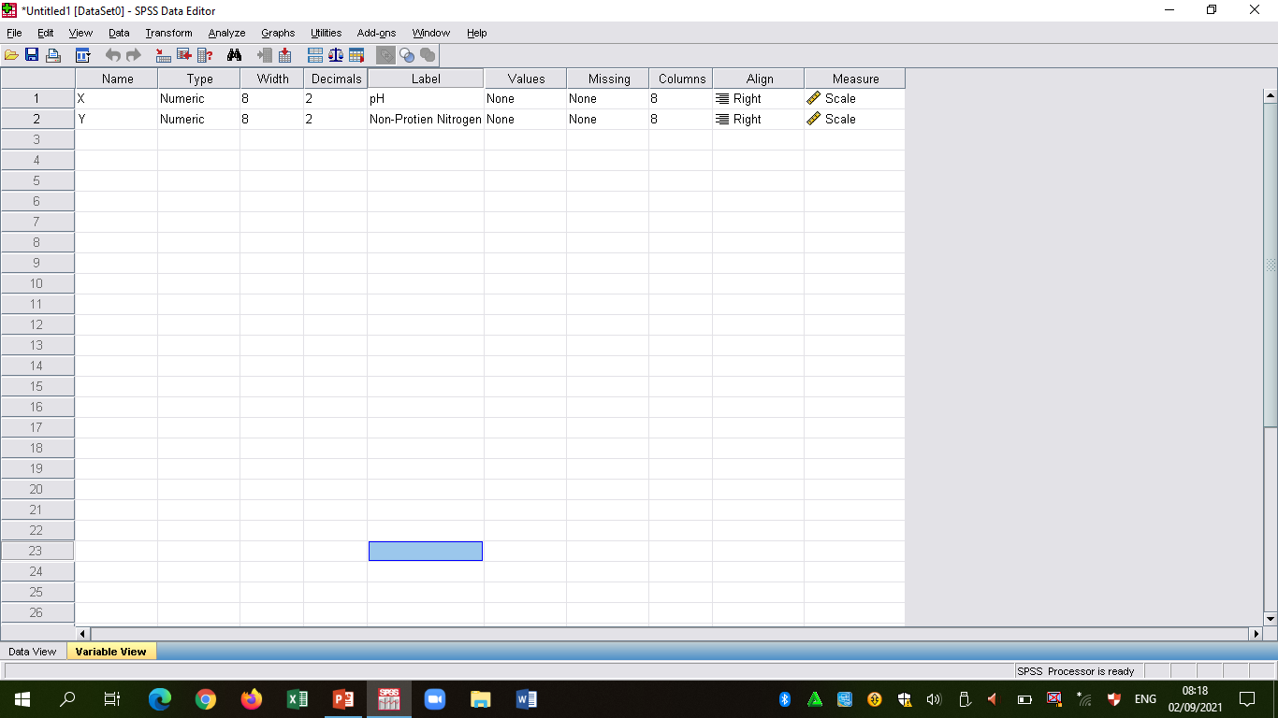

Slide 37
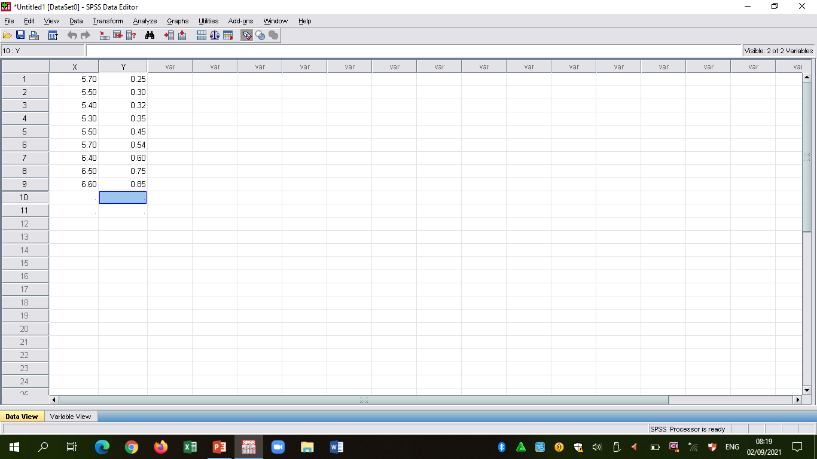

Slide 38
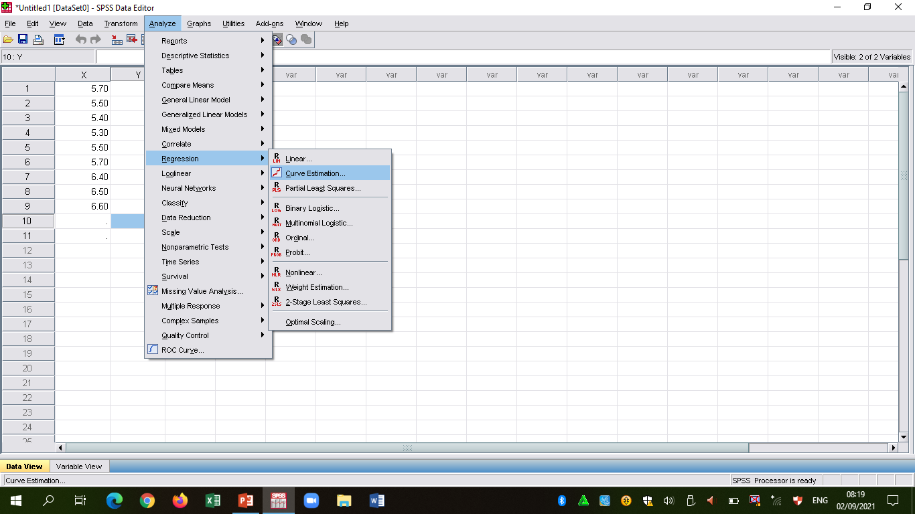

Slide 39
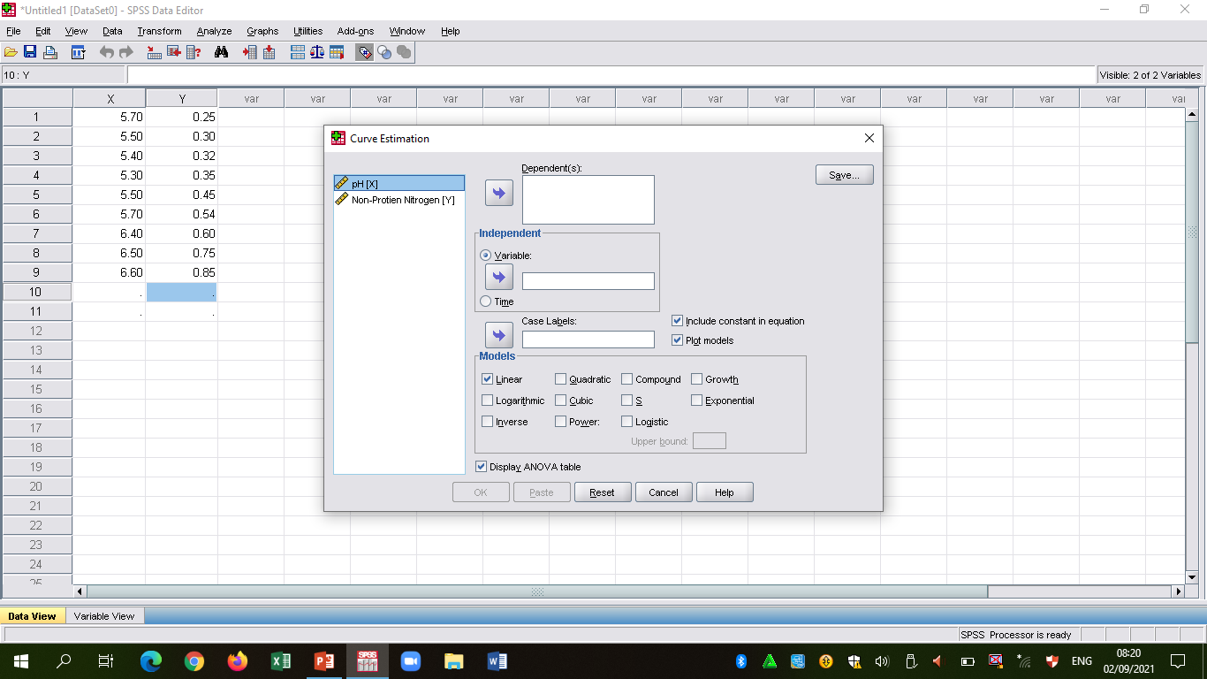

Slide 40
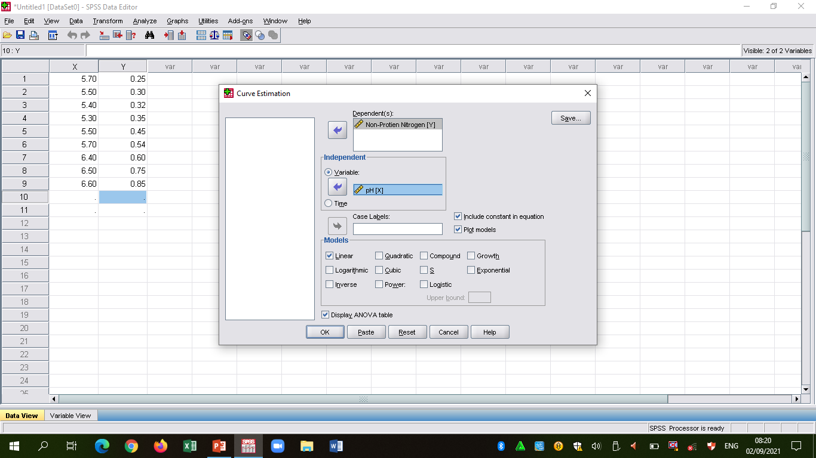

Slide 41
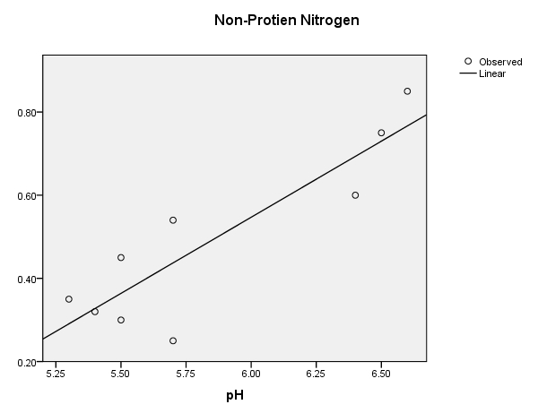
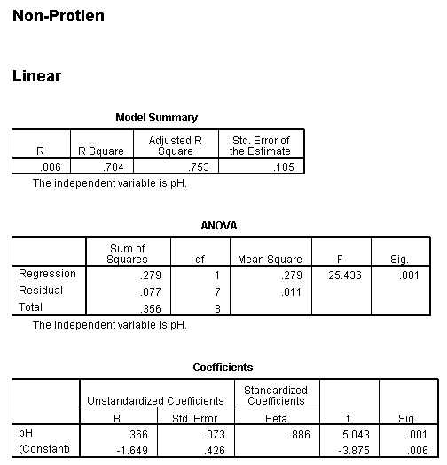
THE PREDICTING EQUATION

Slide 42
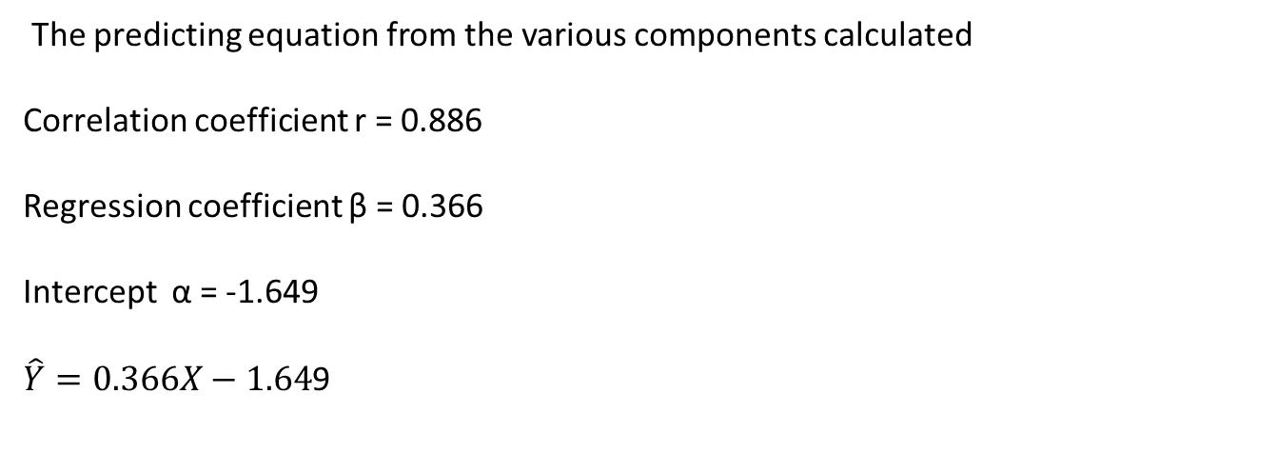
THE PREDICTING EQUATION
The predicting equation from the various components calculated
Correlation coefficient r = 0.886
Regression coefficient β = 0.366
Intercept α = -1.649
$\hat{Y}=0.366X−1.64$9

Slide 43
APPENDIX 3
DATA FOR T-TEST
The following data were the results of check weighing from two filling machines (Machine A = MA and Machine B = MB) in factory producing a 60g pack of a product.
MA: 61 63 60 64 62 62 59 61 64 62
MB: 61 62 59 59 62 62 64 60 60 59
Using t-test, determine if there is a significant difference in the deliveries of the two machines.

Slide 44
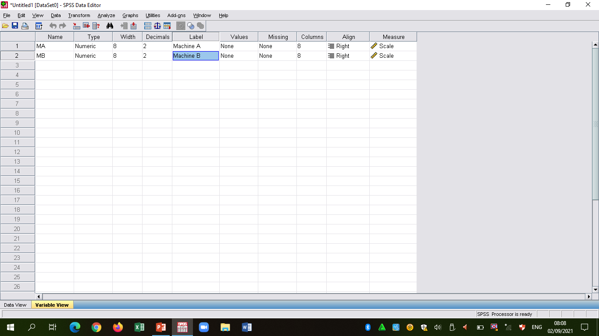

Slide 45
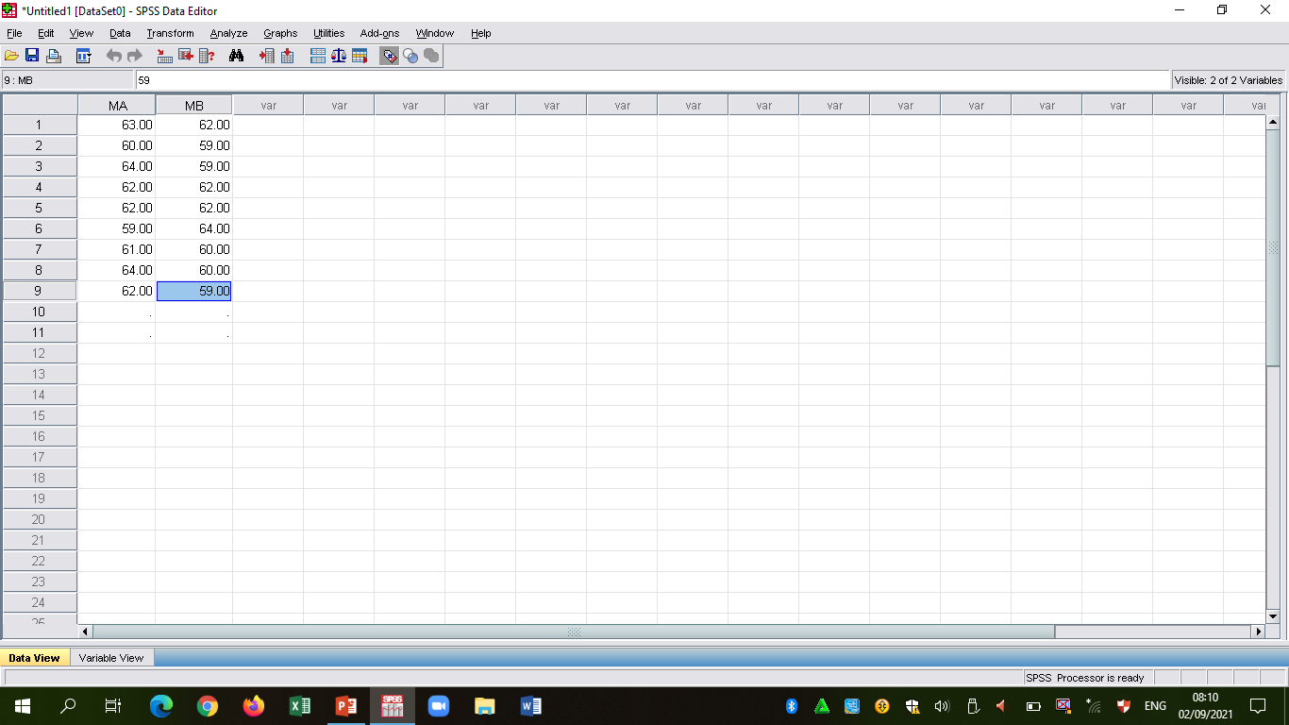

Slide 46
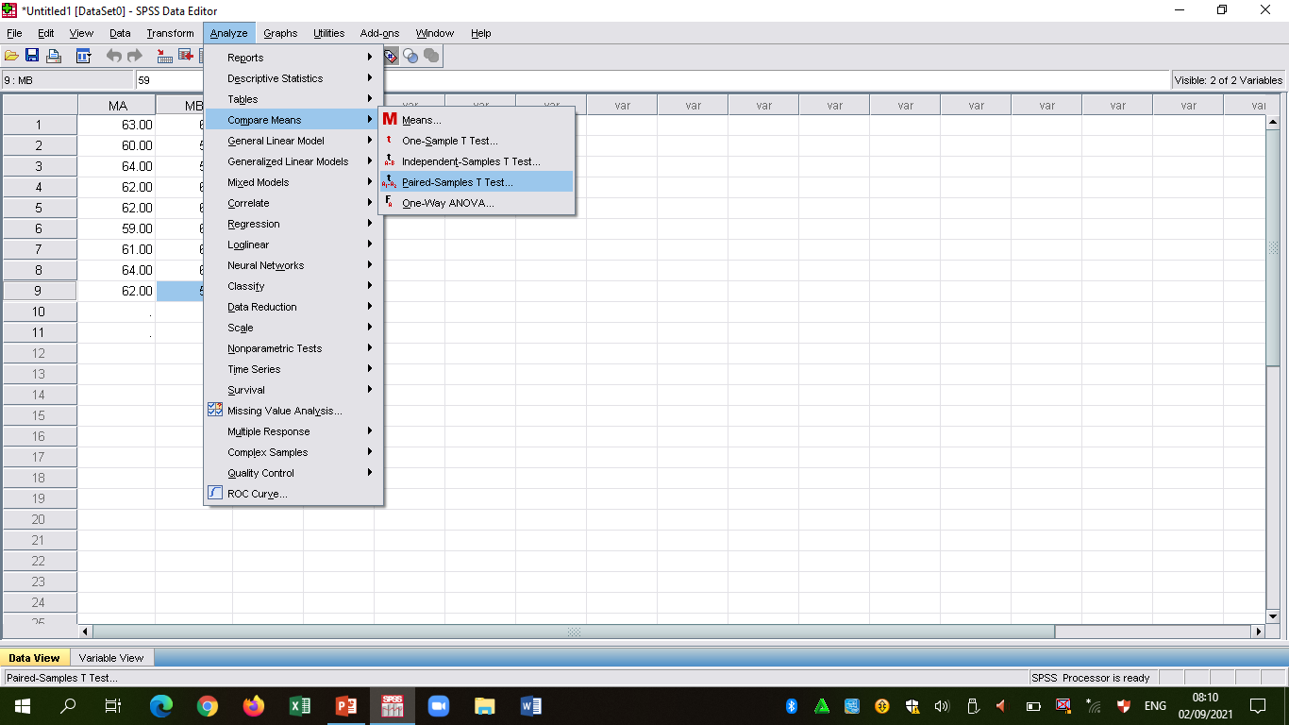

Slide 47
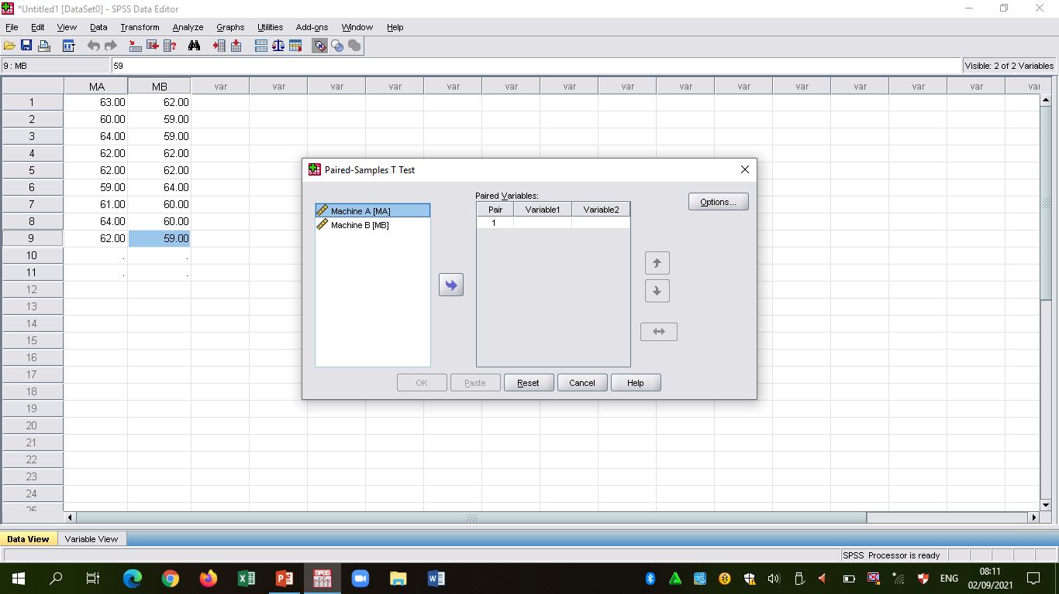

Slide 48
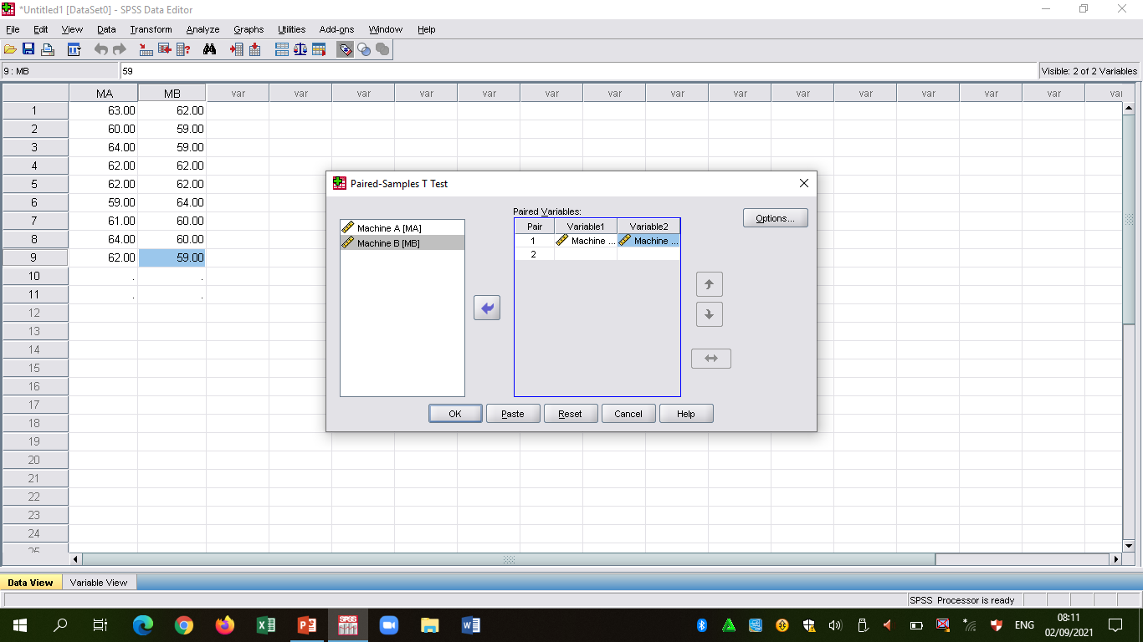

Slide 49
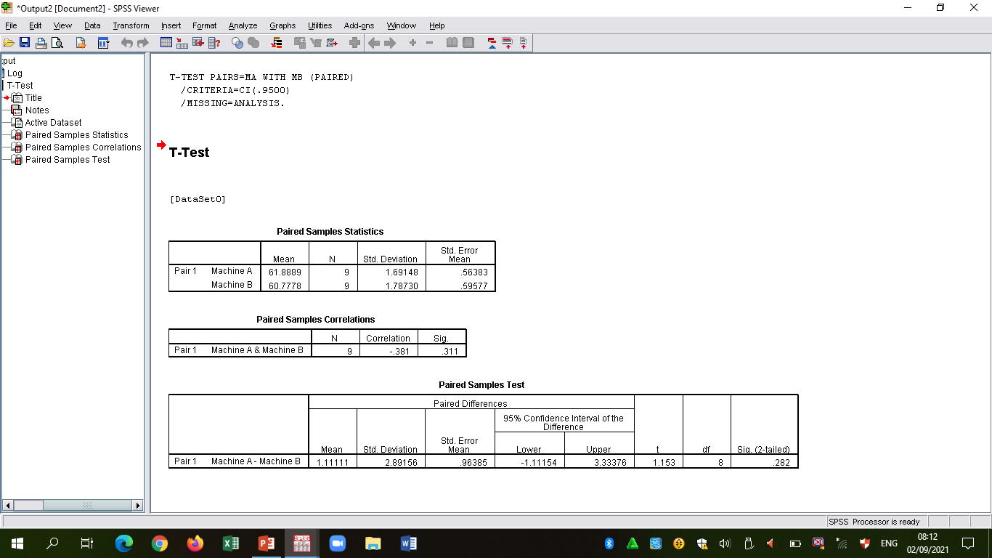

Slide 50
APPENDIX 4
DATA FOR ONE-WAY ANOVA
The data below represent the result of the effect of four different complimentary diets formulations on weight gain of infants using feeding trial of rat.
Diet Replications(weight gains in grams per weighing period)
D1 2.0 2.5 1.5 2.0
D2 4.0 3.0 2.5 2.5
D3 4.0 4.5 5.0 3.5
D4 4.5 3.5 2.5 4.5
Determine if there are significant differences in the ability of the complimentary diets to cause weight gain.

Slide 51
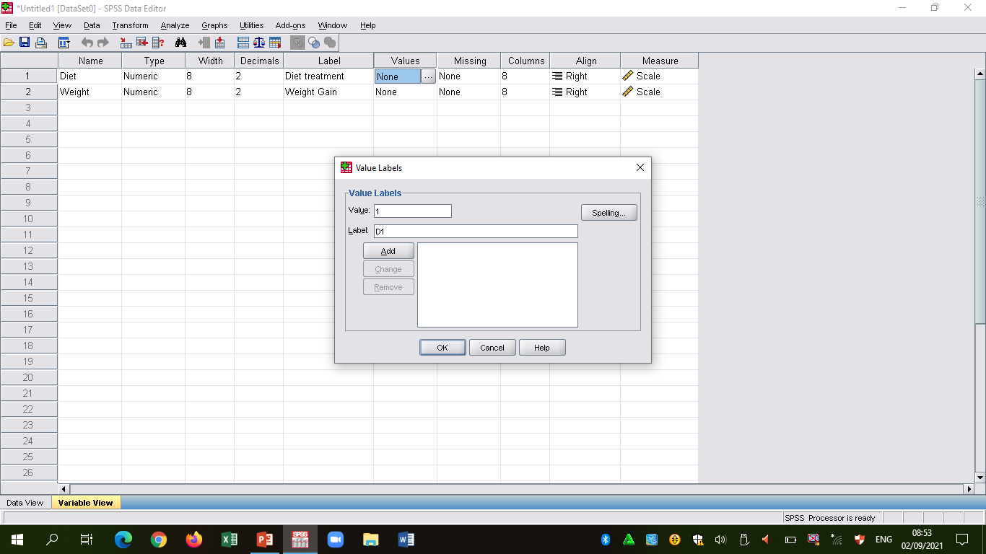

Slide 52
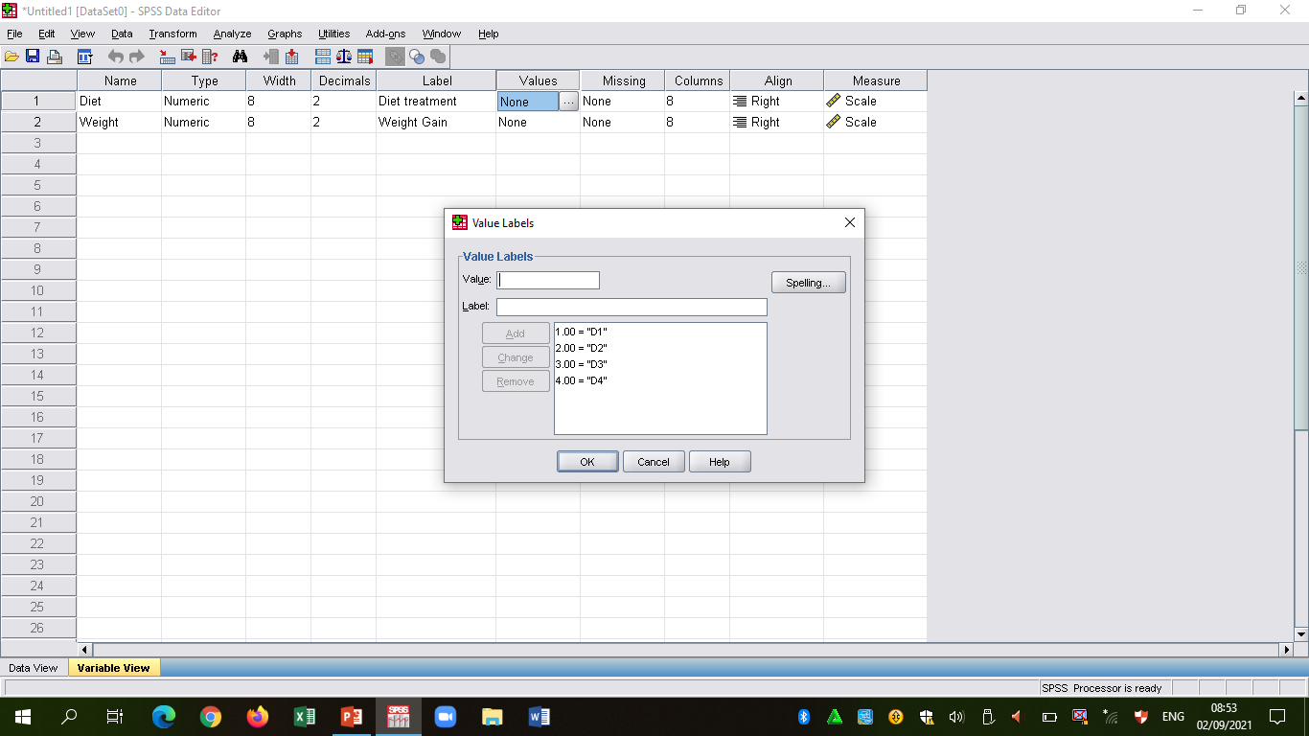

Slide 53
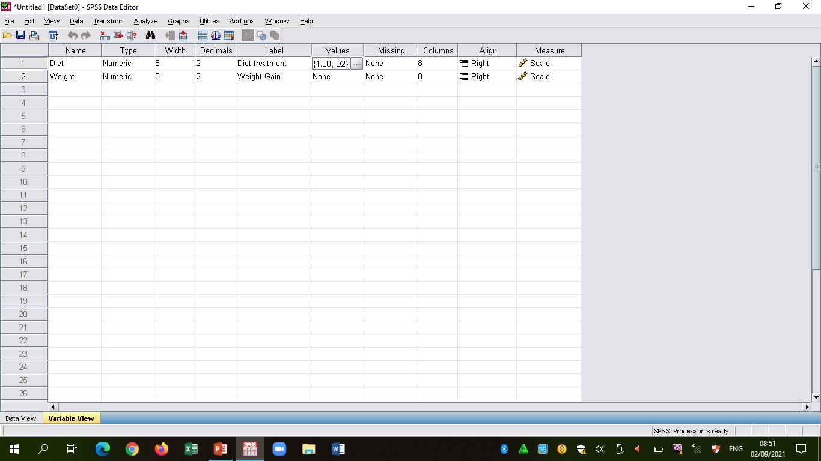

Slide 54
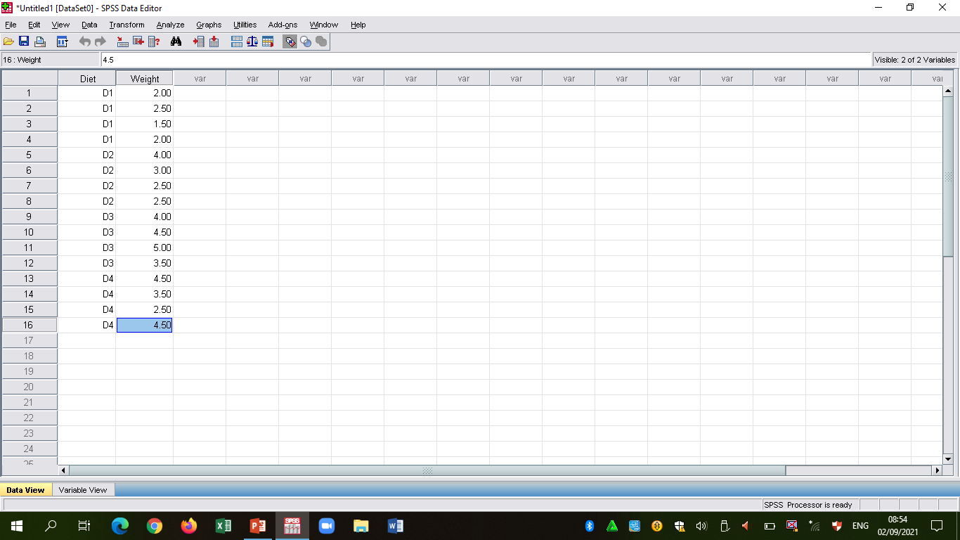

Slide 55
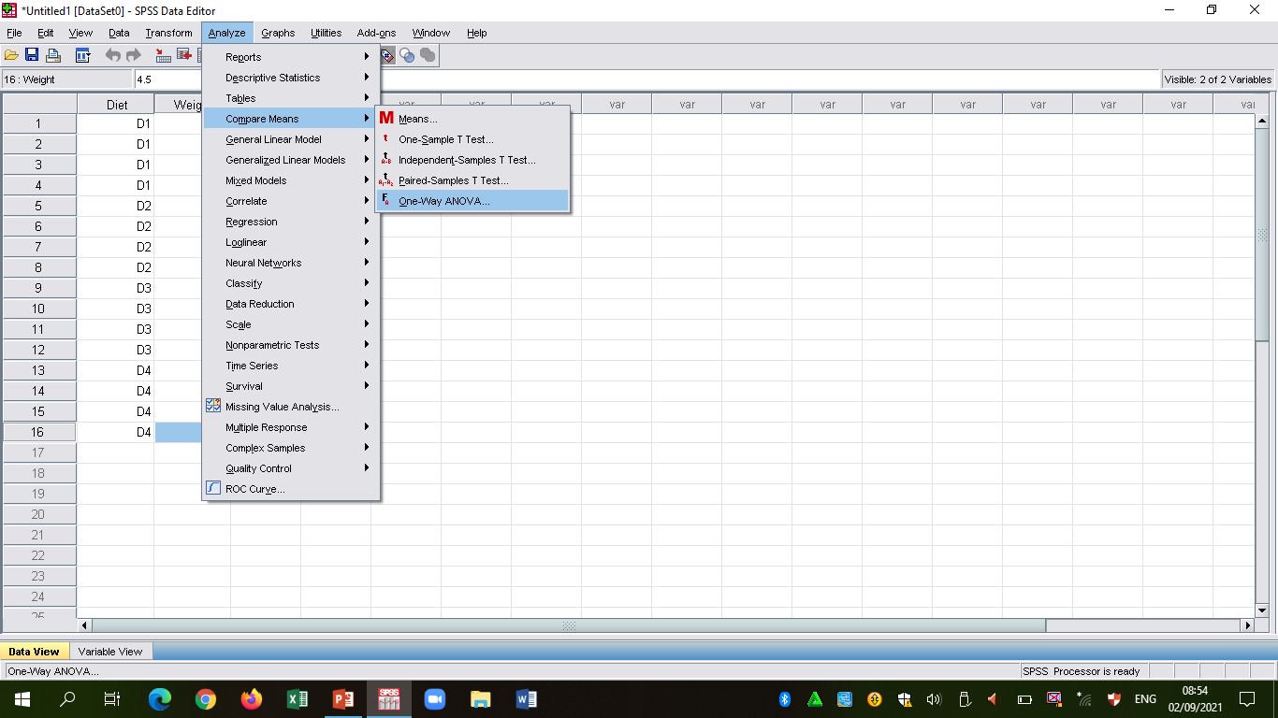

Slide 56
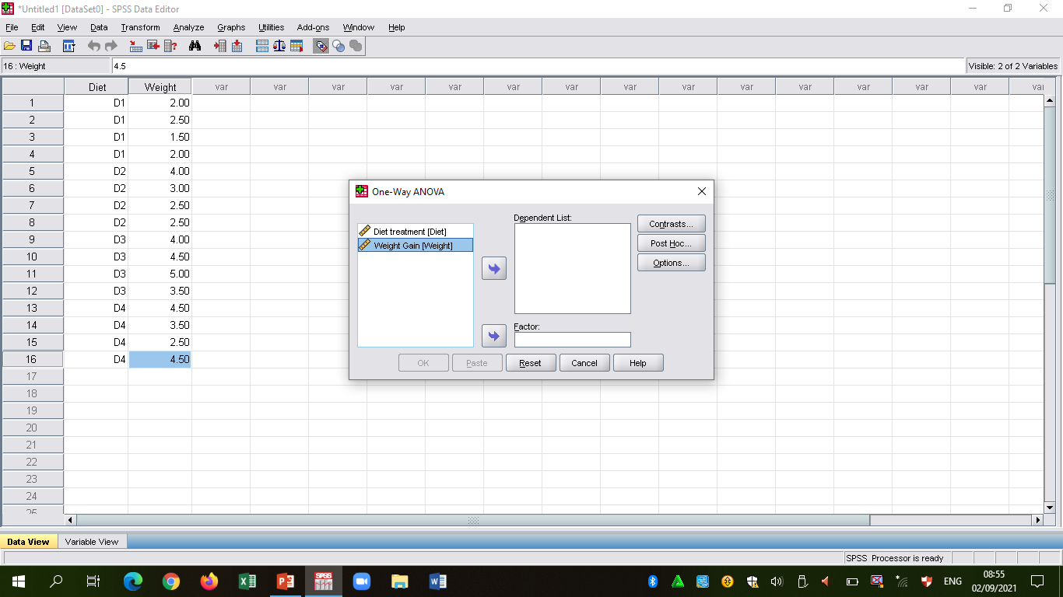

Slide 57
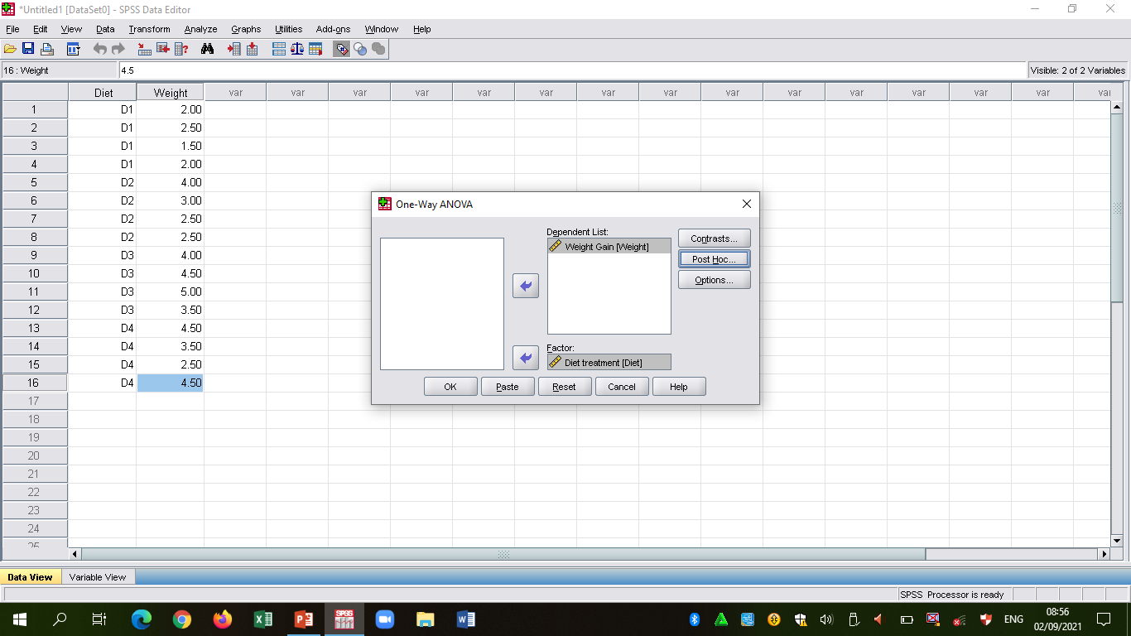

Slide 58
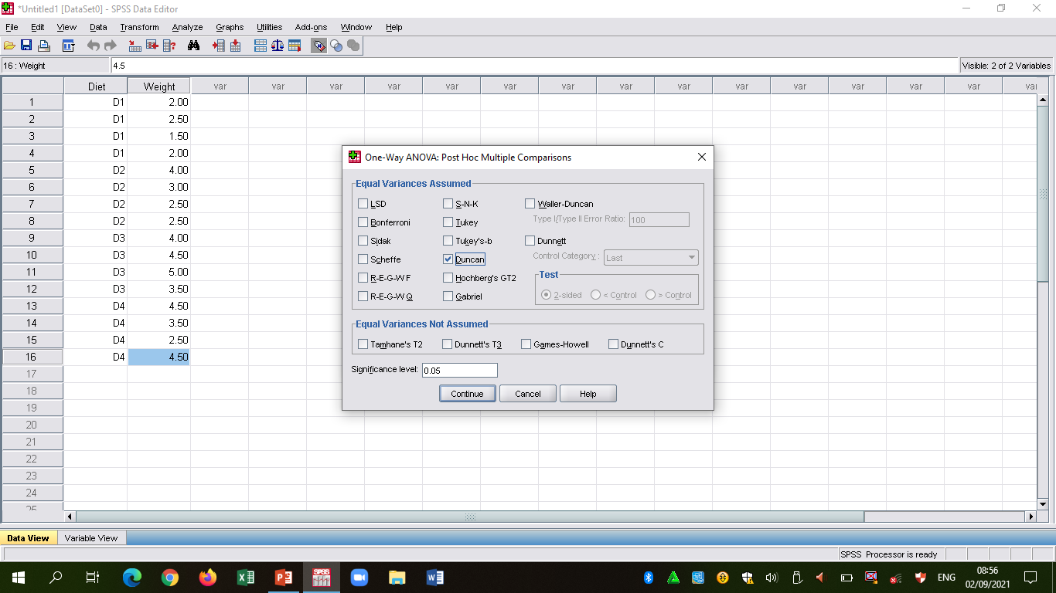

Slide 59
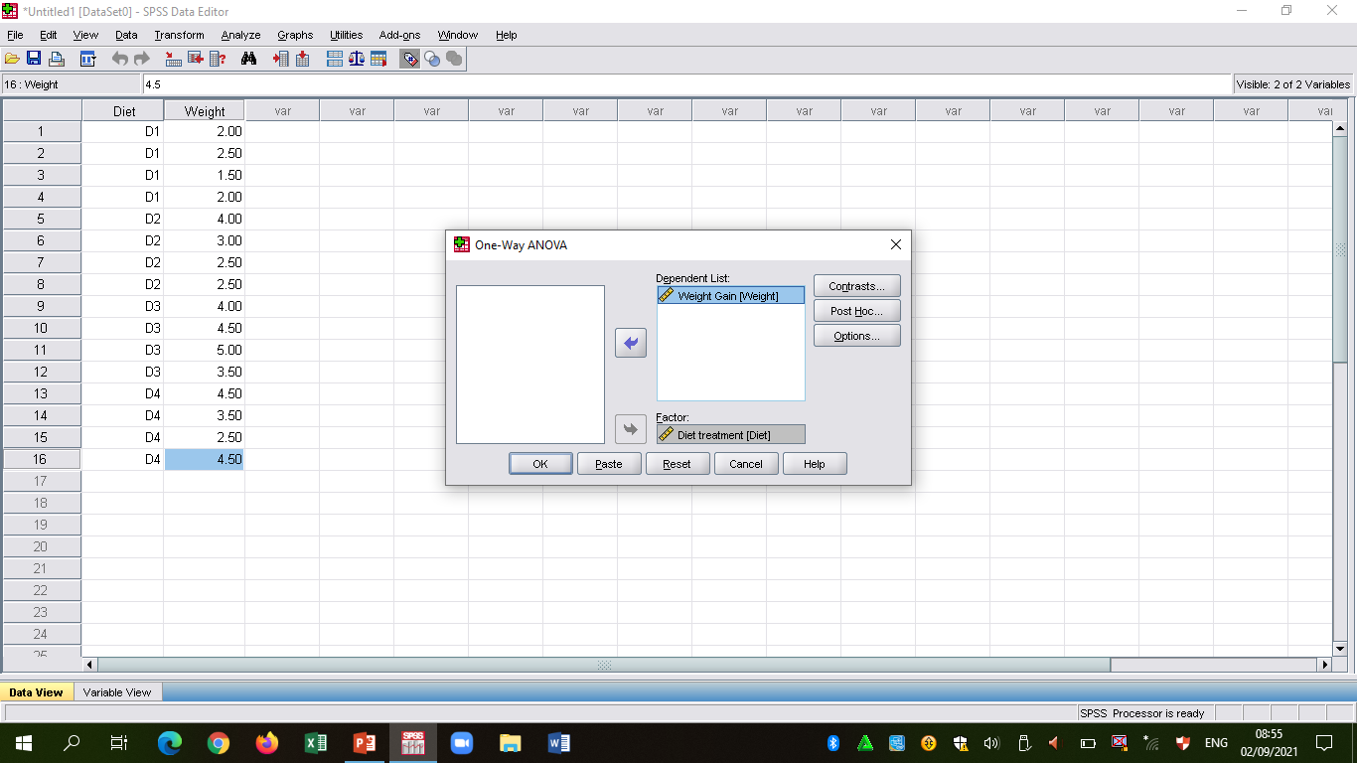

Slide 60
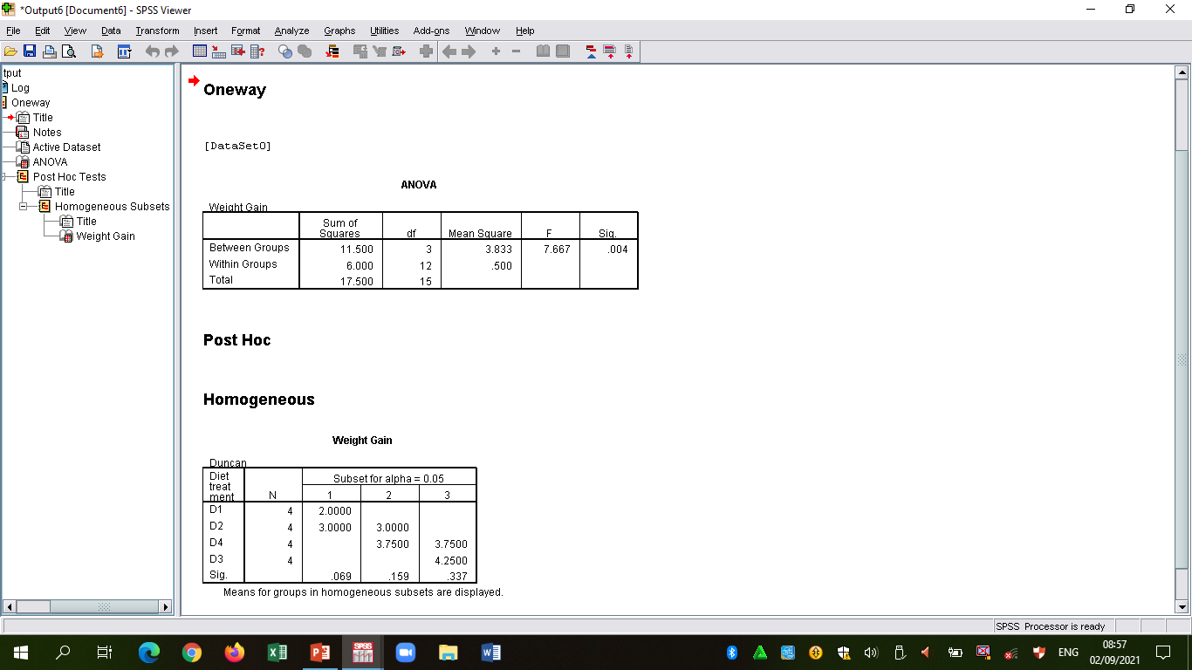

Slide 61
SUMMARY OF ANALYSIS
Diet | Replications (weight gain in grams) I II III IV |  |  |  | Total | Mean
D₁ | 2 | 1.5 | 2.5 | 2 | 8 | 2^{c}
D₂ | 4 | 3 | 2.5 | 2.5 | 12 | 3^{bc}
D₃ | 4 | 4.5 | 5 | 3.5 | 17 | 4.25ª
D₄ | 4.5 | 3.5 | 2.5 | 4.5 | 15 | 3.75^{ab}
Means carrying different superscripts in the same column are significantly different (p<0.05)

Slide 62
END
  THANK YOU VERY MUCH FOR LISTENING

