Slide 1

COLLEGE OF POSTGRADUATE STUDIES
ICT AND DATA ANALYSES
Engr. Prof. C. C. Nnaji
¹Department of Civil Engineering, University of Nigeria, Nsukka
² Faculty of Engineering and the Built Environment, University of Johannesburg
Email: Chidozie.nnaji@unn.edu.ng
Phone: 08038948808

Slide 2
OUTLINE
INFORMATION COMMUNICATION AND TECHNOLOGY
  Genera and Specific Application of ICT In Research
  ICT In Literature Search and Referencing
  Article Submission and Publication Made Easy Through ICT
DATA ANALYSES
  Data Collection
  Tips for Reliable Data Analyses
  Requirements for Data Analyses
  Types Data
  Purpose of Data Analyses
  Dealing with Outliers and Missing Values
  Types of Data Analyses

Slide 3
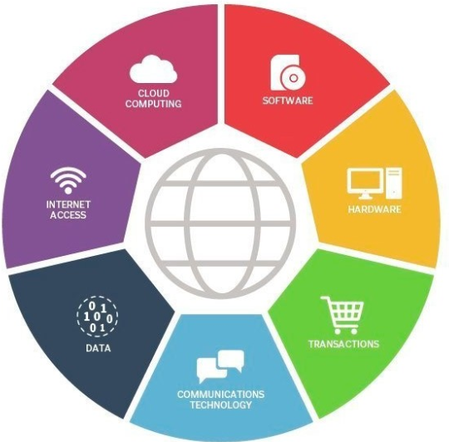
General Applications of ICT In Research
Level 1
Information gathering
Data collection
Level 2
Data synthesis and Analyses
Inferences & interpretations
Level 3
Documentation of results
Dissemination of findings
Components of ICT
Levels of ICT Application in Research

Slide 4
Specific Applications of ICT In Research
Literature Search
Data Collection
Data Analyses
Project Reporting and Manuscript Preparation
Citation and Referencing
Manuscript Submission and Publication
Plagiarisms Check
Article Reputation and Citation Tracking
Storage and Retrieval of Research Information

Slide 5

ICT IN LITERATURE SEARCH
ICT provides an unlimited possibility when searching for relevant research materials.
A manual search will limit one to only what is within reach
ICT has the following advantages
  Time-saving
  Economical
  Convenient
  Has a global reach

Slide 6



ICT IN LITERATURE SEARCH CONTD.
The quality and relevance of your research is dependent on
  Quality of literature consulted
  Scope of materials consulted
  Quantity of materials read
Sometimes it is difficult to find relevant materials.
Relevant materials may be hidden in plain sight
It might even be a blind search
ICT is the

Slide 7
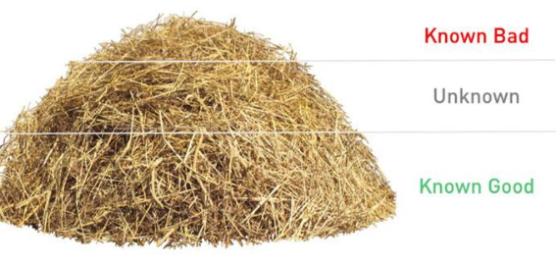

Without ICT, literature search would be like looking for a needle in haystacks
To find relevant materials, you need to sift and search deeper

Slide 8
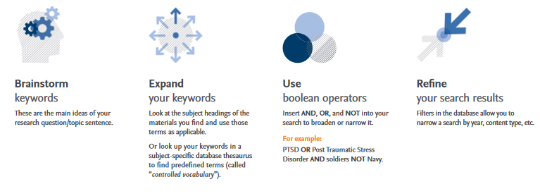
ICT IN LITERATURE SEARCH
1 Use keywords operators and filters
3. Use only citable sources
Articles
Books
Conference proceedings
Research projects and thesis
Published reports or dataset
4. Evaluate information in terms of
Currency – when?
Accuracy – how reliable?
Relevance – how important?
Authority – who/where?
2 Use the appropriate search tools
Abstract and citation database for article overview
  Eg SCOPUS, CABI, Index Copernicus, etc
Full-text database for detail
  Eg. ResearchGate, Academia.edu, etc
Web search engine for a wider coverage and most popular materials. Eg. Google, Bing, Yahoo. Ask.com, etc.
5. Organize Materials
Download and store
Consult and cite

Slide 9
Referencing
Manual management of references can be daunting when dealing with numerous references.
Reference Managers are used to simplify article citation and referencing during manuscript preparation
They ensure consistency of referencing style.
Most reference managers can keep a virtual database of relevant references
Example of Popular Reference Managers
  Microsoft Reference Manager – A Microsoft Word Add-In for managing references
  EndNote by Clarivate Analytics - a desktop-based proprietary citation management program with over 6,000 reference styles. Excellent for collaborative research
  F1000 Workspace - a web-based citation manager and collaborative author program
  Mendeley by Elsevier - a freely available citation management program adaptable to MS Word, LibreOffice or LaTeX
  Zotero (web-based and offline) - a free, easy-to-use tool to help you collect, organize, cite, and share research.

Slide 10
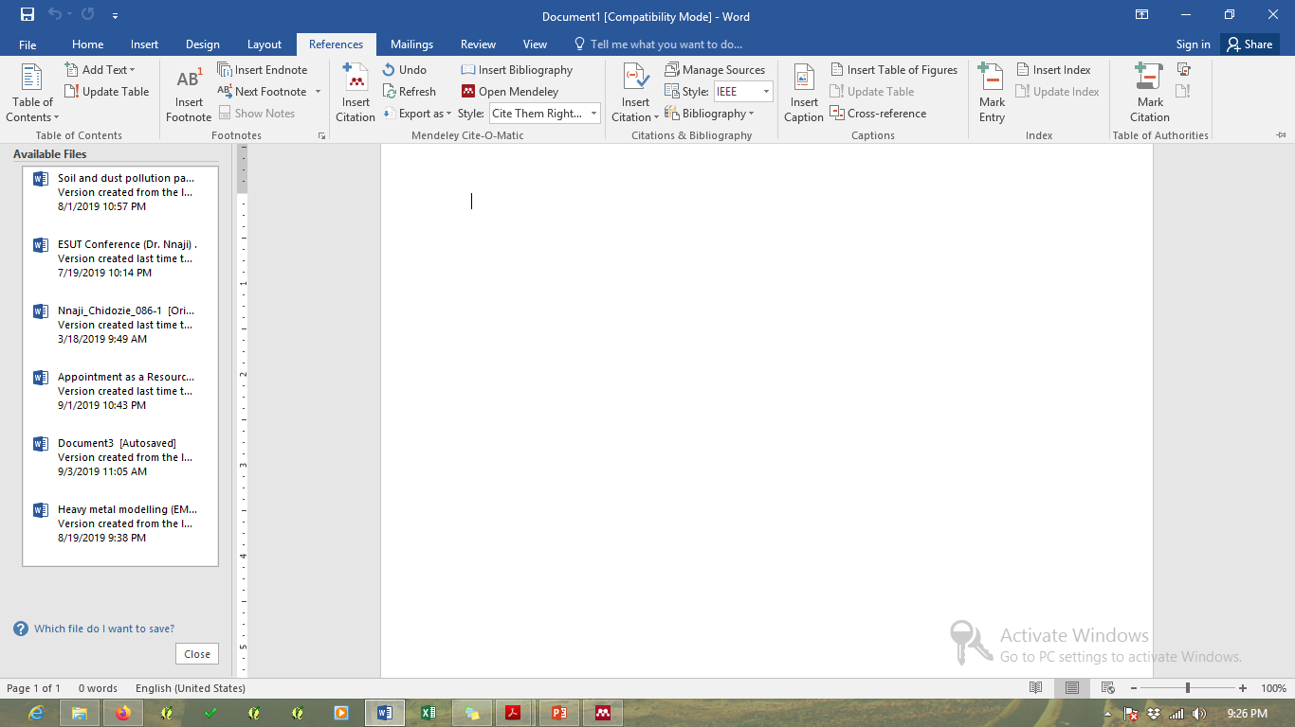

HOW REFERENCE MANAGERS ADAPT TO WORD PROCESSING PROGRAMMES
Microsoft Reference Manager
Mendeley
WHAT EXACTLY DO REFERENCE MANAGERS DO?
Literature search
Storage
Retrieval
Citation
Bibliography
To download Mendeley Desktop click here

Slide 11
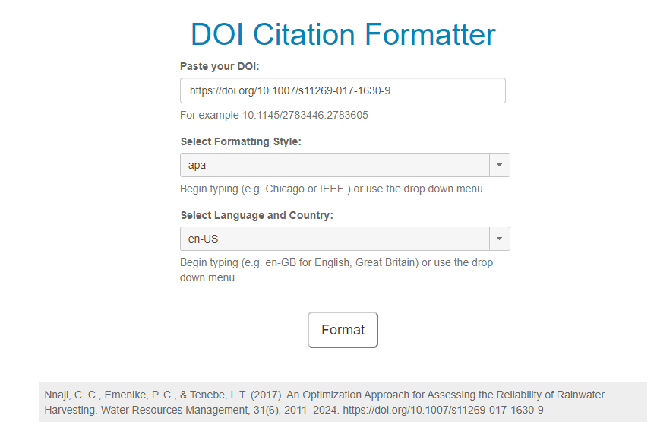
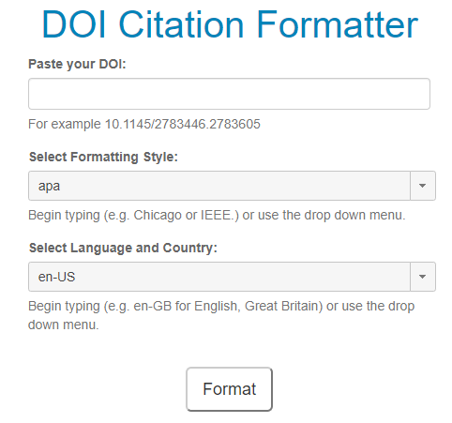
QUICK EXTRACTION OF CITATTION
Sometimes, there may be need for urgent retrieval of citation details.
DOI Citation Formatter is the right tool for you.
By just inserting the DOI of the articles, it will immediately extract the citation in the desired format
DOI
After inserting DOI
Extracted citation

Slide 12
Manuscript Submission And Publication
Manuscript submission used to be a very rigorous and lengthy process (postage, emails)
Now articles can be submitted and received by the editor instantly
Most reputable journals use standardized online submission platforms such as
  Editorial Manager (EM)
  Elsevier Editorial Services (EES)
  ScholarOne Manuscript
  Some new journals use the Open Journal System (OJS)
These systems allow authors to track their manuscripts after submission.
Most online submission systems will usually progress as follows
  Manuscript Submitted
  Awaiting Editorial Processing
  Editor Assigned
  Reviewers Invited
  Under Review
  Decision in Progress
  Decision – accept/reject

Slide 13
Plagiarism Check
  Plagiarism simply implies using other peoples’ intellectual output without due credit.
  The extreme form of plagiarism is attempting to portray another person’s work as one’s own
  Plagiarism can result in paper rejection, withdrawal of degree or even prosecution
  Plagiarism checkers allow the researcher to do the following:
    Check for copied contents or similar ones
    Check for grammatical errors
    Help in re-writing a document to minimize the incidence of plagiarism
    Show plagiarized sources
    Provide information on the degree of uniqueness or plagiarism of the document
  As a general guide, a similarity index of less than 15% is acceptable
  Plagiarism check software are freely available online. Use the links below to access them.
Click for smallseotools
Click for grammarly

Slide 14

Hands On
  Download Mendeley Reference Manager and do the following
    Enter three references using the doi
    Cite the references in a MS Word document using Mendeley Reference Manager
    Automatically produce a list of those references in MS Word in any style of your choice
  Using the DOI Citation Formatter, extract the citation for the article with the following doi: https://doi.org/10.1007/s11269-017-1630-9
  Create an author’s account with any journal of your choice that uses online manuscript submission system

Slide 15
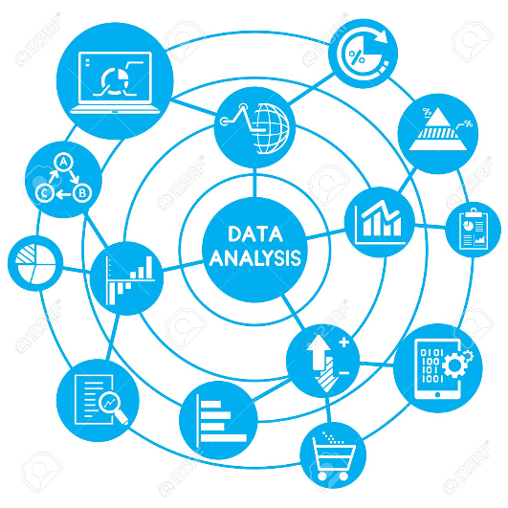
DATA ANALYSES

Slide 16
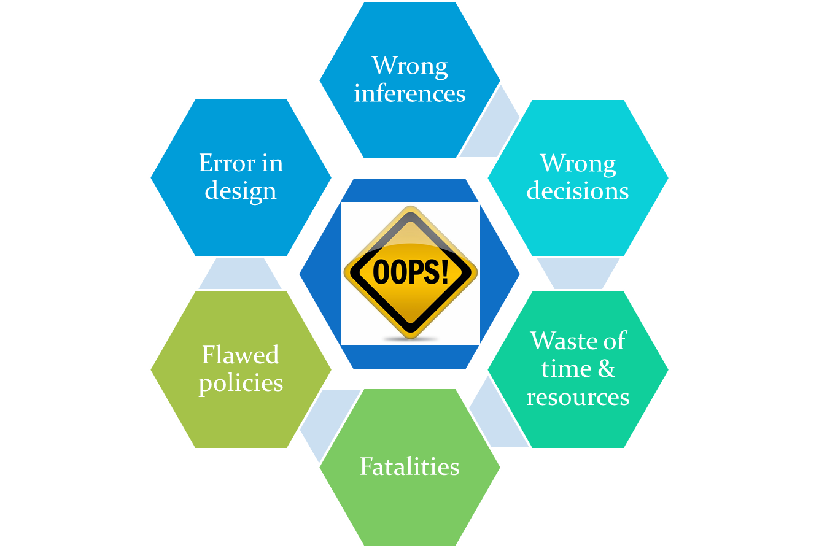
What is Data Analysis
  Data analysis is the process of unveiling information hidden in data
  Method of analysis depends on the type of data available
  Inappropriate analysis leads to

Slide 17
Data Collection
  Data Collection Possibilities with ICT
  Data logging
  Access to online repository and databases
  Interactive online/offline surveys (Eg. Survey Monkey, Google Form)
  Remote sensing (drones and satellite imaging)
  Paperless and cost-effective data acquisition
  Ease of organization and analyses of large amount of data
  Online data storage
  Real-time and instantaneous data transmission
  Accurate and easy duplication and distribution
Click here for links to online data repositories

Slide 18
Tips For Reliable Data Analyses
No analyses can be better than the parent data.
For good results from data analyses, the following conditions should be ensured
  Data reliability – will we get the same result again?
  Data validity – Is the appropriate data being collected?
  Data integrity – Is the data free from manipulation?
  Data accuracy – does the measurement reflect the actual situation?
  Data Timeliness – Was measurement taken as and when due?
Data
reliability
Security
Timeliness
Accuracy
Integrity
validity

Slide 19
Relationship Between Data And Analysis
Requirements For Data Analysis
Identification and selection of appropriate method of analysis
Possessing necessary skills to analyze
Sound theoretical knowledge base for unbiased and correct inference
Adherence to standard and acceptable norms and practices
Data being analysed must target the objective of the research
Analysis must be accurate and honest
Details of data manipulation should be clearly reported
Factors that could influence accuracy of data should be taken into cognizance
Research team must maintain uniformity in data collection, analysis and reporting
Quality of analysis
Bad data
+
Bad analysis
Default state
Good data
+
Good analysis
Most desirable
Quality of analysis
Bad data
+
Good analysis
Wasted professionalism
Good data
+
Bad analysis
Wasteful Amateurism

Slide 20
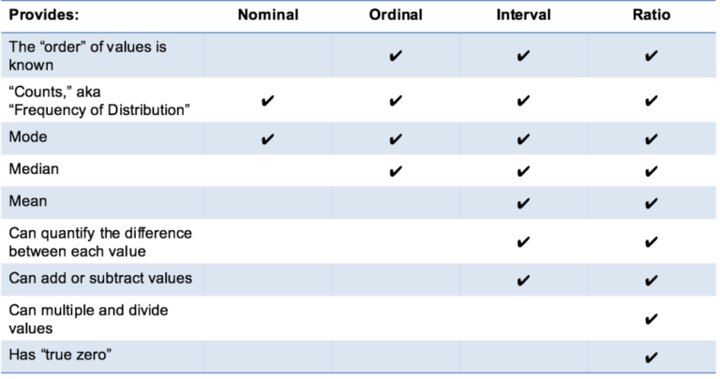
Types of Data
Nominal scale - mere labels without any quantitative significance
  Colour of the eyes, state of origin, course of study, type of soil
Ordinal scale - rank or order of data where actual numerical difference cannot be ascertained.
  Class of degree, relative height,
Interval scale – order and exact difference between values are known. There is no true zero here
  Temperature, Likert scale, time of the day, IQ, Age, dates, class
Ratio scale – More like the interval scale but possesses a true zero.
  Speed, length, weight, etc

Slide 21
Purpose of Data Analysis
Group identification: Eg. grouping of soils based on physical properties
  Principal component analysis
  Hierarchical cluster
Anomalies detection:
  outlier detection
  Fraud detection
  Error detection
  Jumps (Eg. Kruskal-Wallis test of jump)
Dependencies:
  Pearson’s correlation
  Spearmen rho correlation
Variations:
  Descriptive statistics
Trends and Patterns
Data Analysis
Group identification
Trends and patterns
Dependencies
Anomalies detection
Variations

Slide 22
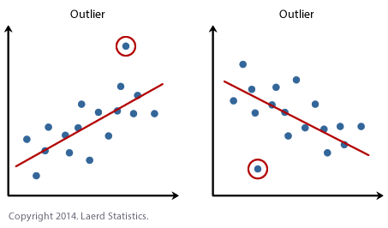
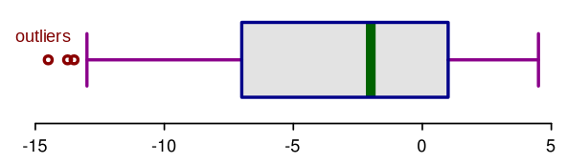
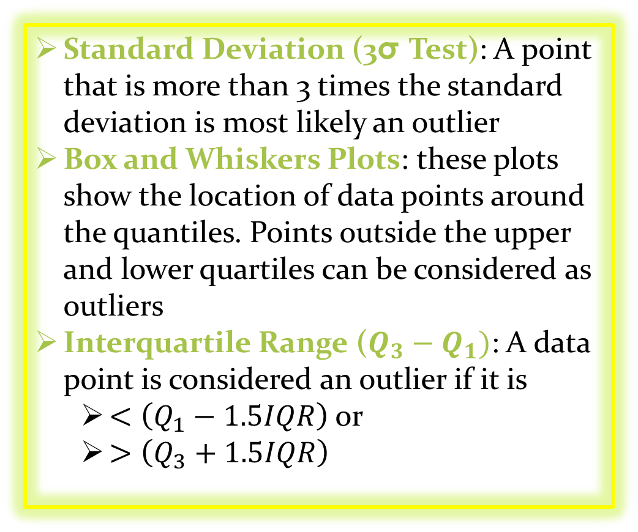
Dealing With Outliers
An outlier is a data point that lies far away from other values
A single or few outliers can totally distort the result of an analysis, leading to wrong inferences
Ways To Detect Outliers
Standard Deviation (3σTest):A point that is more than 3 times the standard deviation is most likely an outlier
Box and Whiskers Plots: these plots show the location of data points around the quantiles. Points outside the upper and lower quartiles can be considered as outliers
Interquartile Range($Q_{3}−Q_{1})$: A data point is considered an outlier if it is
  $<\left(Q_{1}−1.5IQR\right)$ or
  $>\left(Q_{3}+1.5IQR\right)$
Lower whisker
Median
Upper whisker
First quartile
Outliers
Third quartile

Slide 23


Dealing With Missing Data
Listwise Deletion: removal of all data recorded for the observation that has one or more missing values
  Reduction in sample size
  Biased result if data is not missing at random (MAR)
Pairwise Deletion: Exclusion of only missing data point in analysis
Variable Dropping: if over 60% of data belonging to a particular variable is missing, it should be dropped
Last observation carried forward or next observation carried backward: introduces bias if data has visible trend
Linear interpolation: works well for time series but not for seasonal data
Use overall mean, mode or median: reduces variance
Regression imputation: using all available data to predict missing data
Click here for online article

Slide 24
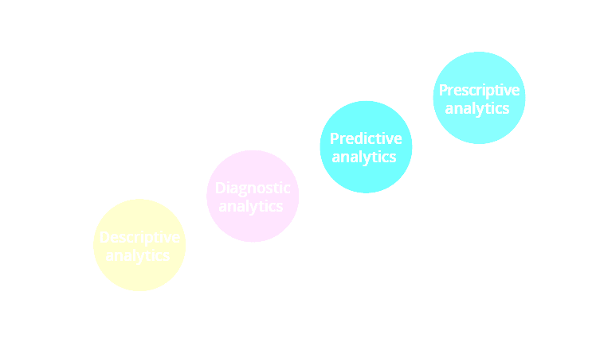
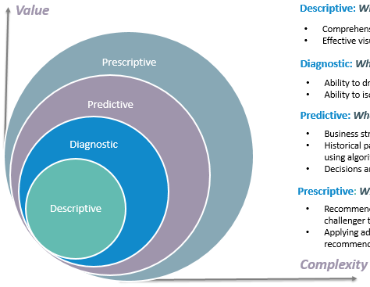
Types of Data Analysis
Descriptive Analysis (what happened?): Provides information without providing reasons.
  Measures of central tendency (mean, mode, median)
  Measures of spread (variance, standard deviation, coefficient of variation)
  Measure of divergence from normality (skew, kurtosis)
Diagnostic Analysis (Why did it happen?): Identifies dependencies and patterns
  Correlation (Pearson)
  Trend (positive, negative)
Predictive Analysis (what is likely to happen?):
  Forecasting – regression and mechanistic models
  Clusters
  Tendencies
Prescriptive Analysis (what should be done?):

Slide 25
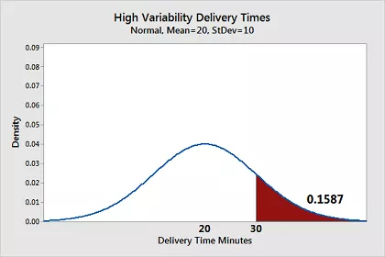
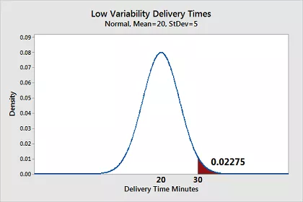
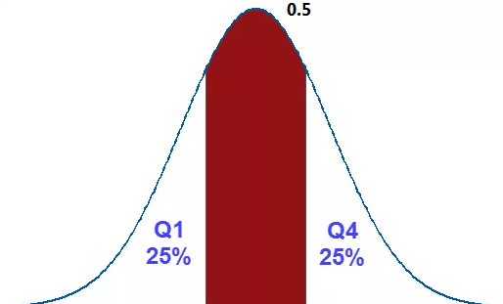
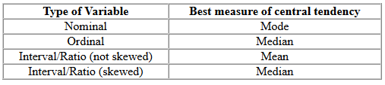
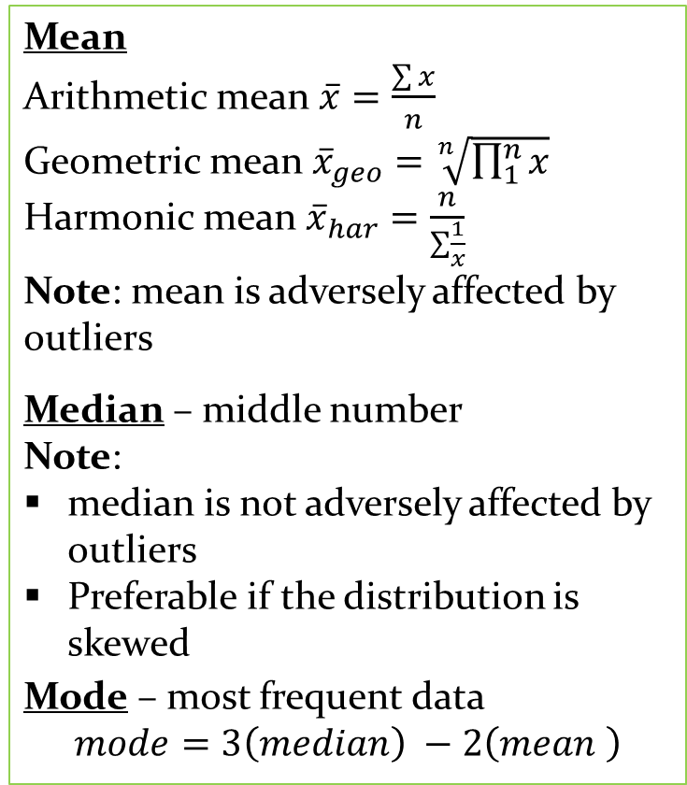
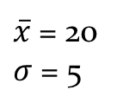
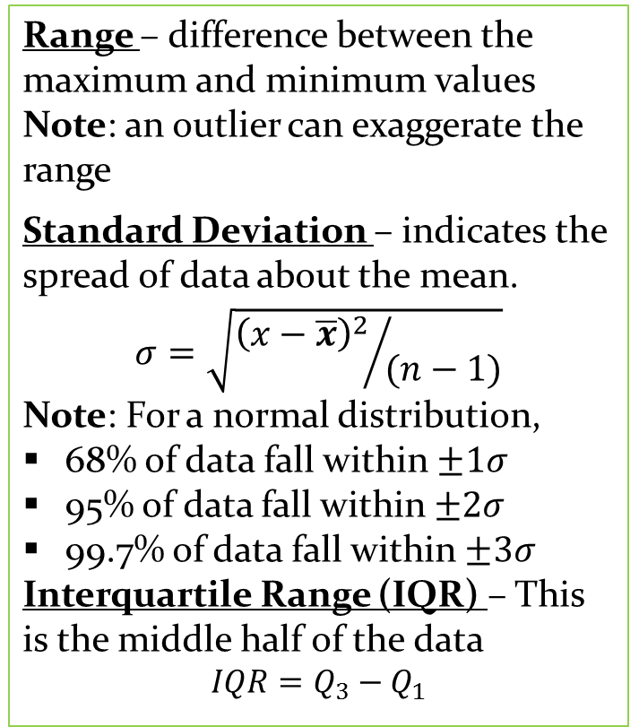
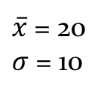
Descriptive Analyses
Range – difference between the maximum and minimum values
Note: an outlier can exaggerate the range
Standard Deviation – indicates the spread of data about the mean.
$$σ=\sqrt{{{\left(x−\overline{x}\right)}^{2}}/{(n−1)}}$$
Note: For a normal distribution,
68% of data fall within $±1σ$
95% of data fall within $±2σ$
99.7% of data fall within $±3σ$
Interquartile Range (IQR) – This is the middle half of the data
$$IQR=Q_{3}−Q_{1}$$
Means can be deceptive
Mean
Arithmetic mean $\overline{x}=\frac{\sum{x}}{n}$
Geometric mean ${\overline{x}}_{geo}=\sqrt[n]{\prod_{1}^{n}{x}}$
Harmonic mean ${\overline{x}}_{har}=\frac{n}{\sum{\frac{1}{x}}}$
Note: mean is adversely affected by outliers
Median – middle number
Note:
median is not adversely affected by outliers
Preferable if the distribution is skewed
Mode – most frequent data
$$mode=3\left(median\right) −2\left(mean \right)$$
For a cutoff value of 30 mins, about 16% of the data are unacceptable
$\overline{x}$ = 20
$σ$ = 10
$\overline{x}$ = 20
$σ$ = 5
For a cutoff value of 30 mins, only about 2.3% of the data are unacceptable
Interquartile Range
Always report both the mean and the standard deviation

Slide 26
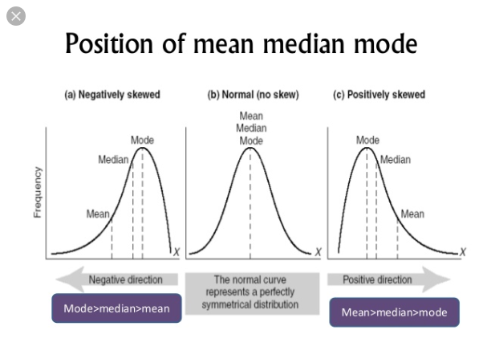
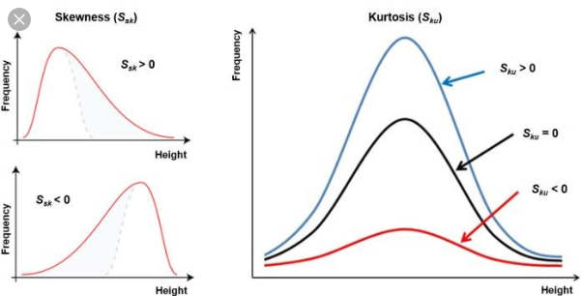
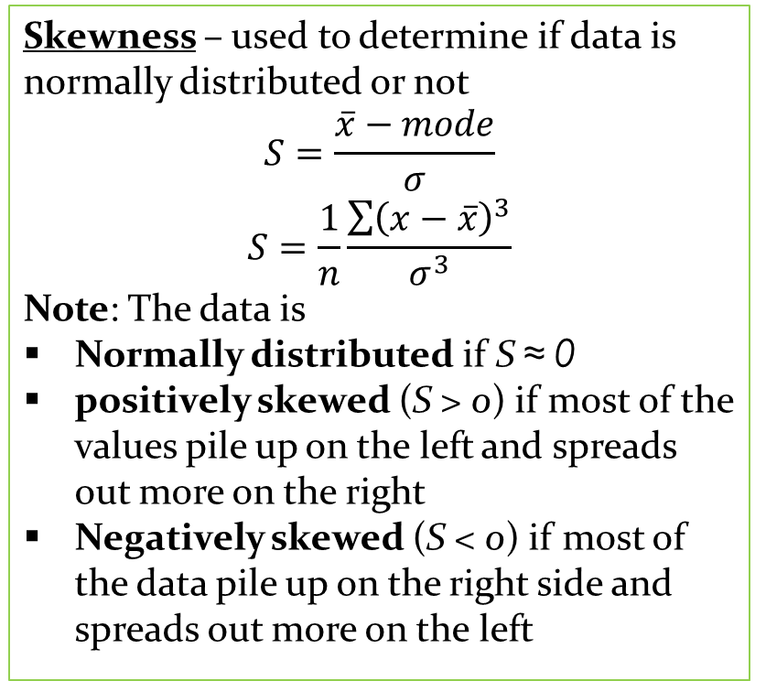
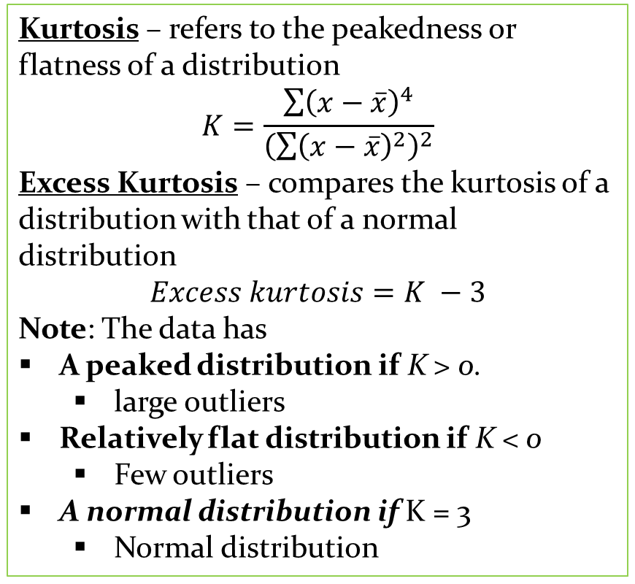
Kurtosis– refers to the peakednessor flatness of a distribution
$$K=\frac{\sum{{\left(x−\overline{x}\right)}^{4}}}{{\left(\sum{{\left(x−\overline{x}\right)}^{2}}\right)}^{2}}$$
Excess Kurtosis – compares the kurtosis of a distribution with that of a normal distribution
$$Excess kurtosis=K −3$$
Note: The data has
A peaked distribution if K > 0.
  large outliers
Relatively flat distribution if K < 0
  Few outliers
A normal distribution if K = 3
  Normal distribution
Descriptive Analyses Contd
Skewness– used to determine if data is normally distributed or not
$$S=\frac{\overline{x}−mode}{σ}$$
$$S=\frac{1}{n}\frac{\sum{{\left(x−\overline{x}\right)}^{3}}}{σ^{3}}$$
Note: The data is
Normally distributed if S ≈ 0
positively skewed (S > 0) if most of the values pile up on the left and spreads out more on the right
Negatively skewed (S < 0) if most of the data pile up on the right side and spreads out more on the left
Kurtosis
Skewness

Slide 27
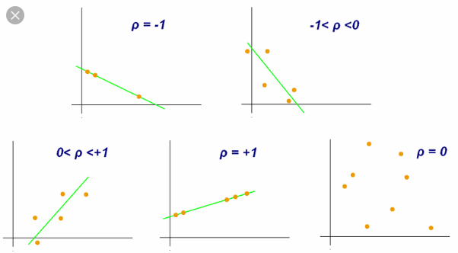
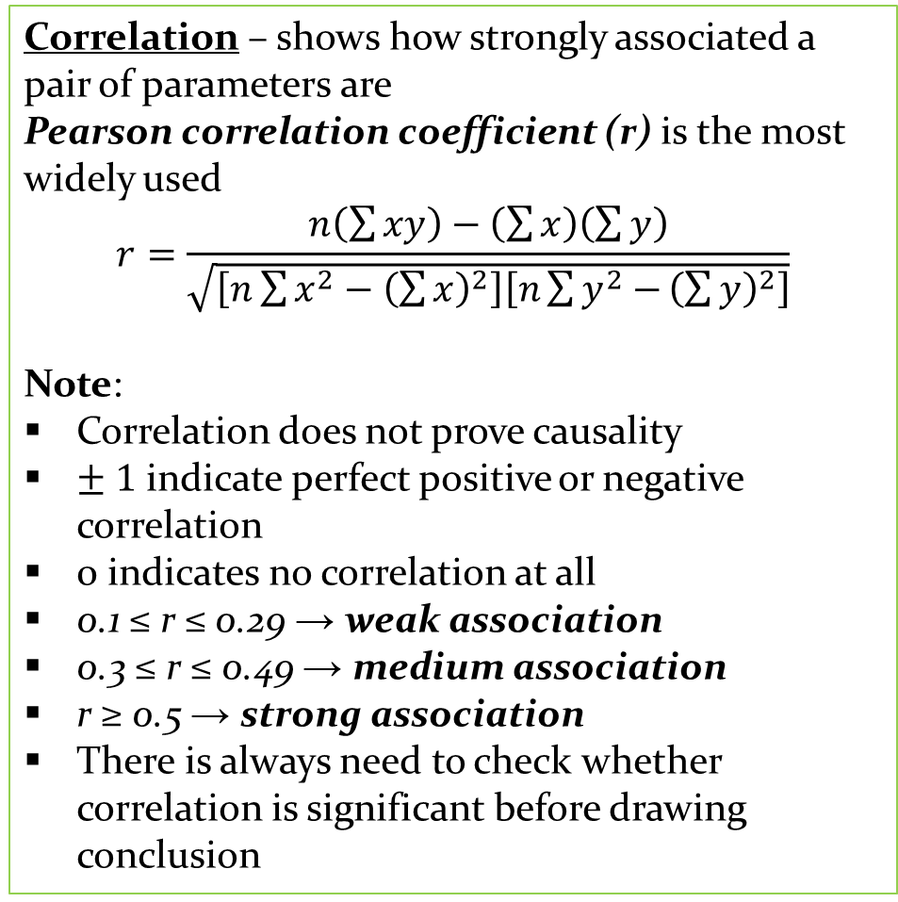
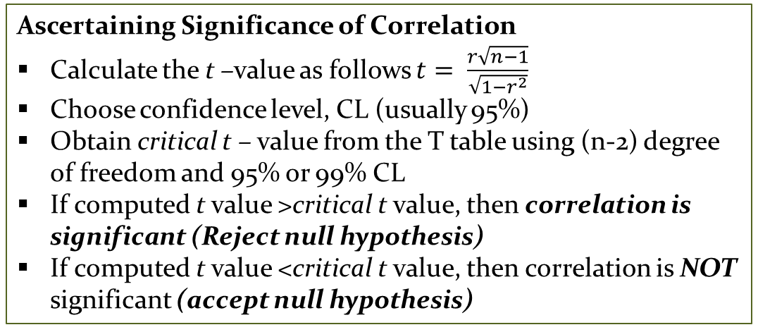
Diagnostic Analyses
Correlation – shows how strongly associated a pair of parameters are
Pearson correlation coefficient (r) is the most widely used
$$r=\frac{n\left(\sum{xy}\right)−\left(\sum{x}\right)\left(\sum{y}\right)}{\sqrt{\left[n\sum{x^{2}−{\left(\sum{x}\right)}^{2}}\right]\left[n\sum{y^{2}−}{\left(\sum{y}\right)}^{2}\right]}}$$
Note:
Correlation does not prove causality
$± 1$ indicate perfect positive or negative correlation
0 indicates no correlation at all
0.1 ≤ r ≤ 0.29 → weak association
0.3 ≤ r ≤ 0.49 → medium association
r ≥ 0.5 → strong association
There is always need to check whether correlation is significant before drawing conclusion
Ascertaining Significance of Correlation
Calculate the t –value as follows $t= \frac{r\sqrt{n−1}}{\sqrt{1−r^{2}}}$
Choose confidence level, CL (usually 95%)
Obtain critical t – value from the T table using (n-2) degree of freedom and 95% or 99% CL
If computed t value >critical t value, then correlation is significant (Reject null hypothesis)
If computed t value <critical t value, then correlation is NOT significant (accept null hypothesis)
Click here to download t table

Slide 28
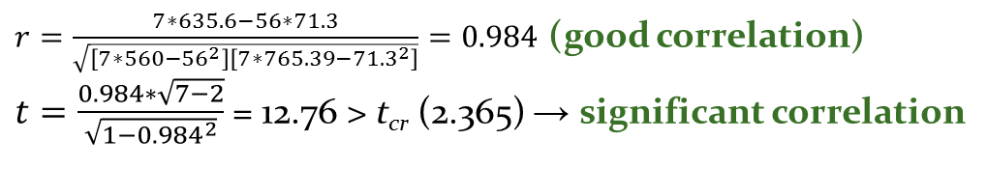
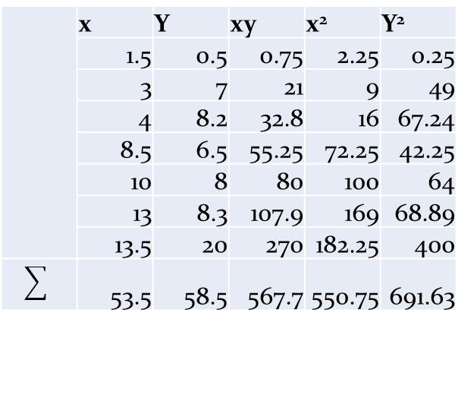
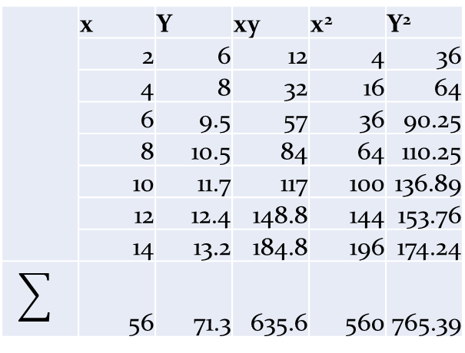
Hands-on Problem
For the two sets of data given, calculate the correlation coefficient and state whether they are significant or not at 99% CL
Plot of Data 1
 | x | Y | xy | x² | Y²
 | 2 | 6 | 12 | 4 | 36
 | 4 | 8 | 32 | 16 | 64
 | 6 | 9.5 | 57 | 36 | 90.25
 | 8 | 10.5 | 84 | 64 | 110.25
 | 10 | 11.7 | 117 | 100 | 136.89
 | 12 | 12.4 | 148.8 | 144 | 153.76
 | 14 | 13.2 | 184.8 | 196 | 174.24
 | 56 | 71.3 | 635.6 | 560 | 765.39
$r=\frac{7∗635.6−56∗71.3}{\sqrt{\left[7∗560−{56}^{2}\right]\left[7∗765.39−{71.3}^{2}\right]}}=0.984$(good correlation)
$t=\frac{0.984∗\sqrt{7−2}}{\sqrt{1−{0.984}^{2}}}$ = 12.76 >t_{cr}(2.365) → significant correlation
Data 1
Data 2
 | x | Y | xy | x² | Y²
 | 1.5 | 0.5 | 0.75 | 2.25 | 0.25
 | 3 | 7 | 21 | 9 | 49
 | 4 | 8.2 | 32.8 | 16 | 67.24
 | 8.5 | 6.5 | 55.25 | 72.25 | 42.25
 | 10 | 8 | 80 | 100 | 64
 | 13 | 8.3 | 107.9 | 169 | 68.89
 | 13.5 | 20 | 270 | 182.25 | 400
 | 53.5 | 58.5 | 567.7 | 550.75 | 691.63
Plot of Data 2
x | Y
2 | 6
4 | 8
6 | 9.5
8 | 10.5
10 | 11.7
12 | 12.4
14 | 13.2
x | Y
1.5 | 0.5
3 | 7
4 | 8.2
8.5 | 6.5
10 | 8
13 | 8.3
13.5 | 20
Similarly r = 0.71 (good correlation)
t =2.26 < t_{cr} (2.365) → correlation NOT significant!

Slide 29
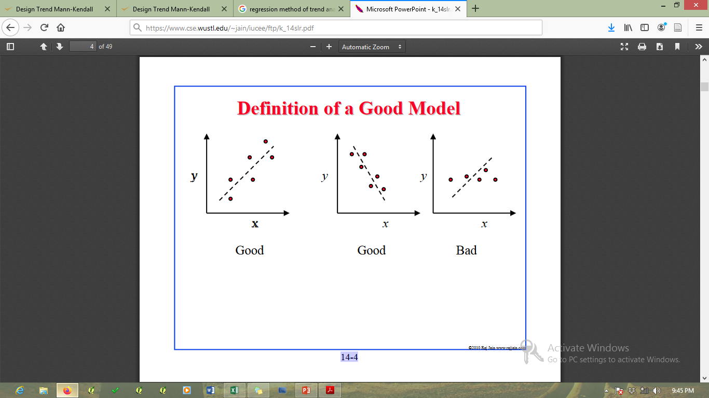
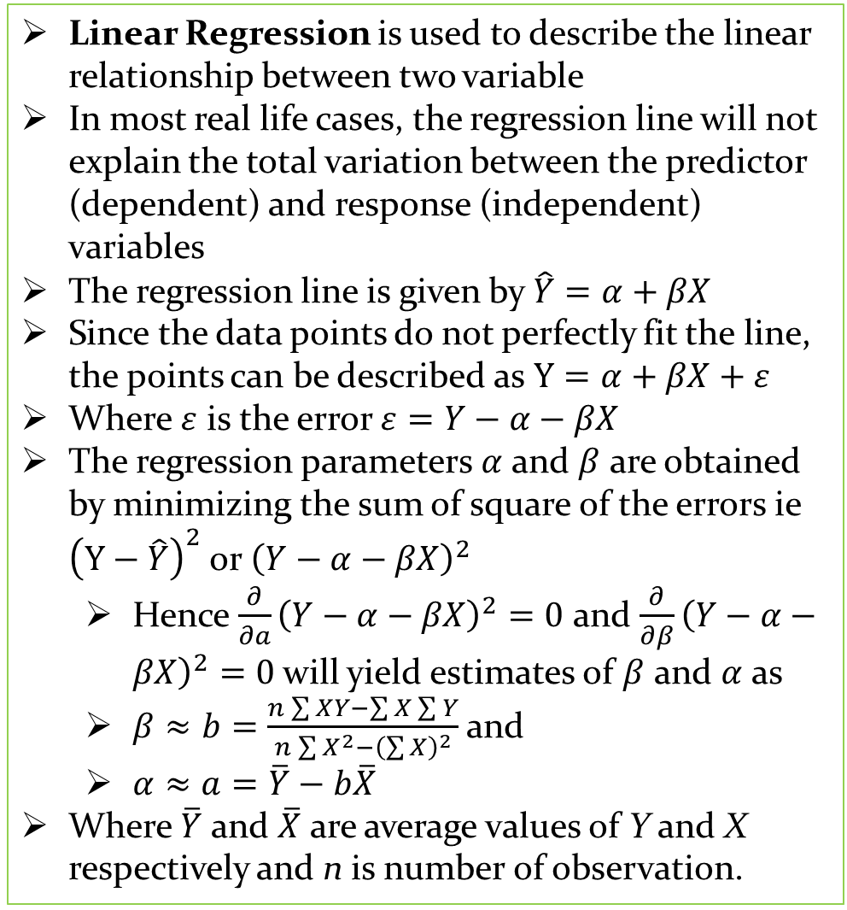
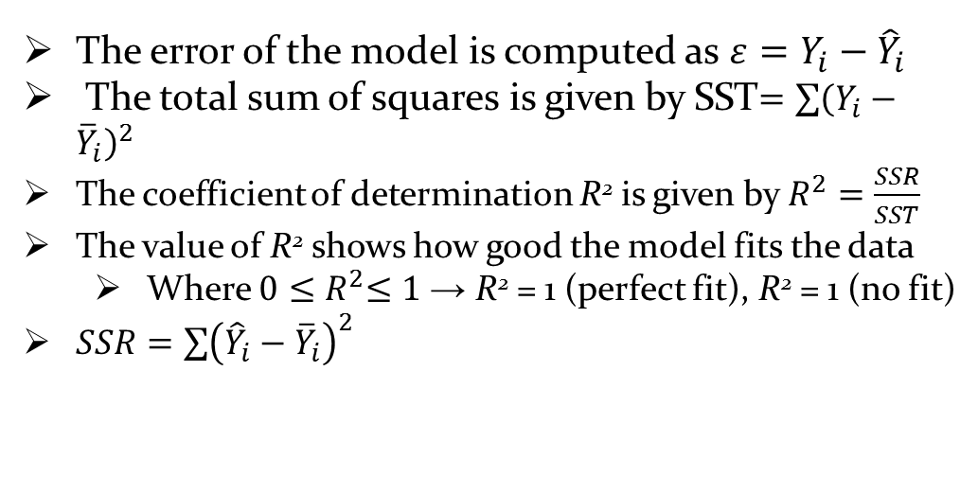
Ordinary Linear Regression
Linear Regression is used to describe the linear relationship between two variable
In most real life cases, the regression line will not explain the total variation between the predictor (dependent) and response (independent) variables
The regression line is given by $\hat{Y}=α+βX$
Since the data points do not perfectly fit the line, the points can be described as $Y=α+βX+ε$
Where $ε$ is the error$ε=Y−α−βX$
The regression parameters $α$ and $β$ are obtained by minimizing the sum of square of the errors ie${\left(Y−\hat{Y}\right)}^{2}$ or ${\left(Y−α−βX\right)}^{2}$
  Hence $\frac{∂}{∂a}{\left(Y−α−βX\right)}^{2}=0$ and $\frac{∂}{∂β}{\left(Y−α−βX\right)}^{2}=0$will yield estimates of $β$ and $α$ as
  $β≈b=\frac{n\sum{X}Y−\sum{X}\sum{Y}}{n\sum{X^{2}−{\left(\sum{X}\right)}^{2}}}$ and
  $α≈a=\overline{Y}−b\overline{X}$
Where $\overline{Y}$ and $\overline{X}$ are average values of Y and X respectively and n is number of observation.
ε
ε
ε
The error of the model is computed as $ε=Y_{i}−{\hat{Y}}_{i}$
The total sum of squares is given by SST$=\sum{{\left(Y_{i}−{\overline{Y}}_{i}\right)}^{2}}$
The coefficient of determination R²is given by $R^{2}=\frac{SSR}{SST}$
The value of R²shows how good the model fits the data
  Where $0{≤R}^{2}≤1$→ R² = 1 (perfect fit), R² = 1 (no fit)
$SSR=\sum{{\left({\hat{Y}}_{i}−{\overline{Y}}_{i}\right)}^{2}}$
Poor correlation (R² = 0.35
Good correlation (R² = 0.95
More on regression

Slide 30
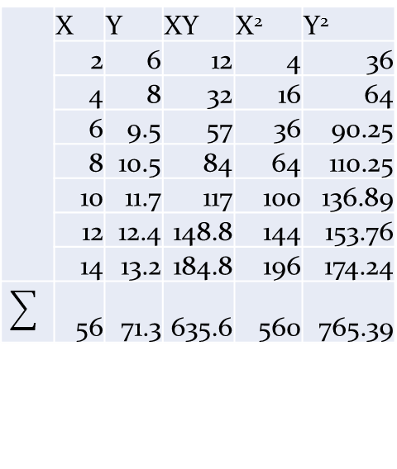
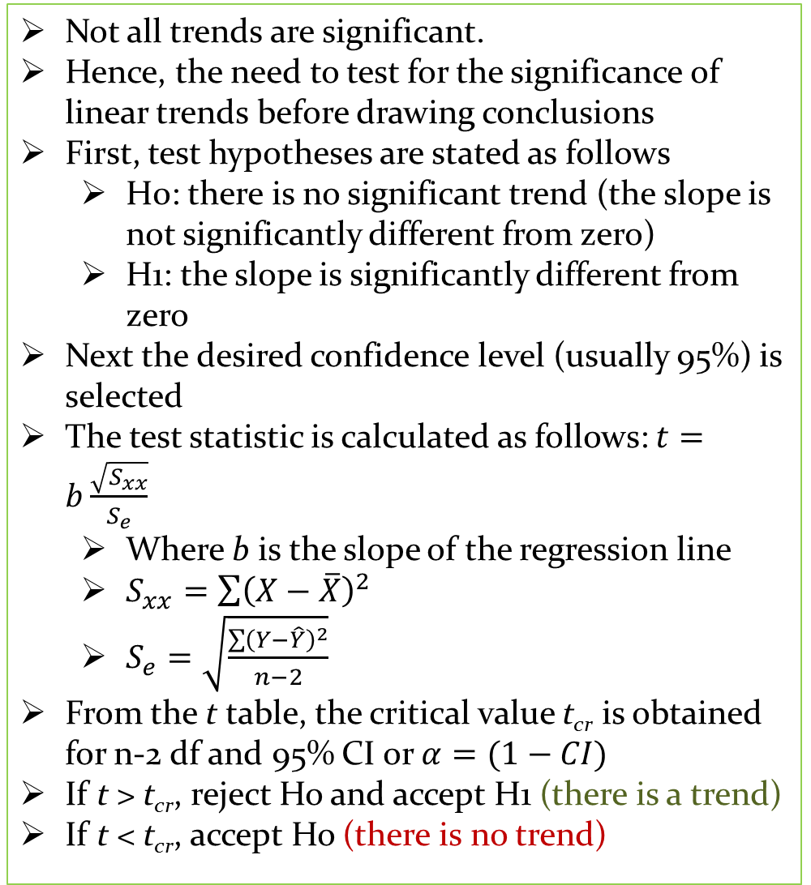
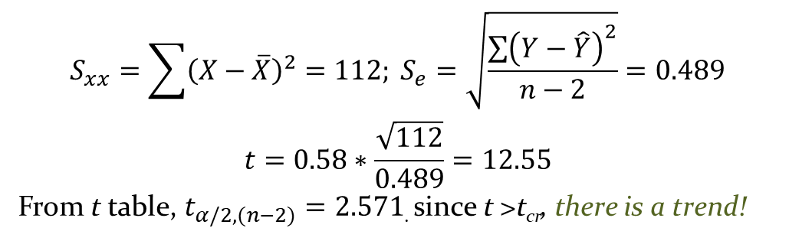
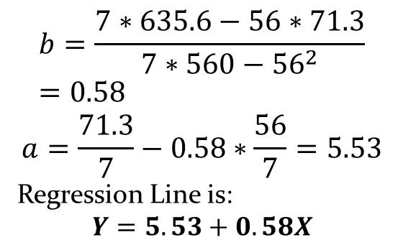
Significance of Linear Trend
X | Y
2 | 6
4 | 8
6 | 9.5
8 | 10.5
10 | 11.7
12 | 12.4
14 | 13.2
Not all trends are significant.
Hence, the need to test for the significance of linear trends before drawing conclusions
First, test hypotheses are stated as follows
  H0: there is no significant trend (the slope is not significantly different from zero)
  H1: the slope is significantly different from zero
Next the desired confidence level (usually 95%) is selected
The test statistic is calculated as follows: $t=b\frac{\sqrt{S_{xx}}}{S_{e}}$
  Where b is the slope of the regression line
  $S_{xx}=\sum{{\left(X−\overline{X}\right)}^{2}}$
  $S_{e}=\sqrt{\frac{\sum{{\left(Y−\hat{Y}\right)}^{2}}}{n−2}}$
From the t table, the critical value t_{cr} is obtained for n-2 df and 95% CI or $α=(1−CI)$
If t >t_{cr}, reject Ho and accept H1 (there is a trend)
If t <t_{cr}, accept Ho (there is no trend)
EXAMPLE
For the data given determine
  the relationship b/w X and Y
  Whether a trend actually exists at 95% CI
Solution
 | X | Y | XY | X² | Y²
 | 2 | 6 | 12 | 4 | 36
 | 4 | 8 | 32 | 16 | 64
 | 6 | 9.5 | 57 | 36 | 90.25
 | 8 | 10.5 | 84 | 64 | 110.25
 | 10 | 11.7 | 117 | 100 | 136.89
 | 12 | 12.4 | 148.8 | 144 | 153.76
 | 14 | 13.2 | 184.8 | 196 | 174.24
 | 56 | 71.3 | 635.6 | 560 | 765.39
$$b=\frac{7∗635.6−56∗71.3}{7∗560−{56}^{2}}=0.58$$
$$a=\frac{71.3}{7}−0.58∗\frac{56}{7}=5.53$$
Regression Line is:
$$Y=5.53+0.58X$$
$$S_{xx}=\sum{{\left(X−\overline{X}\right)}^{2}}=112; S_{e}=\sqrt{\frac{\sum{{\left(Y−\hat{Y}\right)}^{2}}}{n−2}}=0.489$$
$$t=0.58∗\frac{\sqrt{112}}{0.489}=12.55$$
From t table, $t_{α/2,(n−2)}=2.571$. since t >t_{cr}, there is a trend!

Slide 31
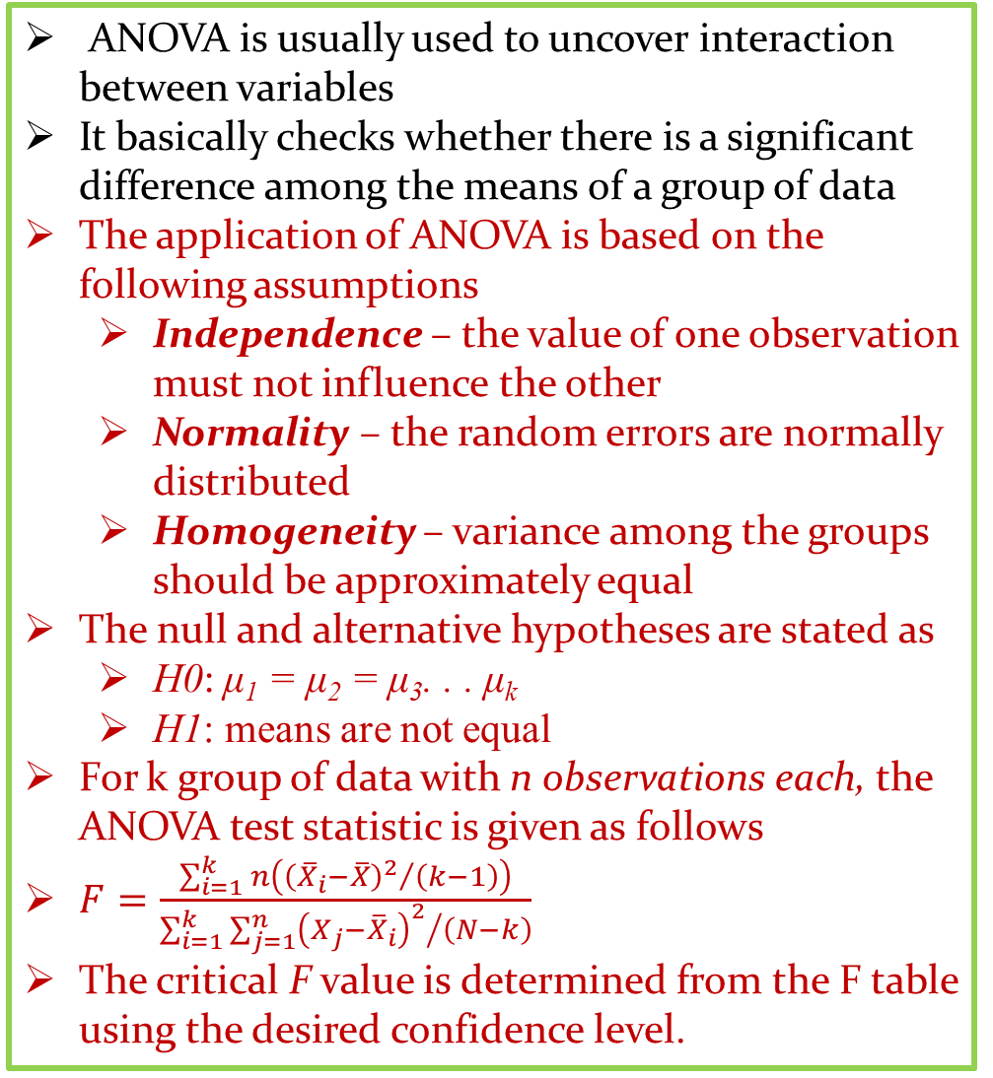
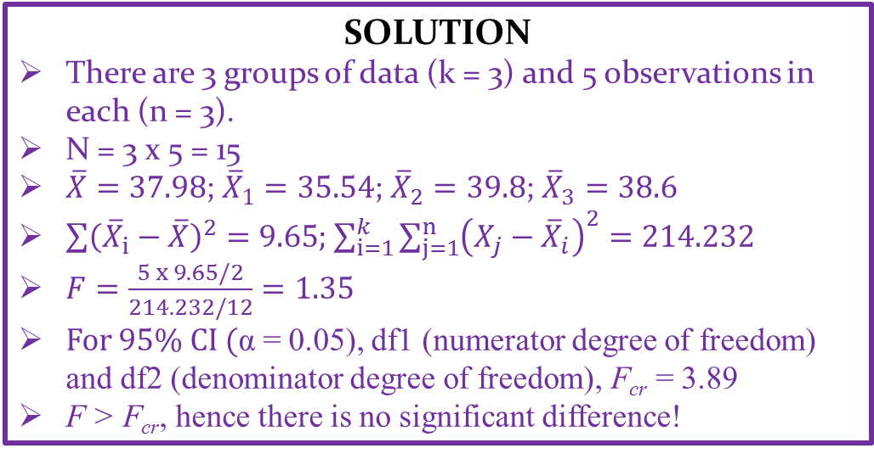
Analysis of Variance (ANOVA)
ANOVA is usually used to uncover interaction between variables
It basically checks whether there is a significant difference among the means of a group of data
The application of ANOVA is based on the following assumptions
  Independence – the value of one observation must not influence the other
  Normality – the random errors are normally distributed
  Homogeneity – variance among the groups should be approximately equal
The null and alternative hypotheses are stated as
  H0: μ₁ = μ₂ = μ₃. . . μ_{k}
  H1: means are not equal
For k group of data with n observations each, the ANOVA test statistic is given as follows
$F=\frac{\sum_{i=1}^{k}{n\left({{\left({\overline{X}}_{i}−\overline{X}\right)}^{2}}/{\left(k−1\right)}\right)}}{\sum_{i=1}^{k}{\sum_{j=1}^{n}{{{\left(X_{j}−{\overline{X}}_{i}\right)}^{2}}/{\left(N−k\right)}}}}$
The critical F value is determined from the F table using the desired confidence level.
EXAMPLE
Determine whether there is a significant difference between air temperatures (ºC) recorded at different times of the day as shown in the table below
Location | Morning | Afternoon | Evening
Edem | 31 | 37 | 35
Obollo | 39 | 40 | 41
Aku | 34 | 41 | 45
Ikem | 40 | 45 | 32
Obimo | 33.7 | 36 | 40
SOLUTION
There are 3 groups of data (k = 3) and 5 observations in each (n = 3).
N = 3 x 5 = 15
$\overline{X}=37.98$;${\overline{X}}_{1}=35.54$; ${\overline{X}}_{2}=39.8$; ${\overline{X}}_{3}=38.6$
$\sum{{\left({\overline{X}}_{i}−\overline{X}\right)}^{2}}=9.65$; $\sum_{i=1}^{k}{\sum_{j=1}^{n}{{\left(X_{j}−{\overline{X}}_{i}\right)}^{2}}}=214.232$
$F=\frac{5 x 9.65/2}{214.232/12}=1.35$
For 95% CI (α= 0.05), df1 (numerator degree of freedom) and df2 (denominator degree of freedom), F_{cr} = 3.89
F >F_{cr}, hence there is no significant difference!
Click for F table (α = 0.05)
Click for Excel worksheet for ANOVA

Slide 32
More Resources
https://drive.google.com/open?id=1sv3B1_de7T-vUjL-MmIwwRf3mMr-xbZI
https://drive.google.com/open?id=1NpGMA1TEnqyldo-D-DxmKvNRHZnZHBAO

Slide 33


