Slide 1
UNIVERSITY OF NIGERIA, NSUKKA
COLLEGE OF POSTGRADUATE STUDIES
Opening Ceremony/Introduction to Research & Academic Writing Skills.
Resource Person
Prof. James E. Conable-Nweke
CPGS RAW MENTORING UNIT
Email: james.conable@unn.edu.ng
WhatsApp:+234 81 6043 8899

Slide 2
COLLEGE OF POSTGRADUATE STUDIES
Vision
“Through research and innovation, to become a globally reputed first-rate School of Postgraduate studies.”
Mission
“The school aims to attract, educate, train and transform qualified persons to high level manpower that are thoroughly equipped with adequate and update knowledge and specialized skills in research and innovation and deployable for first-rate development and improvement in all fields of human endeavor.”

Slide 3
OUTLINE
WORKSHOP GOAL & OBJECTIVE.
WHY DOES RESEARCH & ACADEMIC WRITING MATTERS?
THE ROLE OF RAW MENTORING UNIT.
PARTICIPATION GUILDELINES
CONCLUSION.

Slide 4
GOAL
Through a combination of theoretical session and hands-on workshop, the main goal is to equip students with the tools and knowledge they need to effectively carryout advanced innovative research inline with CPGS’ vision and mission.

Slide 5
OBJECTIVE
Believing in the potential of our young researchers to drive innovation, the primary objective is to provide you with the information to identify the tools and resources that you would need to complete an innovative research project.

Slide 6
1. INTRODUCTION
Research and academic writing are fundamental to the advancement of knowledge. They promote critical thinking, ensure accurate dissemination of information, and provide a structured method for exploring questions and validating answers. In academia, these skills enable scholars to contribute to their fields, while in broader contexts, they empower individuals to make informed decisions and engage in substantive discussions.
.

Slide 7
2. WHY DOES RESEARCH & ACADEMIC WRITING MATTERS?
Contributes to Knowledge Creation and Dissemination.
2. Promotes Critical Thinking.
3. Ensures Credibility and Rigor.
Continued

Slide 8
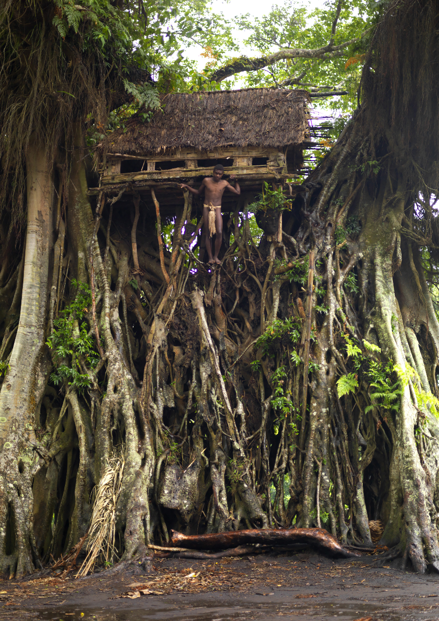
Notes:
Roof on Tree top

Slide 9
4. Facilitates Peer Review and Collaboration.
5. Permanent Record for Future Generations.
6. Skills Beyond Academia.
7. Informed Decision-making:
8. Broadens Perspective.

Slide 10
3. THE ROLE OF RAW MENTORING UNIT.
The role of CPGS is to provide students with the essential skills to identify, measure, and analyze research problems and write a standard research paper.
What we do:
Help students to identify research problem.
Help students to understand how to measure and analyze research problem.
Help students to draft standard research paper.
Guide students in crafting research papers suitable in any high-impact-factor journals.
Continued

Slide 11
How we do it:
Employ feedback mechanism.
Practice literature evaluation.
Guide to locate essential resources.
Facilitate academic & professional networking & collaboration.
Provides publication support.
Advise on stress and time management.

Slide 12
4. PARTICIPATION GUILDELINES
Browse the CPGS website and book an online appointment at the following link: http://spgs.unn.edu.ng/pg-school-mentoring-unit/
Virtual Visiting Days: Monday to Friday.
3. Time: 13:00 to 18:00 pm.
4. Face-to-face Visiting: Tuesdays & Wednesdays (CPGS Main Building |Nsukka Campus, Room 106 between October-March when the Mentor is available ).
5.Time: 9:00 am to 2:00 pm.
Continued

Slide 13
Who Qualifies to participate in the RAW Mentoring?
You must have completed your course work and preparing to write a Master’s thesis or PhD Dissertation or Journal article.
Your have a course work relating to research that you think you need support to accomplish.
Continued

Slide 14
How do you prepare for your first mentoring session?
Before the Session, do the following:
Send the mentor your brief resume, i.e., two or three brief paragraphs describing your department or faculty, program, and personal data.
2. Give the mentor an idea of the research area you'd like to focus on.
3. Ask for the mentor’s WhatsApp number if you do not have it already.

Slide 15
Closing Remark
Expect workshop final assignment.
Complete the final assignment as a measure of learning for each presentation.
Take advantage of all opportunities to learn and to network with faculty and student peers/colleagues
For RAW mentoring advising, please e-mail me at: Email: james.conable@unn.edu.ng
Thank you all for your participation!

