Slide 1
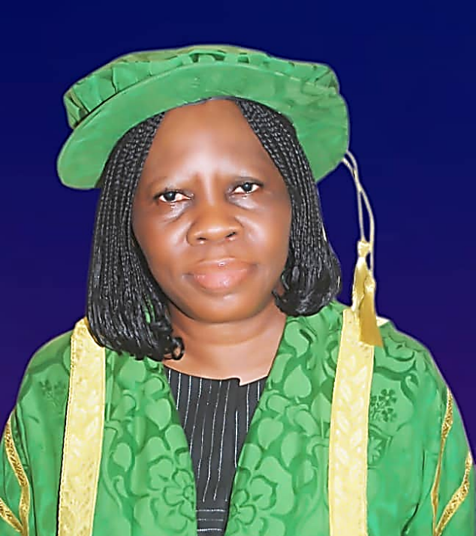
Optimal Use of Library Resources in Modern Research
A Presentation made at the Postgraduate Orientation Exercise for 2021/2022 Academic Session, September 13, 2023 by Dr (Mrs) C.P. Madumere on behalf of
Dr (Mrs) PROMISE I. ILO
University Librarian

Slide 2
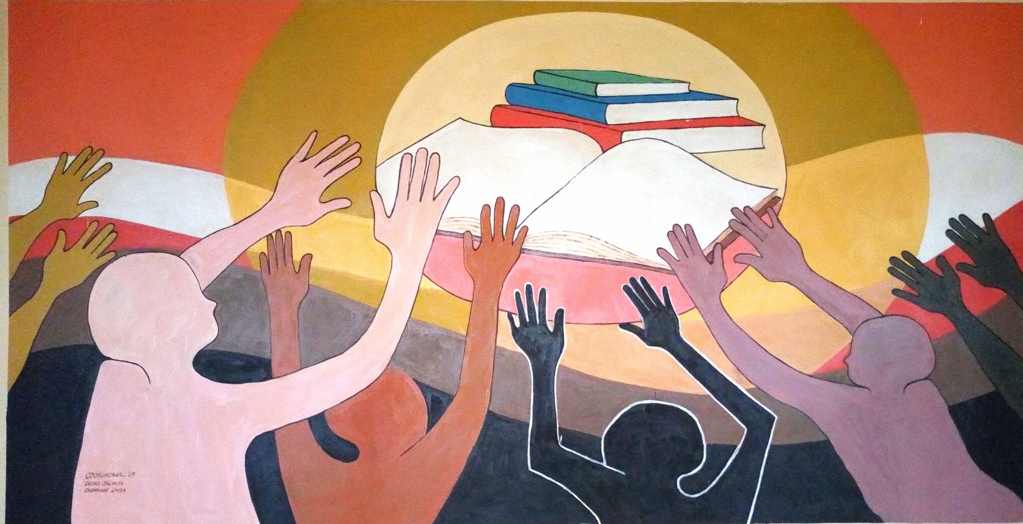
TO RESTORE THE DIGNITY OF MAN
The Library
To restore
Helps UNN
The Dignity
of Man!

Slide 3
The University of Nigeria Nsukka Library
The University of Nigeria Nsukka operates a multi-library system at the campus locations namely;
The central/ main Library
2. The Enugu Campus Library
3. College of Medicine Library

Slide 4
We also have branch libraries located in the faculties and some departments. Some examples include but not limited to:
Faculty of Education library
Faculty of Agriculture
Faculty of Engineering
DEPARTMENTAL LIBRARIES
English Department
Library and Information Science, among others

Slide 5
DIVISIONS
SPECIAL NEEDS & BRANCH LIBRARIES
DIGITAL
LIBRARY SERVICES
COLLECTION DEVELOPMENT
SPECIAL
COLLECTIONS
TECHNICAL SERVICES
SERIALS
PUBLIC SERVICES

Slide 6
PUBLIC SERVICES
Public Services Division takes care of users public needs.
The major functions are:
CIRCULATION
Registration of Users
Issuing clearance to graduating students and retiring staff
Capturing users’ personal information
Charging and discharging of books.
Book renewals
Sending overdue notices to users

Slide 7
Circulation Reading Area
Circulation Reading Area

Slide 8
REFERENCE SECTION
Answers reference queries
Gives guidance to users on the choice of resources and locations
Organizes orientation programmers to get the users acquainted with library procedures and use.
Prepares bibliographies in various subjects to help users know the available materials in their areas of interest.
Preparation of Readers’ Guide for effective use of the Library.

Slide 9
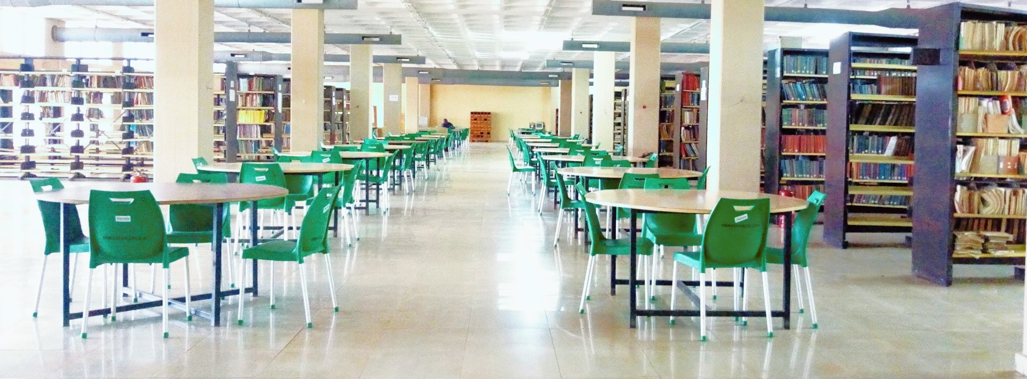
SERIALS SECTION

Slide 10
SERIALS
The division is made up of two sections; Serials Section and Bibliographical Control Section.
The division is concerned with the
acquisition
and
preservation
of
* magazines and newspapers
The Division also does
*abstracting and indexing of journals
* newsletters
* Electronic journals

Slide 11
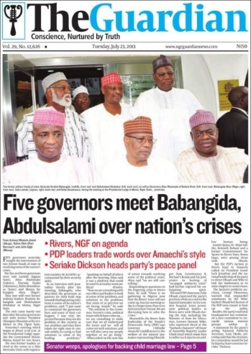
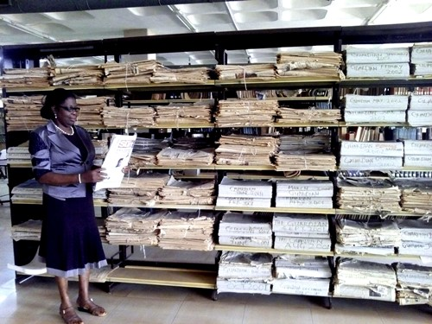
NEWSPAPER SECTION
Indexing of Newspapers and Magazines
Serving users, using newspapers and magazines.

Slide 12
SPECIAL COLLECTIONS
This is located on the last floor of the Library . The division is made up of three sections namely, Africana, Government Documents/Archives, and United Nations Organization Publications.
AFRICANA SECTION
Collections about Africa and by Africans. Houses Africana materials including fictions, books in different subject areas, rare publications and students’ projects, theses and dissertations. It has three sub-sections:

Slide 13
Special Collections
BIAFRANA
A collection of documents about Nigeria/Biafra Civil war of 1967 to 1970; and
ACHEBEANA
This is a unit that houses materials about Chinua Achebe and by Achebe
ZIKIANA
It houses resources by and about the late Dr. Nnamdi Azikiwe. Each section has in its custody collections of unique resources that enhance scholarly communication.

Slide 14
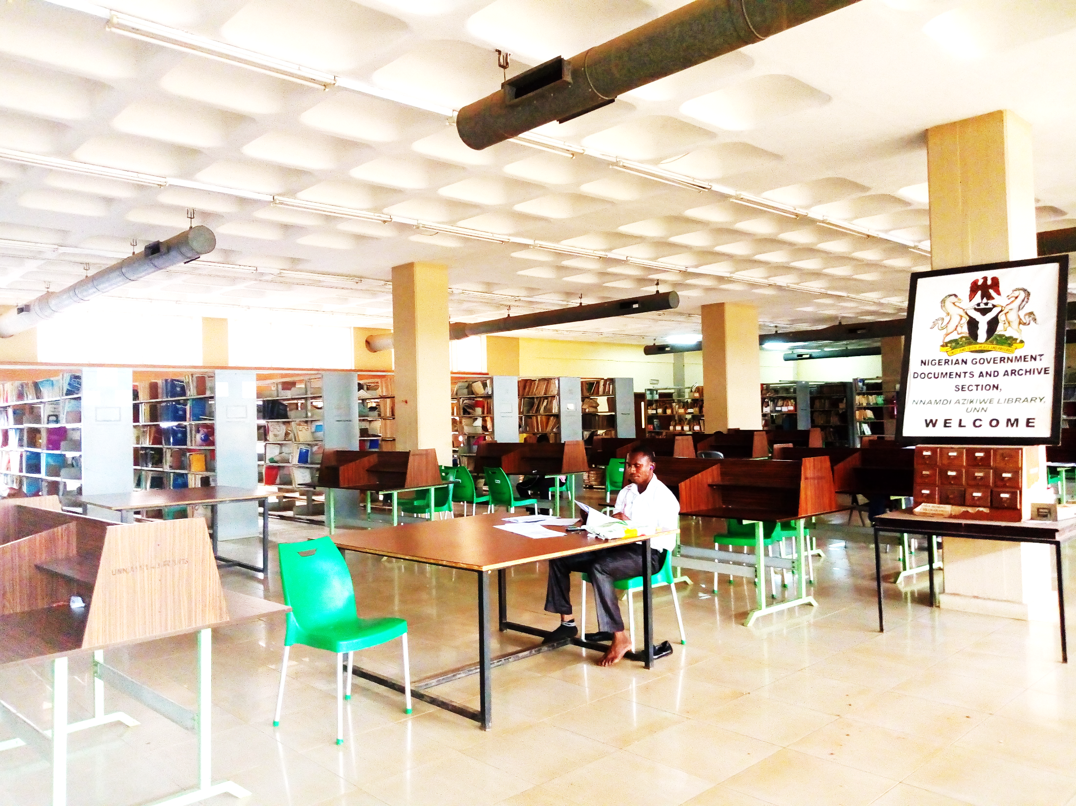
Special Collections
GOVERNMENT DOCUMENTS/ARCHIVES SECTION
It has in its custody collections of Nigerian Government publications and archival resources. These are products of day-to-day activities in Nigerian Government.

Slide 15
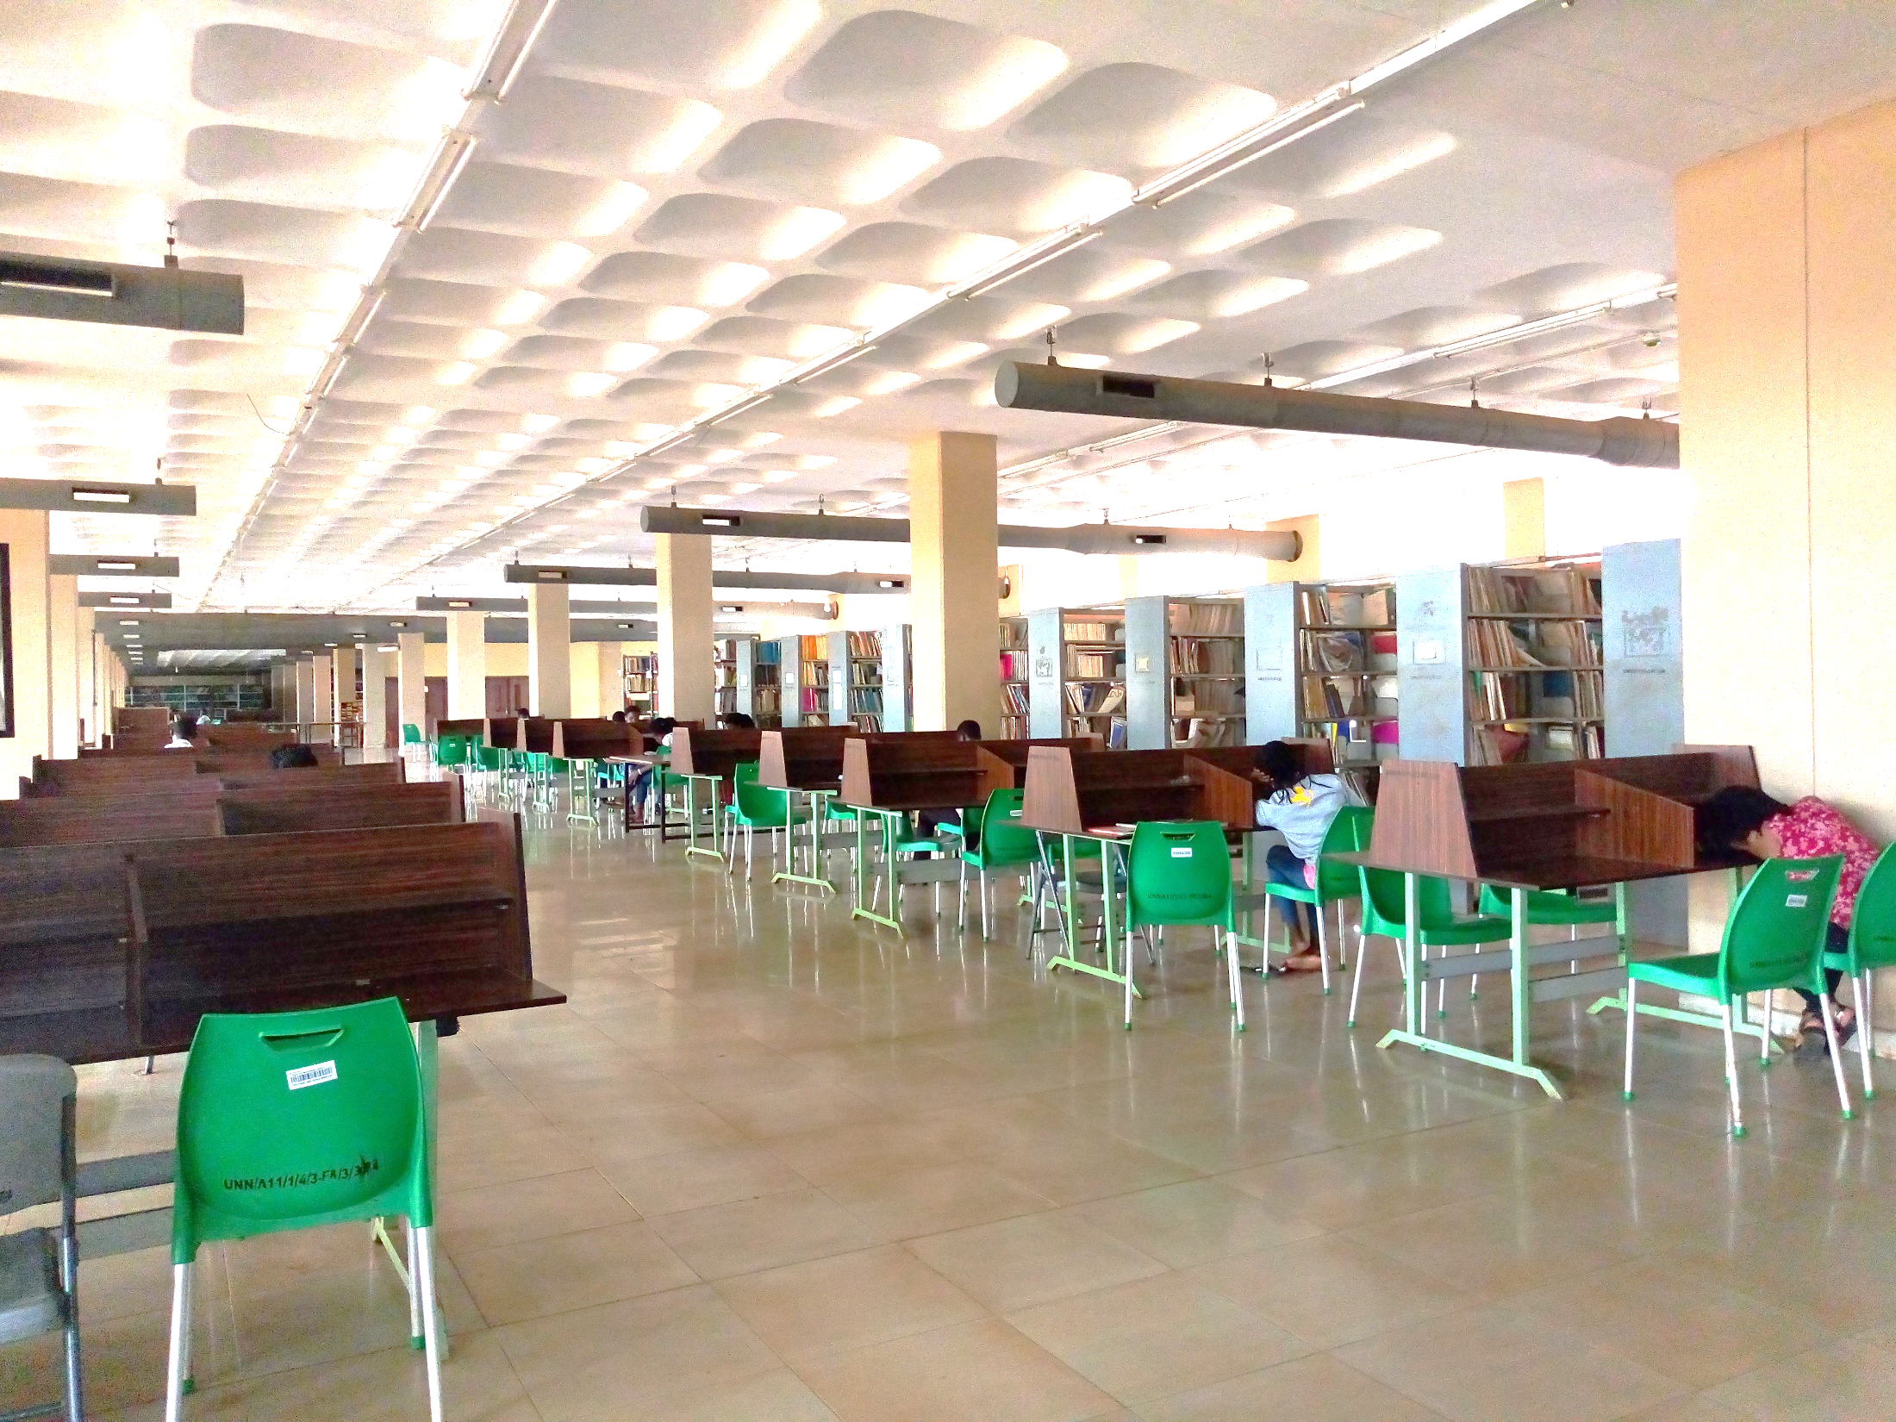
Houses United Nations Publications (WHO, UNICEF, UNESCO etc.)
This section is a depository of publications of the UNO. The section collects and keeps unique materials on current events in the world. Materials in this section are mainly research works and books from UNs Agencies. Use is restricted to postgraduates, final year students, staff and external users.

Slide 16
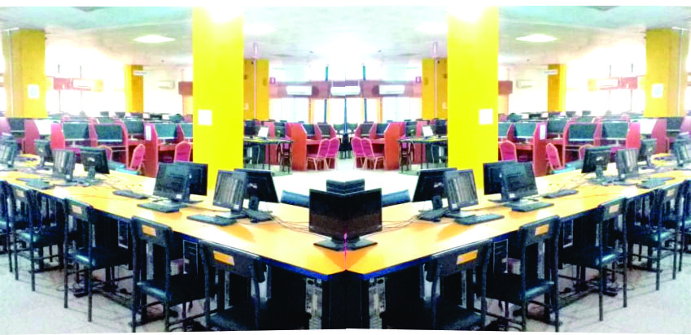
DIGITAL LIBRARY SERVICES
Access to several Databases
Turnitin Services (Plagiarism Check), Photocopying, Printing and Scanning
Institutional Repository, Online Public Access Catalogue (OPAC)

Slide 17
LIBRARY HOURS
Mondays - Fridays | 8.00 am – 10.0pm.
Saturdays | 8.00 am – 8.00pm.
Sundays | 2.00pm---6.00pm
**The Library is closed on official public holidays.

Slide 18
LIBRARY RULES AND REGULATIONS
Do not enter the library with bags.
Always surrender yourself for search while leaving the library
Do not drink or eat anything in the library
Leave all consulted books on the table.
Do not write or make any mark inside a book
Do not make noise or wear noisy shoes to the library.
Do not go out of the library with books that are not properly charged out.
Dress decently while coming to the library

Slide 19
Registration and Usage
Registration is open to all categories of staff and students of the university. To be a registered user, one must complete the library registration forms at the Circulation desk.
Upon completion and return of these forms, the user is issued with Library (Borrowers’) card with his or her passport affixed after having been recommended by the reader’s Head of Department.
**Your Library Card is used in borrowing books

Slide 20
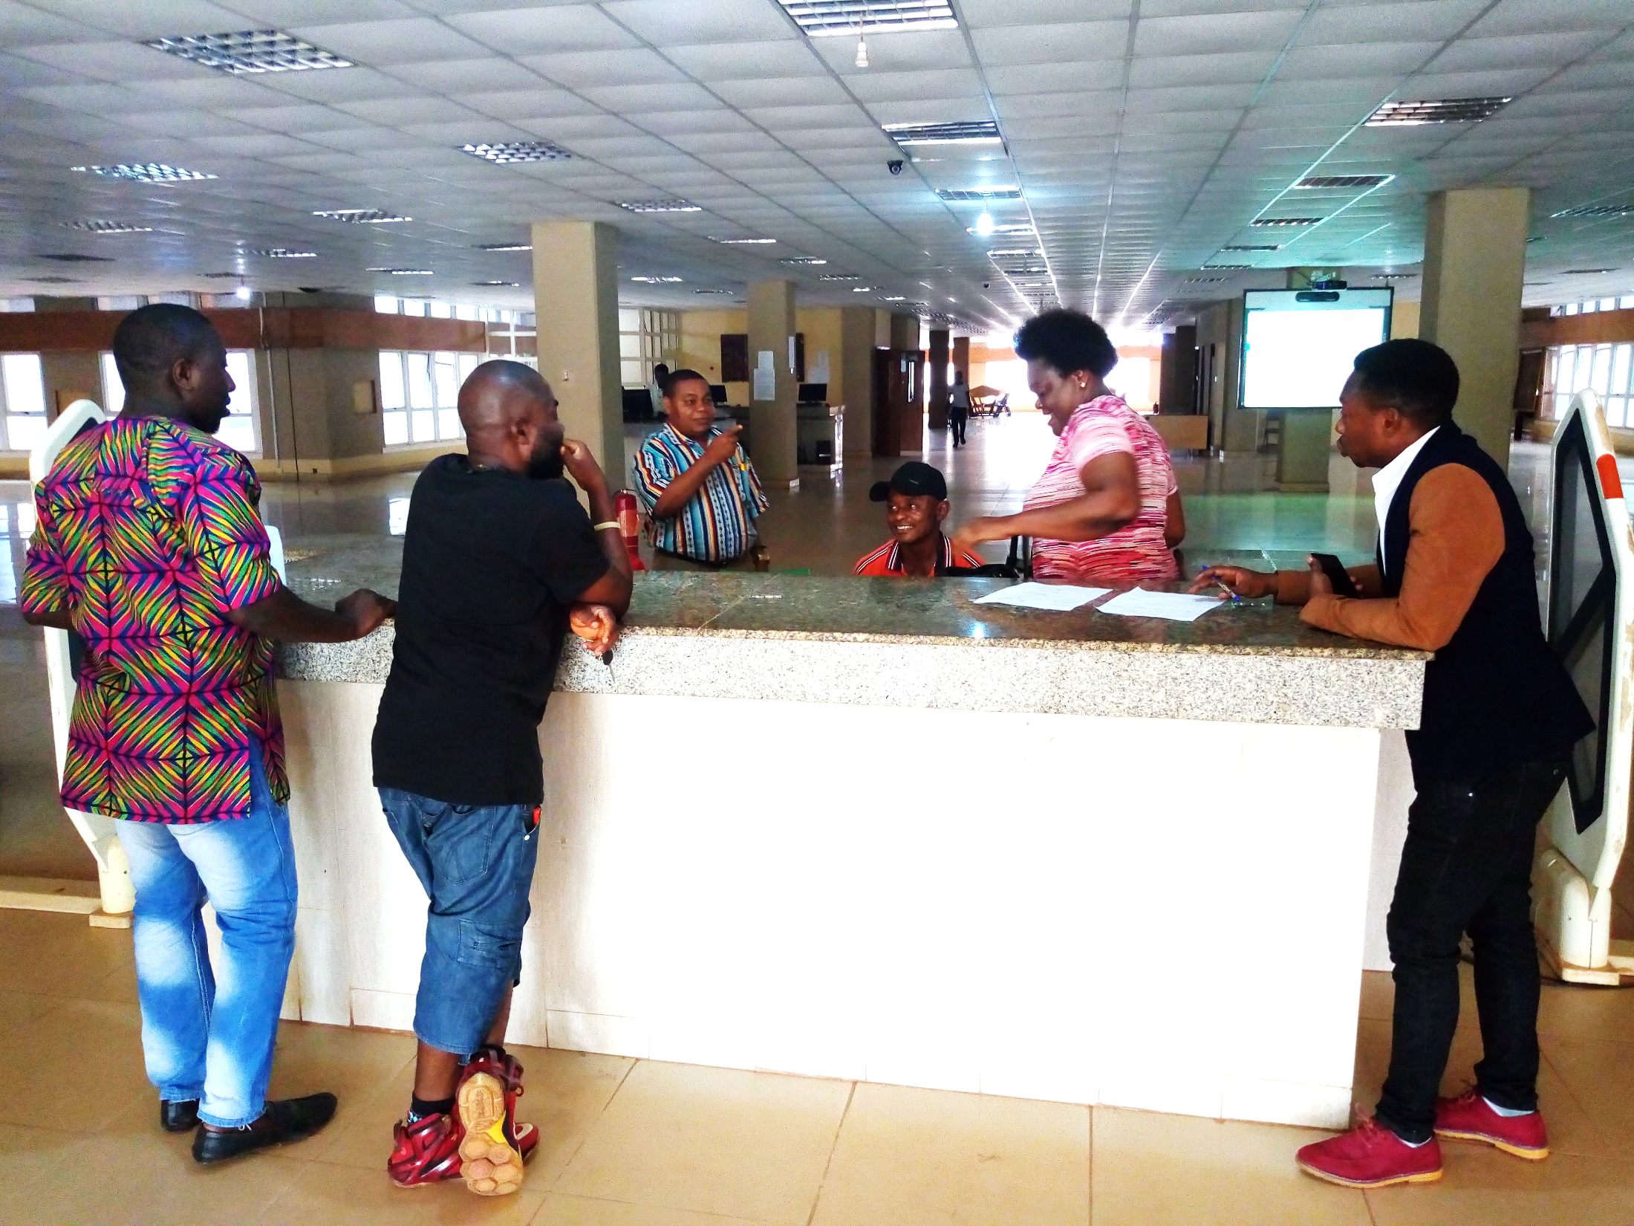
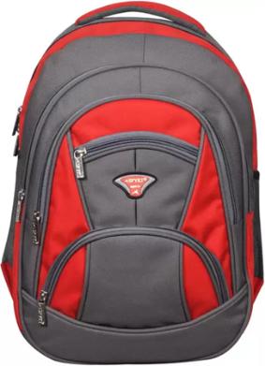
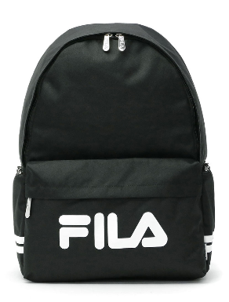
PORTER’S DESK
Bags are NOT
ALLOWED in the Library

Slide 21
WHAT HAPPENS AT THE PORTERS’ DESK?
Students and Staff Present Their Library Cards.
External Users Present Introductory Letters
Users Make General Enquiries

Slide 22
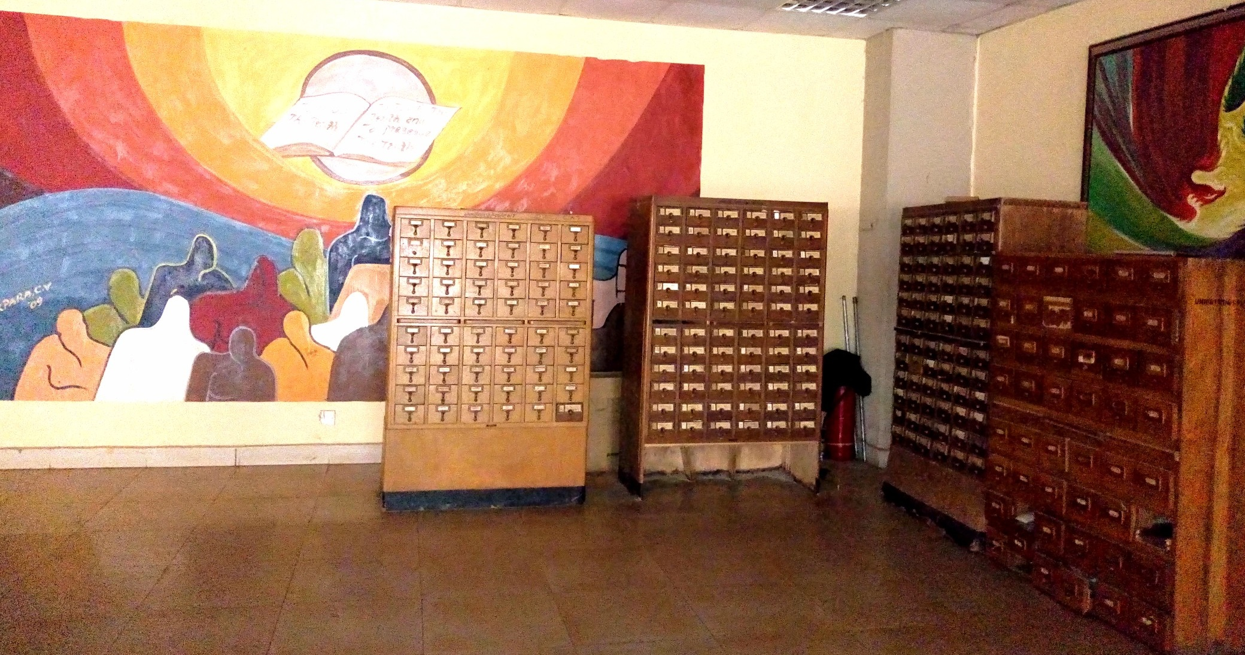
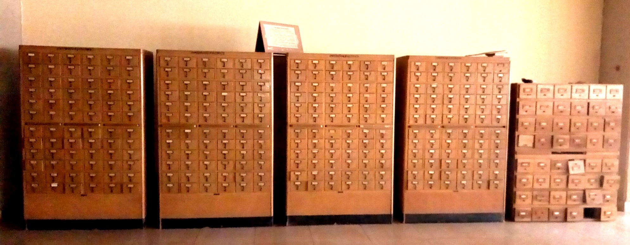
TRADITIONAL LIBRARY CATALOGUE

Slide 23
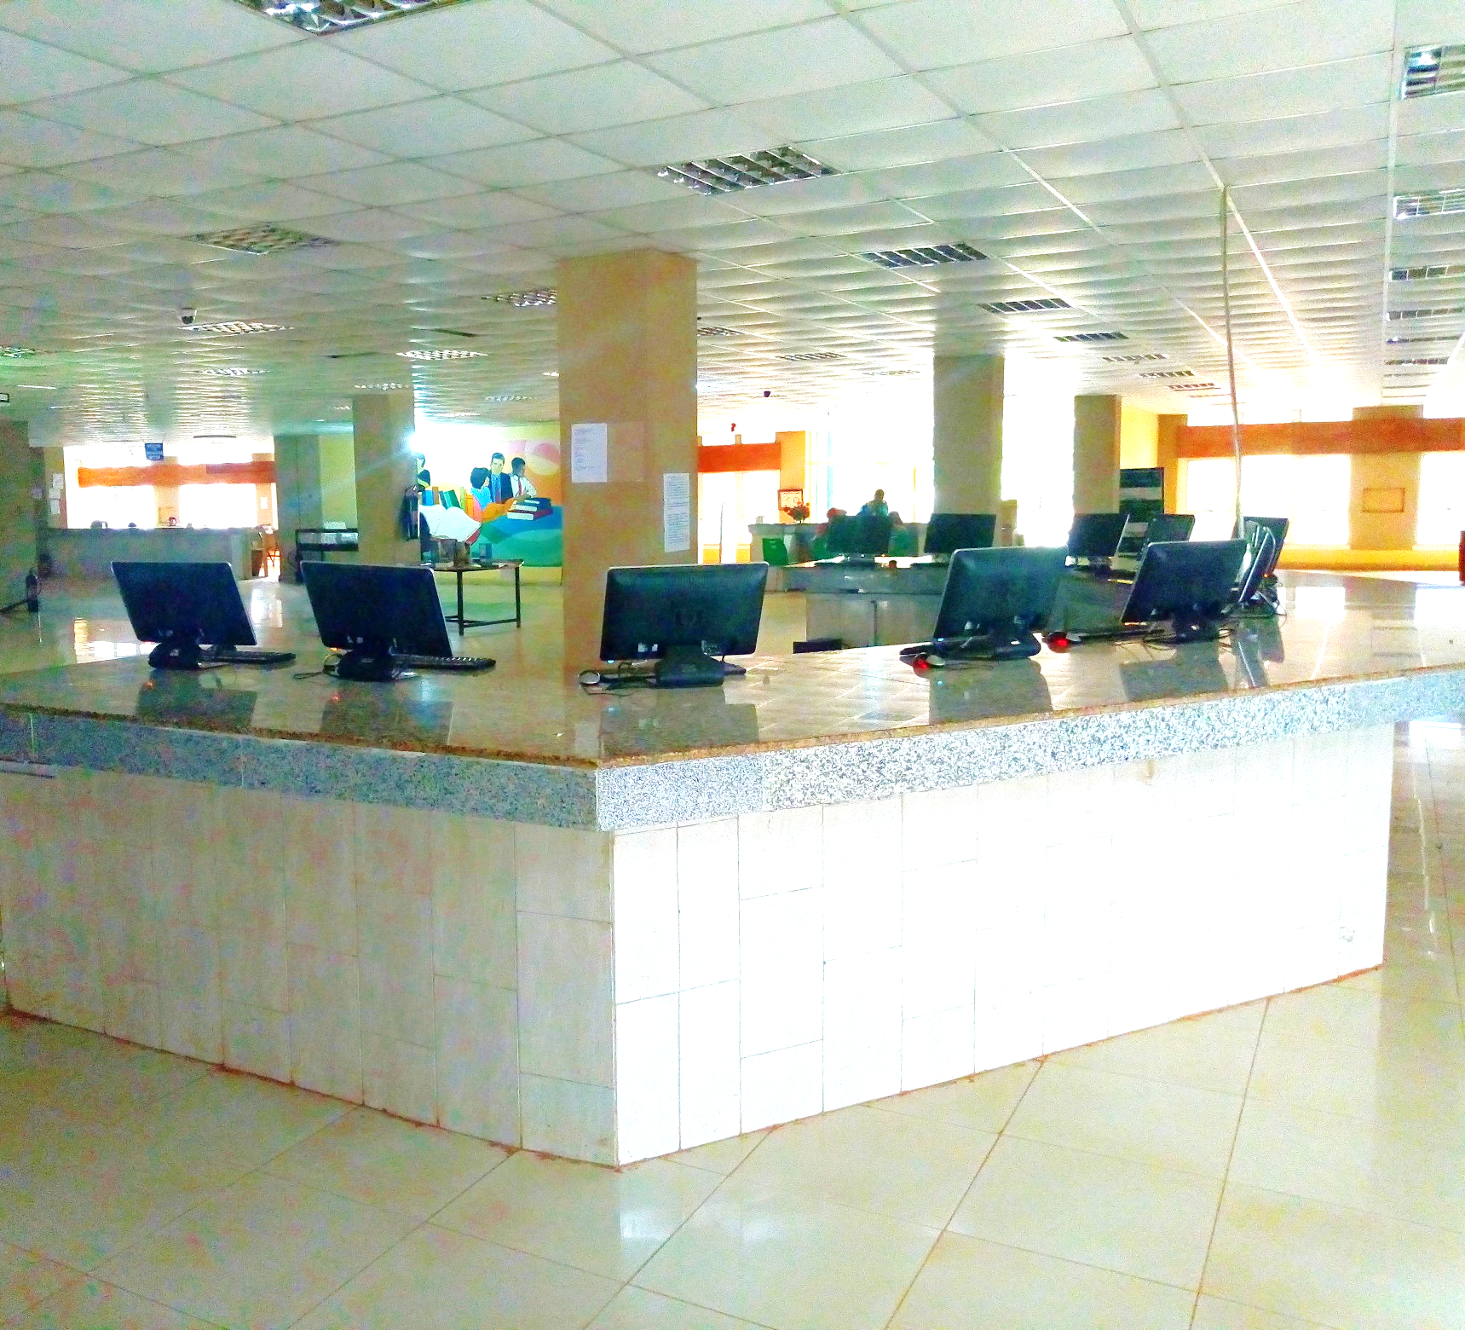
OPAC
www.nal.unn.edu.ng
ACCESS CATALOGUE
ONLINE PUBLIC
www.nal.unn.edu.ng

Slide 24
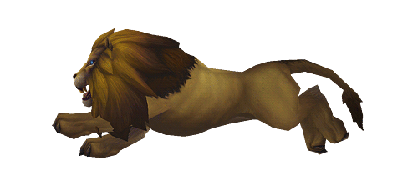
OUR WEB PRESENCE
Facebook: www.facebook.com/unnlibrary
Twitter: www.twitter.com/libraryunn
Blog: www.libraryunn.blogspot.com.ng
Website: www.library.unn.edu.ng
Repository: www.repository.unn.edu.ng
OPAC: www.nal.edu.ng

Slide 25
ONLINE RESOURCES
Edward Elgar's Journals and Development Studies eBooks then
http://www.elgaronline.com/noresults?access=user
Nature Publishing Group
http://www.nature.com/
Scopus Database
www.scopus
Open Access
DOAJ
DOAB
PubMed Central
Virtual Library on Capacity Development

Slide 26
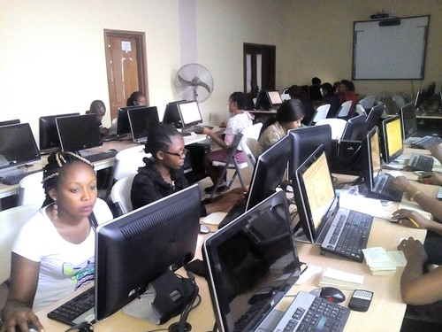
COMPUTER ROOM FOR PG STUDENTS
A Good Number of Computers
For Advanced Research
For Senior Researchers (eg. Lecturers and PG students)

Slide 27
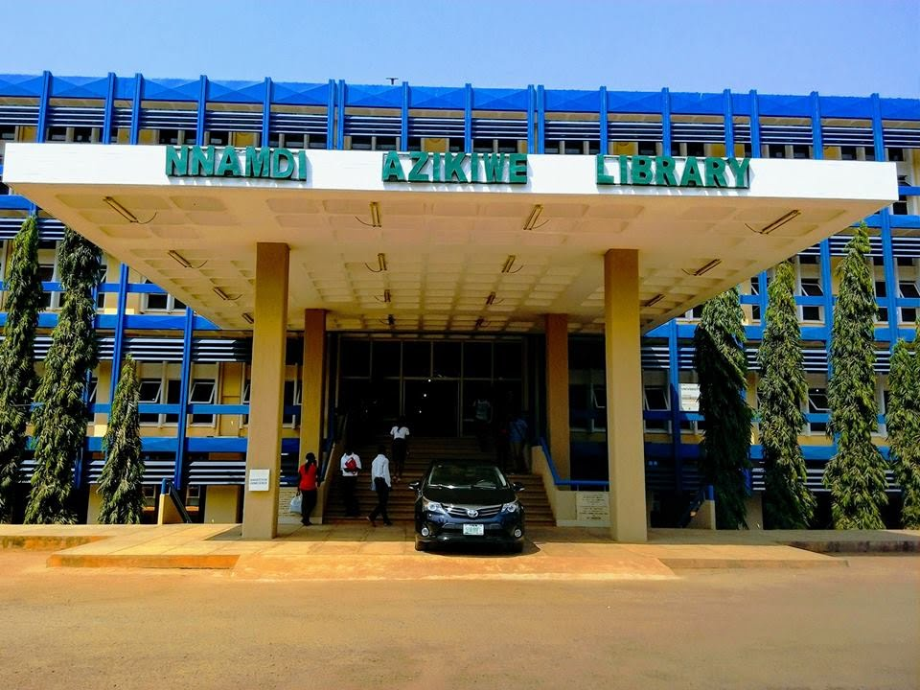
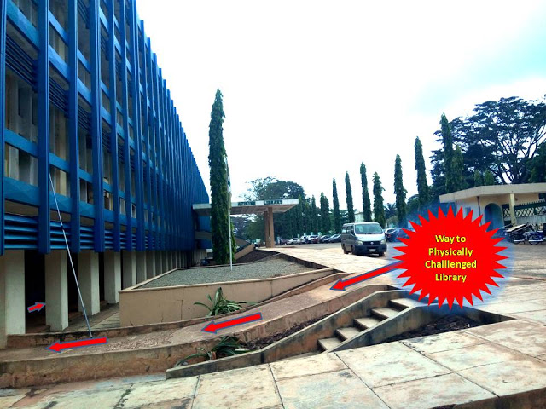
NEW LIBRARY BUILDING
THE SPECIAL NEEDS SECTION AT THE LIBRARY BASEMENT

Slide 28
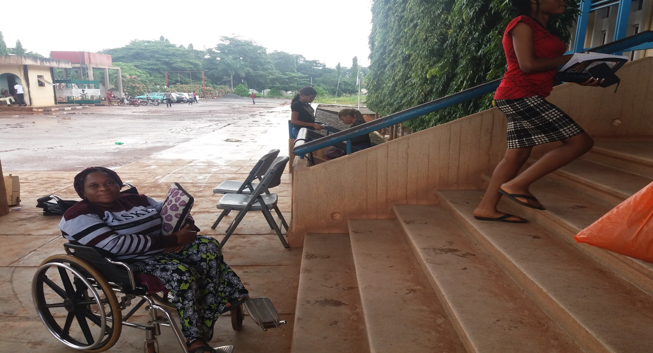
SPECIAL NEEDS SECTION
It is established with the desire to serve students with disabilities.

Slide 29
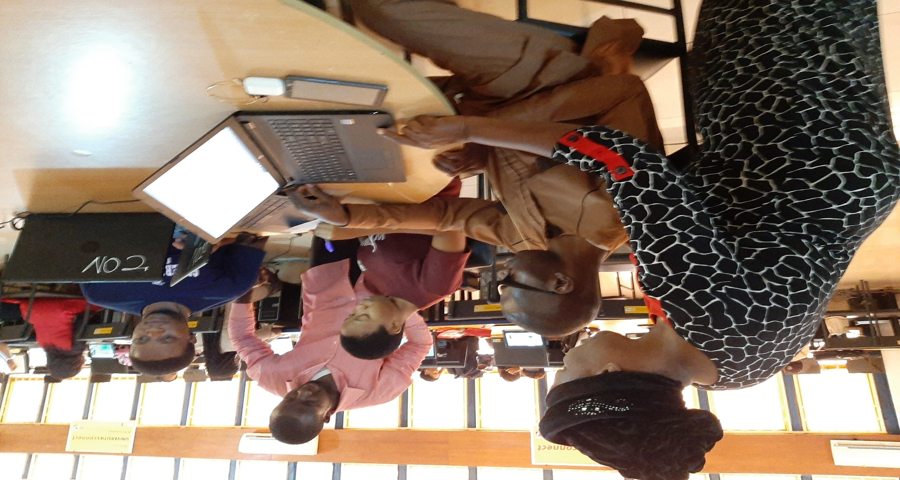
SPECIAL NEEDS SECTION
Services for Physically challenged User (Special Needs). Teaching students with special needs digital literacy.

Slide 30
SPECIAL NEEDS SECTION
Services for Physically challenged Users (Special needs). Information repackaging through scanning

Slide 31
A visually impaired student reading a textbook in Braille

