Slide 1
UNIVERSITY OF NIGERIA, NSUKKA
SCHOOL OF POSTGRADUATE STUDIES
ICT/Data Analysis in Medical Sciences/Environmental Studies
Prof Emmanuel N. Aguwa
Institute of Public Health
Email: emmanuel.aguwa@unn.edu.ng
Phone: 08034873064

Slide 2

Study Objectives
Define & Identify types of data
Analyze different types of data
Common descriptive statistics
  Common tests of significance
Tests of Association
Understand basic concepts in Excel, SPSS and EPI INFO

Slide 3
What are data?
Facts or information used to analyze, or plan something.
Types of data:
1. QUALITATIVE DATA is a categorical measurement expressed by means of a natural language description
  Nominal Categories: e.g. are gender, race, religion, or sport.
  Ordinal Variables: may be ordered e.g. small, medium, large
2. QUANTITATIVE DATA is a numerical measurement.
  Quantitative can be Discrete or Continuous

Slide 4
Steps in Data Analysis
Before data Collection
After data Collection
Determine the method of data analysis
Determine how to process the data
Consult a Statistician
Prepare dummy tables
Process the data
Prepare tables and graphs
Analyze and interpret findings
Consult again the statistician
Prepare for editing

Slide 5

Analyzing and Interpreting Quantitative Data
Descriptive statistics e.g. Frequencies
Cross-tabulations
Test of significance – Chi Square, Student t-test
Test of Association
- Correlation
-Regression

Slide 6
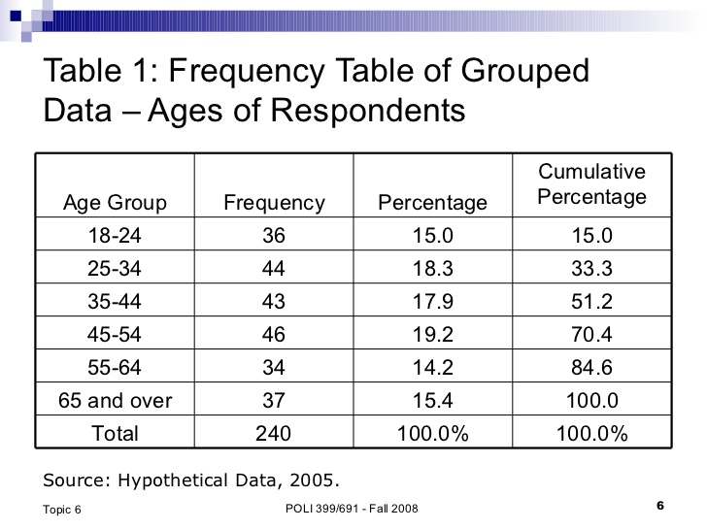
Frequency Tabulations

Slide 7
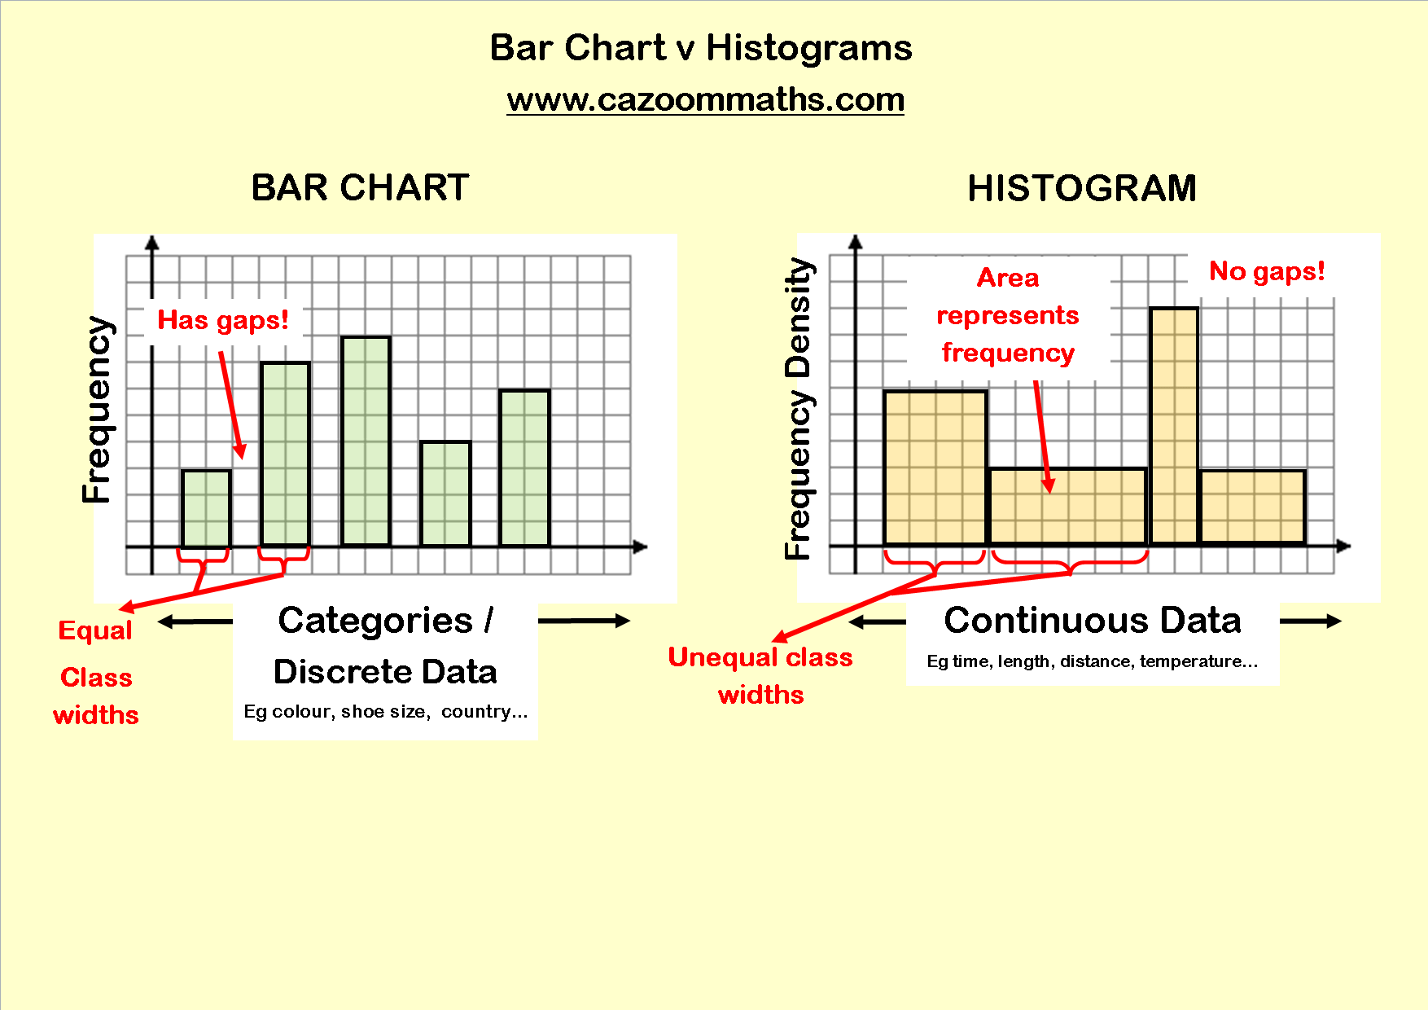
Bar Chart Vs Histogram

Slide 8
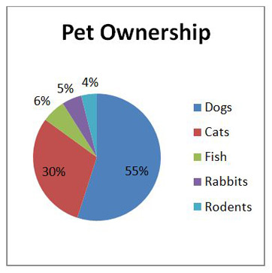
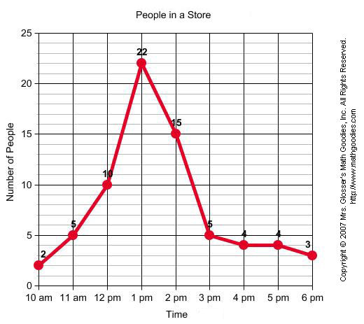
Pie Chart & Line Graph

Slide 9
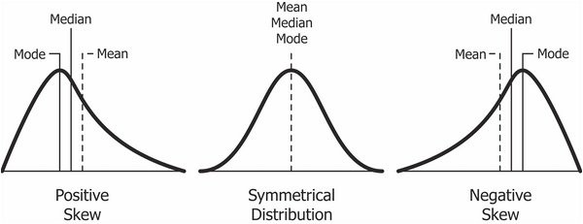
Common descriptive statistics – Measures of Central Tendency

Slide 10
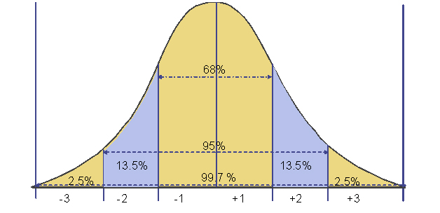
Standard Distribution and Normal Distribution Curve

Slide 11
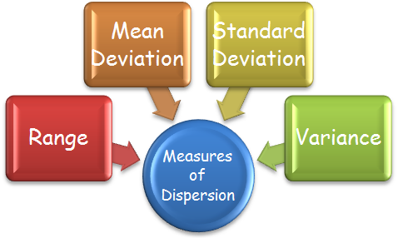
Measures of dispersion

Slide 12
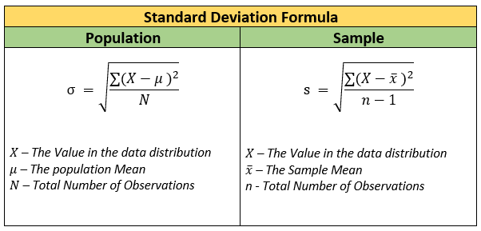

Slide 13
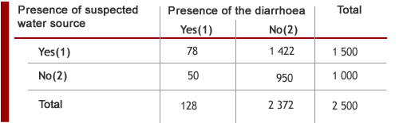
Cross-tabulation

Slide 14
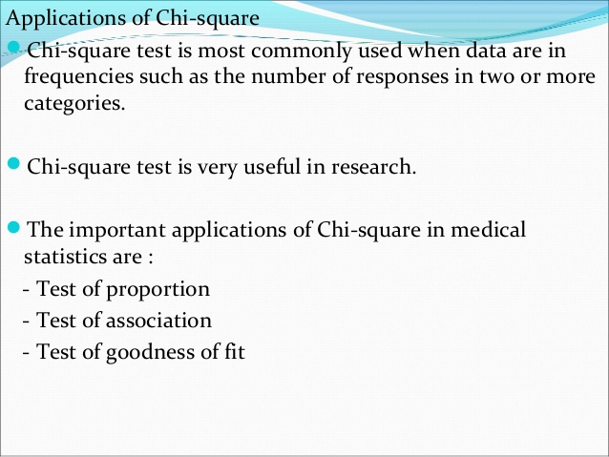
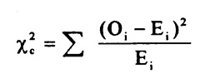
Goodness-of-Fit is a statistical hypothesis test used to see how closely observed data mirrors expected data. Goodness-of-Fit tests can help determine if a sample follows a normal distribution, if categorical variables are related, or if random samples are from the same distribution.

Slide 15
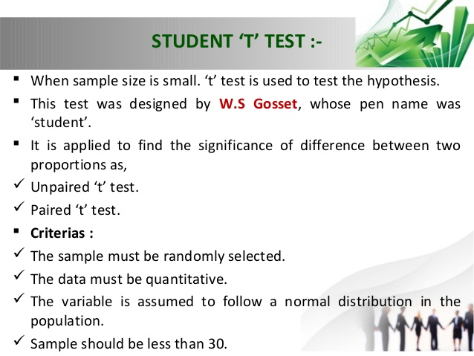

Slide 16
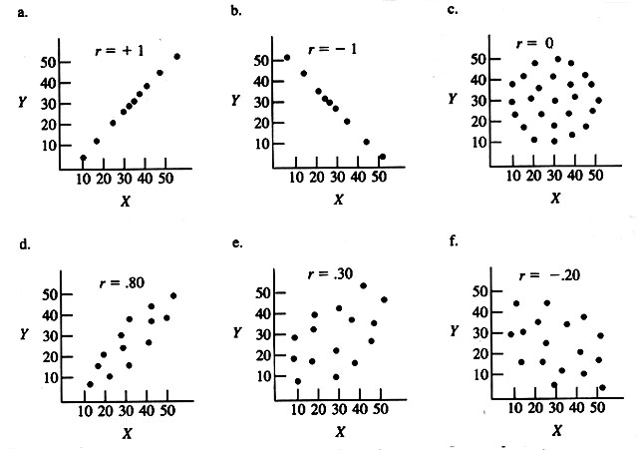
Correlation – strength and direction

Slide 17
The value of r ranges between ( -1) and ( +1)
The value of r denotes the strength of the association as illustrated
by the following diagram
strong
intermediate
weak
weak
intermediate
strong
-1
-0.75
-0.25
0
0.25
0.75
1
indirect
Direct
perfect correlation
perfect correlation
no relation

Slide 18
Regression Equation
Regression equation describes the regression line mathematically
y = a + bx
Where
a = intercept on y axis
b = slope

Slide 19
Weight (y) | Age (x) | Serial no.
12 8 12 10 11 13 | 7 6 8 5 6 9 | 1 2 3 4 5 6

Slide 20
Analyzing and Interpreting Qualitative Data
Qualitative data is thick in detail and description.
Data often in a narrative format
Data often collected by observation, open-ended interviewing, document review
Analysis often emphasizes understanding phenomena as they exist, not following pre-determined hypotheses

Slide 21
Types of Qualitative Analysis
Content analysis
Narrative analysis
Discourse analysis
Framework analysis
Grounded theory

Slide 22
Analyzing qualitative data
“Content analysis” steps:
Transcribe data (if audio taped)
Read transcripts
Highlight quotes and note why important
Code quotes according to margin notes
Sort quotes into coded groups (themes)
Interpret patterns in quotes
Describe these patterns

Slide 23
Practical Sessions
Introduction to Excel, Epi Info and SPSS

Slide 24

Thank You for Listening

Slide 25
Recommended Materials
SPSS Step-by-Step:
http://www.datastep.com/SPSSTutorial_1.pdf
A Handbook of Statistical Analysis using SPSS by Sabine Landau and Brian S. Everitt:
http://www.academia.dk/BiologiskAntropologi/Epidemiologi/PDF/SPSS_Statistical_Analyses_using_SPSS.pdf
https://www.coursera.org/learn/data-analysis-tools
Offered free by Wesleyan University Connecticut, USA (enrolment starts today 3rd September)

