Slide 1


Slide 2

HANDS ON TRAINING ON UNN E-LEARNING PLATFORM by
ENGR. CHISOM ANEKE

Slide 3
Who we are
I am Engr. Chisom Aneke Kanayo, a Software Architect and System Administrator of KSmart Solutions Intl’ Ltd.
KSmart is an Education Technology Company Headquartered in New York, United States.
We Provide Enterprise Software Applications and Related Services to the Education Industry.
Notes:
Restructure and add first offine stage

Slide 4
KSMART SOLUTIONS
KSmart Solutions have designed and implemented a customized E-Learning Entrepreneurship Platform for the University of Nigeria, Nsukka.
The University SPGS have also adopted this entrepreneurial programs
Notes:
Restructure and add first offine stage

Slide 5

NAVIGATING THE ONLINE ENTREPRENUERSHIP PROGRAM
Visit www.elearning.unn.edu.ng
Click on ‘REGISTER’ and fill in the necessary feilds
Notes:
Add first offine stage

Slide 6
NAVIGATING THE ONLINE ENTREPRENUERSHIP PROGRAM
After succesfully creating an account, delegently read through the ”User Account Quick Guide”
Click on “Got it!” after reading through the Quick Guide and this takes you to your User Account
Notes:
Add first offine stage

Slide 7
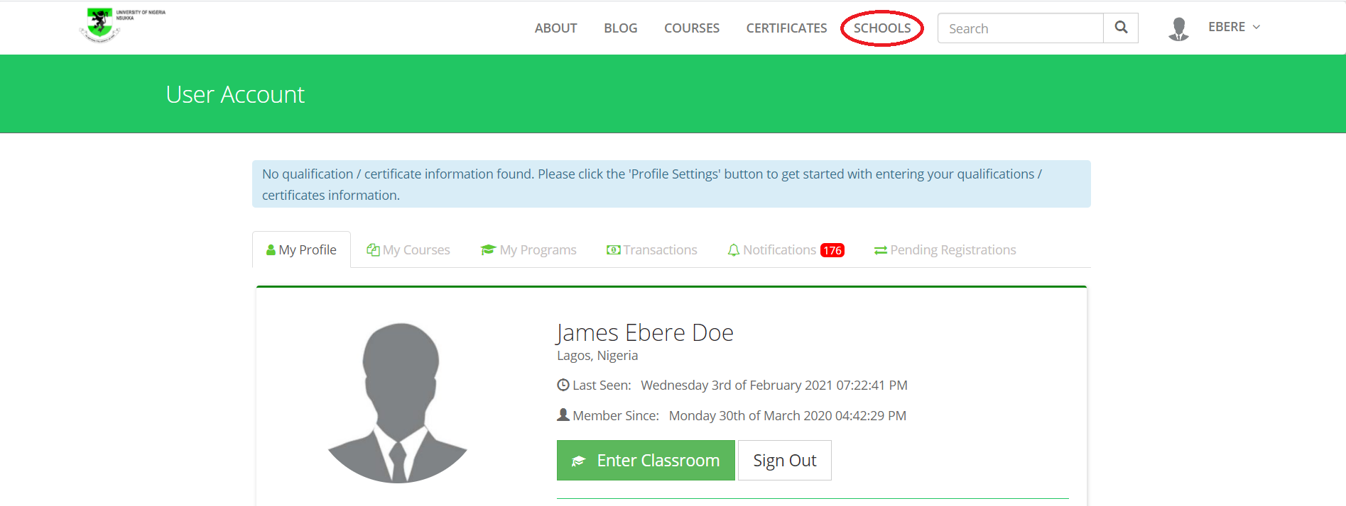
NAVIGATING THE ONLINE ENTREPRENUERSHIP PROGRAM
On the User Account Page, click on “COURSES” as shown below
Notes:
Add first offine stage

Slide 8
NAVIGATING THE ONLINE ENTREPRENUERSHIP PROGRAM
This button takes you to the different schools on the platform
Click on the ‘UNN Enterprise Acquisition School’ and navigate through the courses and programs
Choose the course or program of your choice from the list provided below
Notes:
Add first offine stage

Slide 9
NAVIGATING THE ONLINE ENTREPRENUERSHIP PROGRAM
1. Cosmetology production
2. Confectionary production
3. Crop production
4. Pig production
5. Poultry production
6. Sheep/Goat production
7. Grasscutter production
8. Fish farming/Fish culture
9. Snail farming
10. Online and networking business
Notes:
Add first offine stage

Slide 10
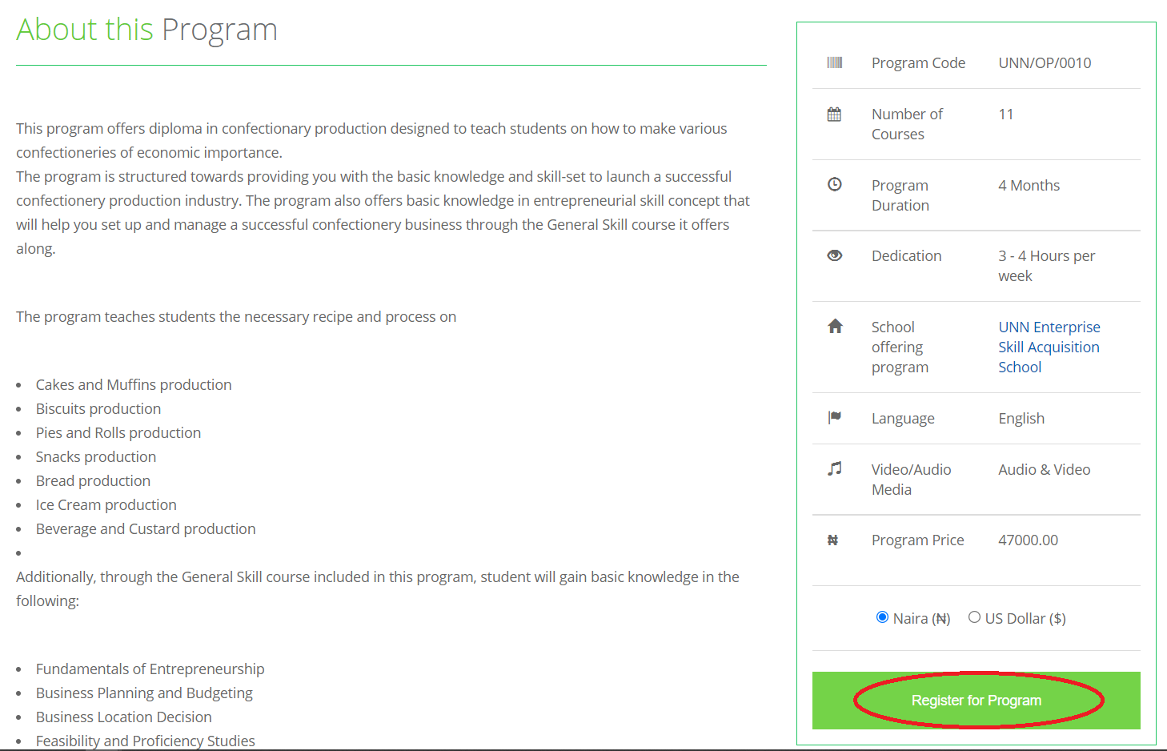
NAVIGATING THE ONLINE ENTREPRENUERSHIP PROGRAM
On the course/program page of your choice, you’d find a well detailed information on the page. Click on the ‘Register for Course”
Notes:
Add first offine stage

Slide 11
NAVIGATING THE ONLINE ENTREPRENUERSHIP PROGRAM
Next is the payment page showing if you want to pay online or bank payment
On the same page down below shows you an option for Token
Proceed to input the Token Key issued to you at the Dean’s office
Once you use this Token, the Course/Program becomes automatically free and you get enrolled instantly

Slide 12
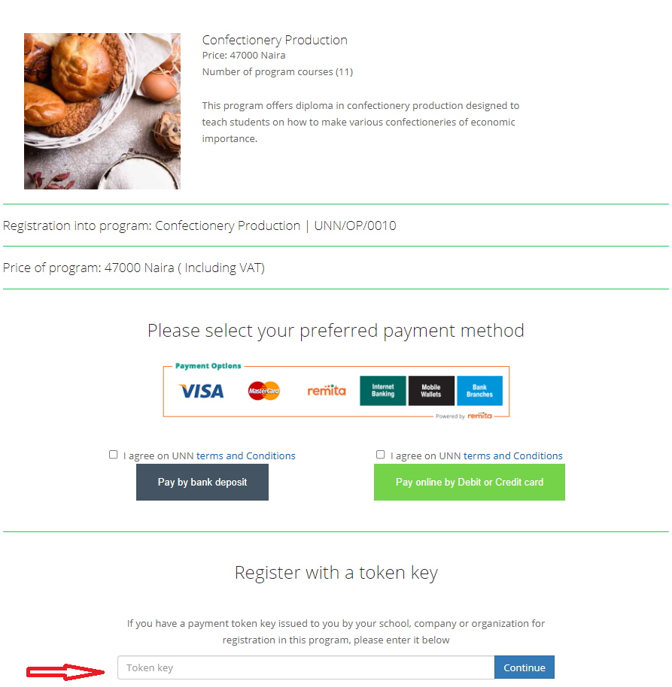
NAVIGATING THE ONLINE ENTREPRENUERSHIP PROGRAM
Another pictorial image of what the page looks like

Slide 13
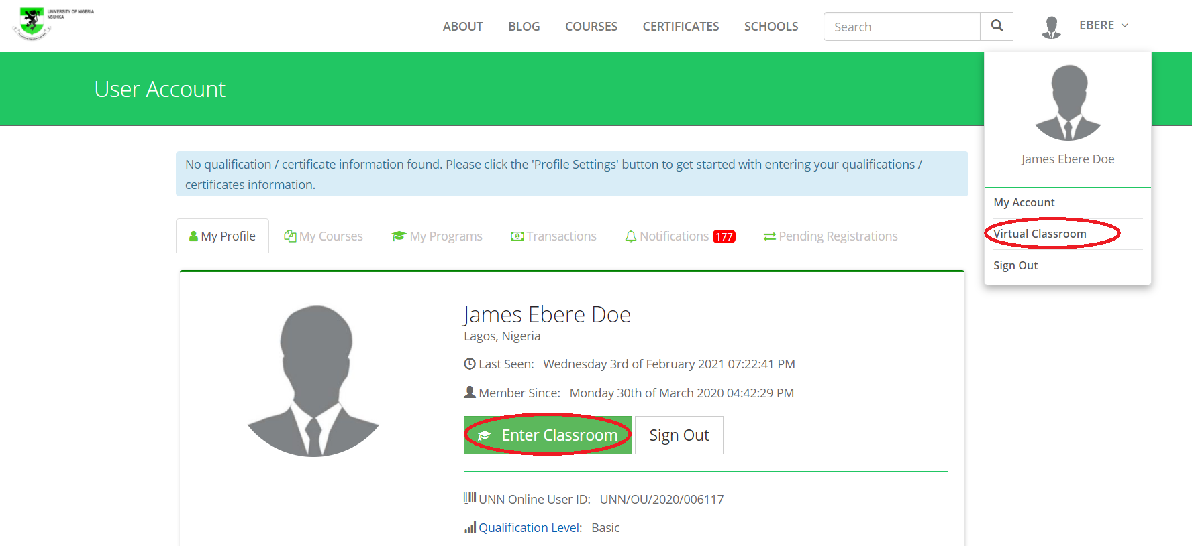
NAVIGATING THE ONLINE ENTREPRENUERSHIP PROGRAM
After enrolling, navigate back to the User Account and click on “Enter Virtual Classroom” as shown below

Slide 14

NAVIGATING THE ONLINE ENTREPRENUERSHIP PROGRAM
This directly takes you to the Virtual Classroom, click on the top right corner labeled “My Courses” to access your course/program.
Notes:
Rename the Heading

Slide 15
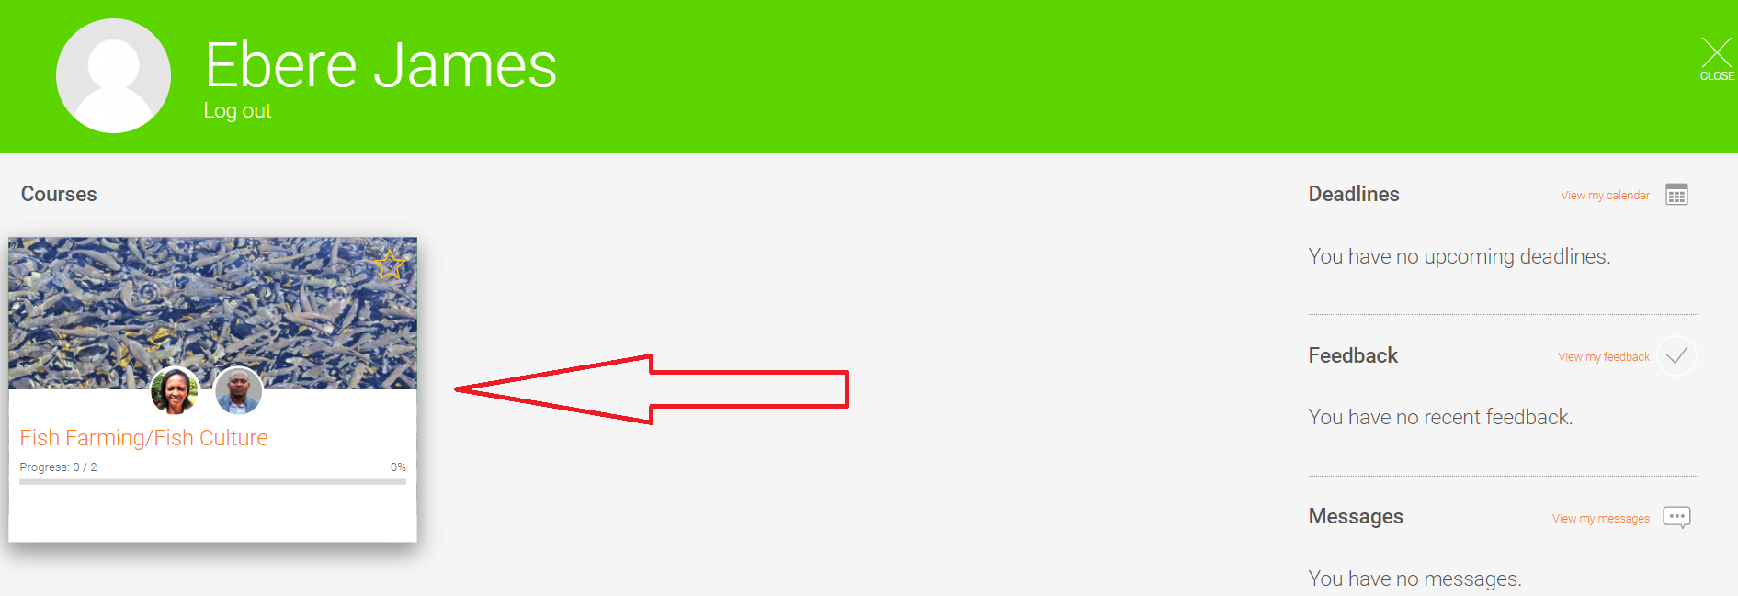
NAVIGATING THE ONLINE ENTREPRENUERSHIP PROGRAM
That action tkes you to your dashbaord that showcases your course or program courses as the case may be
Click on any to start course
Notes:
Rename the Heading

Slide 16
CONCLUSION
These courses were designed to accomodate your day to day activities so you have access to them 24/7
All you need is your personal computers, tables or smartphones and internet
They also contain well detailed step by step practical videos of how it’s done
Upon completion, you get awarded a UNN Diploma or Profeciency Certificate as the case may be

Slide 17
CONTACT US
For further information, please contact:
09075215361,
09050938078,
08035631219.

Slide 18
KSMART SOLUTIONS
THANK YOU

