Slide 1
UNIVERSITY OF NIGERIA, NSUKKA
SCHOOL OF POSTGRADUATE STUDIES
Access to Electronic Resources and use of Turnitin for Similarity Check: A Vehicle for Expanding the Frontiers of Academic Integrity
Dr S C UKWOMA
Nnamdi Azikiwe Library UNN
scholar.ukwoma@unn.edu.ng

Slide 2
OUTLINE
INTRODUCTION
ELECTRONIC RESOURCES
Open and secured resources
SEARCH STRATEGIES
Performing a simple search
How to modify your search
How to evaluate your search
Advanced search
Creating Google Alert
TURNITIN FOR SIMILARITY CHECK
What Turnitin Does
Files that can be checked in Turnitin
Analyzing your Turnitin report
PART TWO: PRACTICAL

Slide 3
GOALS AND OBJECTIVES
By the end of this presentation students should be able to:
1 identify online resources available at Nnamdi Azikiwe library
2 Mention the search strategies to adopt in searching for information resources
3 Analyze their Turnitin report

Slide 4
1. INTRODUCTION
In research writing, it is important that you know what other writers have written in your field or subject area to help you create the basis for your own research.
There is a saying that ‘if I have seen further it is by standing on the shoulders of giants.’
Therefore, it is important that we know how to get to the shoulders of these giants through their works. These works can be in print and electronic format. But our focus is on electronic resources because of its inherent advantages.

Slide 5
Introduction Contd.
As a Postgraduate student you are expected to use the University library.
Use the Reading areas
Use the materials both print and electronic
Benefit from other services available
To help you complete your programme within the stipulated period.

Slide 6
2. ELECTRONIC RESOURCES
These are resources that are accessed via the internet. Some of them can be free while some need authentication.
Open/free resources are those we can access without authentication i.e Username and Password
Restricted/ secured resources you can only have access to the resources with authentication i.e username and password. Or it may be IP based

Slide 7
Advantages
Easy to access
Round the clock availability (24*7)
Multiple access
No physical boundary
Search and browse facility

Slide 8
Sources of information
Primary sources of information e.g Interviews, original experiments
Secondary sources e.g. Academic books
Tertiary sources e.g Encyclopedia, bibliographies, indexes etc.
These are relevant sources you can consult as a researcher in writing your research work.
In writing your research report, it is important you know where to access information resources, the types of materials you need etc.

Slide 9
Types of access tools
We have different access tools such as
Catalogue cards or discovery tools- Gives record of the collections in the library
Databases
Repositories
Indexes
Search engines

Slide 10
Evaluate your information resources
Authority | Accuracy | Objectivity | Coverage | Currency
Who is the author | Is the information-based facts | How objective is the information | Is the coverage basic | The date of publication
Is the author affiliated to an institution | Is it published in a peer reviewed journal | Do you have an information about the publisher | Did they provide any link that explained the coverage | The last update on the website
The educational background or experience | When was the last update | Is there any political under tune | What is the depth of the information | What of the links are they up to date
Area of specialty | How accurate is the information on the web page | Is it informing or persuasive | Are you satisfied with the information
Track record of research output |  | The tune of the language
https://www.research4life.org/training/

Slide 11
Boolean Operatives
AND
used to combine different concepts
It require that both term s should be in the same record
reduces the amount found
OR
used to cater for synonyms
Retrieves all records with both concepts
increases the amount found
NOT
use when the same keyword has different meanings
-Excludes concept from the result

Slide 12
Advanced search
In advanced search you specify exactly the type of information you want to retrieve.
Example, the type of document (pdf, ppt Ms word etc)
The year
Language
Site ( e.g ac., ng., com. )

Slide 13
Search Strategies
You can perform a simple search by using the
keywords, subject or title

Slide 14
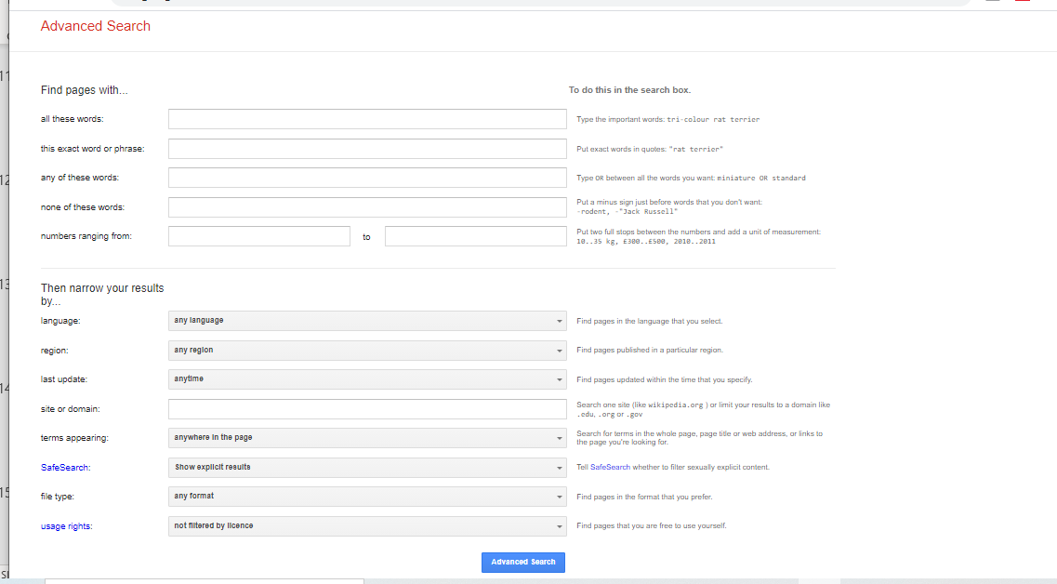

Slide 15
How to modify your search

Slide 16
Creating Google alert
1
2
Click on alert it show existing ones if you have any, if not, click on create alert to create a new one
4
Enter your alert query and the email address to receive the query
3
Click on create alert

Slide 17
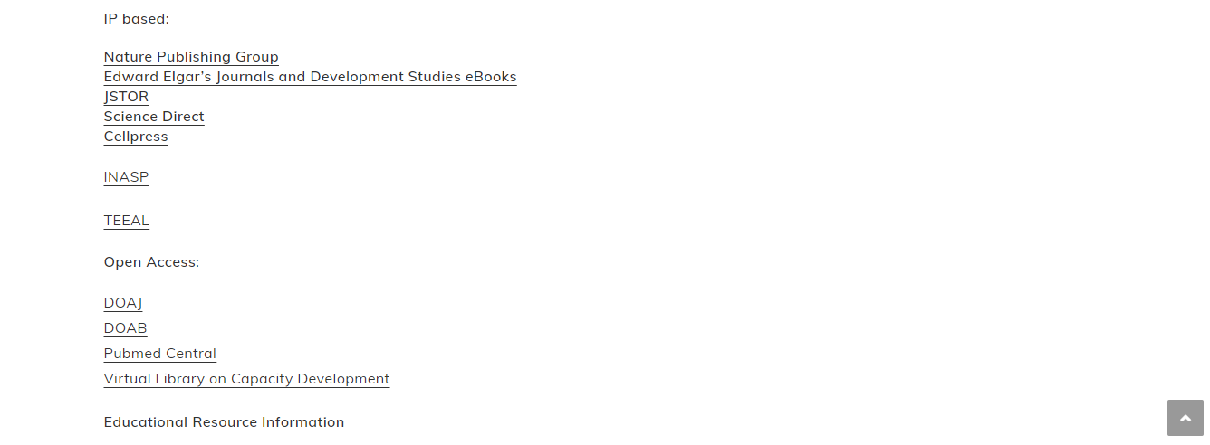
Databases available at the Nnamdi Azikiwe Library

Slide 18
CAUTION
We must develop the habit of reading through the articles we downloaded for our research work to ensure we produce original works.
Steps to take
Print out the materials, read them understand the main idea of the writer and put those ideas in your own words.
Avoid copy and paste
Avoid reading the materials online
Ensure you always acknowledge the authors/source s you cited in your work.
Even if you did not copy the author verbatim but used his/her idea you must acknowledge the source

Slide 19
Turnitin
Is a tool to check the originality of research works of students and academics.
It helps to stay away from plagiarism
Many universities in the world has adopted it to ensure academic integrity in their institutions and ensure researchers write original works
www.turnitin.com

Slide 20
Purpose of Turnitin
Students are accountable for what they submit
To check similarity of text to sources
To improve teaching and learning
To guide against misuse of online resources in research writing

Slide 21
Materials that can be checked in Turnitin
MS Word, WordPerfect, PostScript, PDF, HTML, RTF, and plain text documents
Turnitin.com DOES NOT check files in graphic formats such as TIFF, EPS, PSD, JPEG, PICT, etc.
Document Size:
Less than 40mb
Less than 400pages

Slide 22
Similarity index
BLUE (1) indicates that there are <0% matches
GREEN (2) 1%-25%
YELLOW (3) 26%-50%
ORANGE (4) 51%-75%
RED (5) 76%-100%
https://guides.turnitin.com/01_Manuals_and_Guides/Student/Classic_Student_User_Guide/17_Similarity_Check

Slide 23
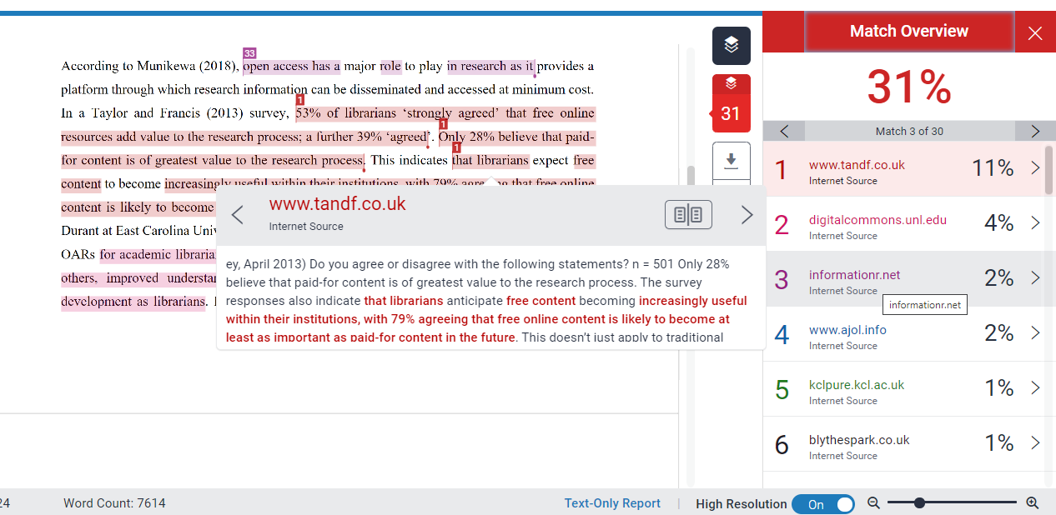
Overall similarity index showing material overlap
Individual source index- helps in interpretation
Source view showing overlap

Slide 24
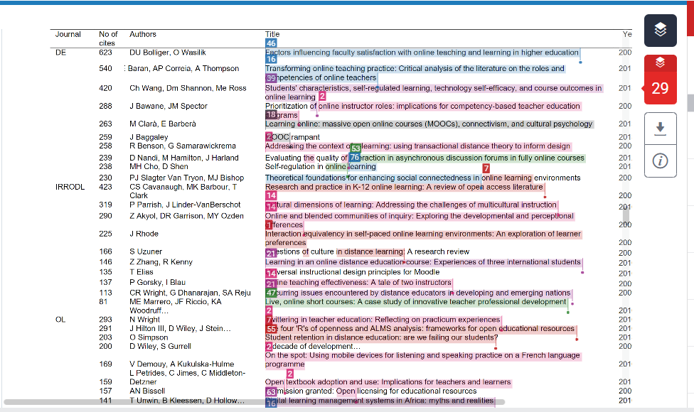

Slide 25
Similarity Index Report

Slide 26
Conclusion
Research is important in solving societal problems and for national development, in order to remain relevant in our various disciplines, we need to write and publish.
Therefore we need the knowledge and skills required to navigate through the web to retrieve relevant information resources. The skills we acquire today will go a long way to help us not only for the successful completion of our Masters and Doctoral programmes but for lifelong learning.
What you publish today may speak volumes about you tomorrow.

Slide 27
Thanks for Listening
Questions
?

Slide 28
Part Two Practical
Online search
the databases, search engine, repository etc

Slide 29
Hands-on exercises
Use the following databases Jstor, DOAJ, search for any topic of your choice
Compare your results, from which database did you retrieve more records that are relevant to the topic
Assuming you checked the similarity of your work and discovered that the percentage is high (30-50), what steps would you take to ensure you reduce the similarity index.

Slide 30
Exercise
Do a search on Google scholar using the Boolean operatives
Search for Political Propaganda
Search for Political Propaganda in Africa
Search for Political Propaganda and Nigeria
Search for Political Propaganda and Nigeria pdf
Compare your results and identify the search
With more Hits
With relevant results

