Slide 1
Electronic Resources: A Vehicle For Expanding the Frontiers of Information Access In The Nnamdi Azikiwe Library, UNN
By
Professor Nwogo Chinwe Ezeani, University Librarian, UNN

Slide 2
Outline
Introduction
Benefits of use of Electronic Resources.
Introduction to online Databases
Scholarly databases: Types available
Tips for Producing excellent scholarly papers
Conclusion

Slide 3
INTRODUCTION
There is no place for any University in the world today without an established research tradition.
The present University Administration has done greatly in this area by enthroning research tradition and increasing research consciousness among the academic staff in the University.
The emerging collaborative research agenda of the University and the support the University Administration has been providing to encourage academic staff in research are important developments for the continued existence and global visibility of the University .
The digital revolution is also playing out in creating new vistas or opportunities for Research and Development (R & D). This has given birth to digital scholarship which requires that with appropriate ICT skills academic staff can harness available and incredible online resource to their own advantage.
It is, therefore, important that we join hands to build the University of Nigeria of our dreams. By engaging in excellent research and adopting or adapting the emerging technologies, we can achieve our collective vision and mission.

Slide 4
Benefits of Electronic Resources
Synchronous multiple access to different users
24/7 access
Very fast access
User-friendly interface that enables easy navigation of pages
Available any time any where around the globe
Timely access to publications, i.e. early cite
Gives useful links to other related topics
Saves space
Very good for visually impaired and other kinds of challenged students.

Slide 5
Overview of Electronic Resources: Conceptual Clarifications.
Online resources- These are information resources that are available online and can be accessed via the internet. These information resources can be of different types such as E-books, E-journals and databases.
Electronic books (E-books)- it is an electronic version of a book that is fully available on the internet. These electronic books can be downloaded or read online if the user has access to them. Though most e-books are freely available online, it is easy to download and read these books on tablet PCs, Ipad with the aid of the e-book reader.
Electronic journals (e-journals)- As the name implies, these are journals that are available online and can be accessed through the internet. These electronic journals have different types of access, some may be freely available in full text, while some may provide free access to only the abstract or table of content. If the electronic journal is not freely available it means that it requires subscription.

Slide 6
Overview of Electronic Resources: Conceptual Clarifications.
Databases- These are collations of different e-books, e-journals or both in one record for easy access and retrieval. These databases can be either subject when they consist of a specific subject or general database which means that it is a combination of different subjects. Some examples of databases are science Direct, JSTOR, Nature, OARE, HINARI etc. These Databases can be accessed either through subscription or the publishers may decide to make the access free. Examples of free Databases are; PubMed, Directory of Open Access Journals (DOAJ) and Directory of Open Access Books (DOAB). These are all efforts to provide information for teaching learning and research in spite of very poor budgetary allocation.

Slide 7
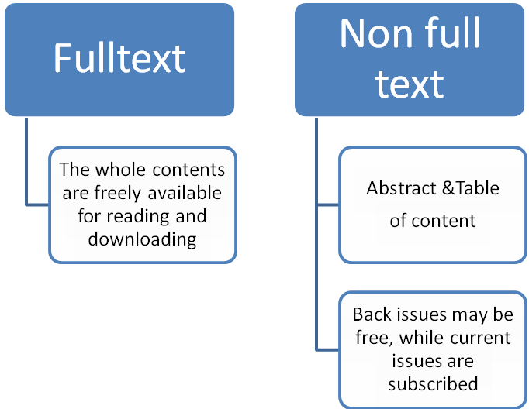
Different types of Online Databases and types of access
Figure 1: Different types of Online Databases and types of access
Figure 1: Different types of Online Databases and types of access
Database
(Subject or General)
E-Books
(Subject or General)
E-journals
(Subject or General)
E-books &E-journals
(Subject or General)
ACCESS

Slide 8
Search Strategies
To access and retrieve the required information from the deep web or pool of resources it is important to develop different search strategies that will facilitate the process and yield results.
The process of search may look tedious but it is good to follow a laid down guide or procedure in order to retrieve useful resources.

Slide 9
A GUIDE ON THE SEARCH STRATEGIES.
Defining Research Topics
Revising the Search
Managing Results
(Print, save)
Developing & Implementing an effective search strategy (identifying concepts)
Assessment of search strategies
Organizing synthesizing communicating information
Locating & Retrieving Information
Evaluating information

Slide 10
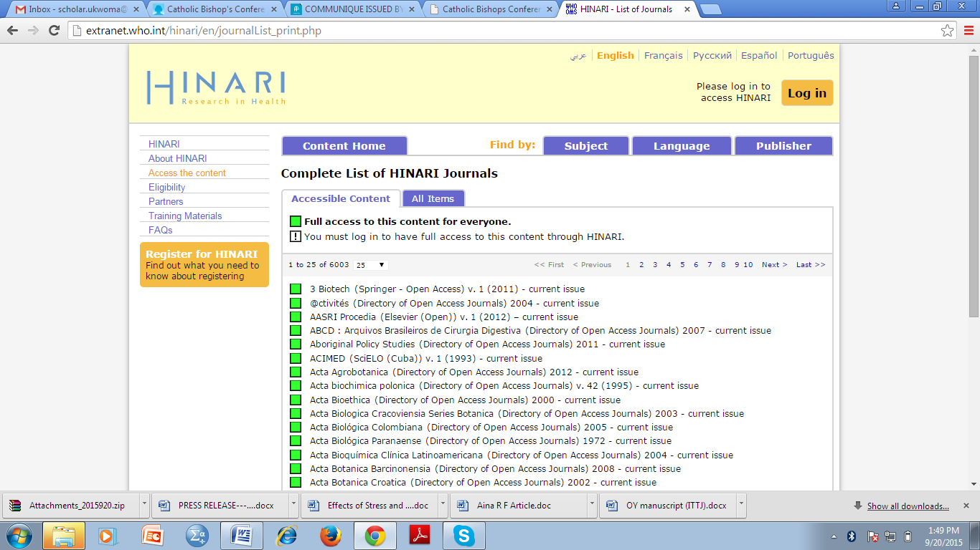
Available Scholarly Databases in the UNN Library.
HINARI

Slide 11
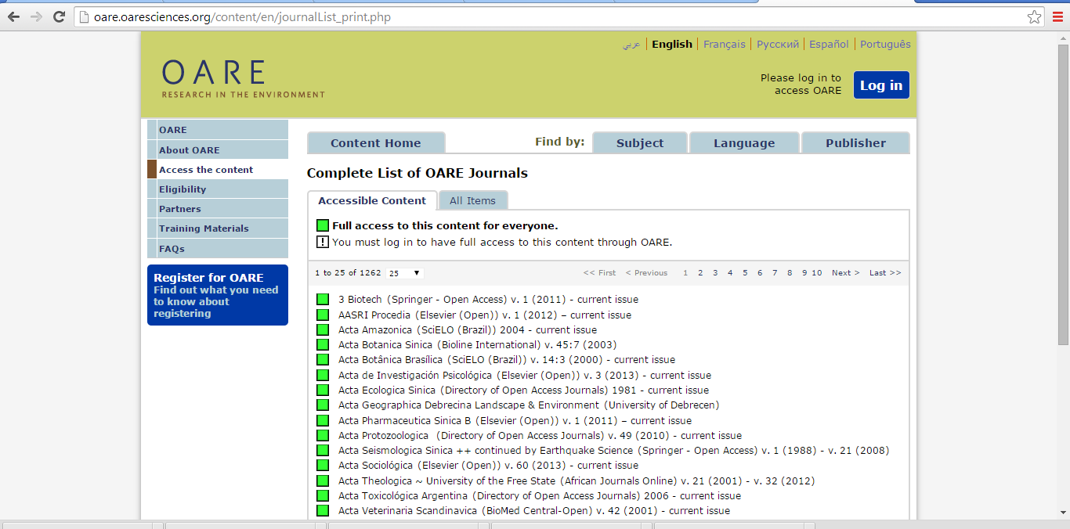
Available Scholarly Databases in the UNN Library.
OARE

Slide 12
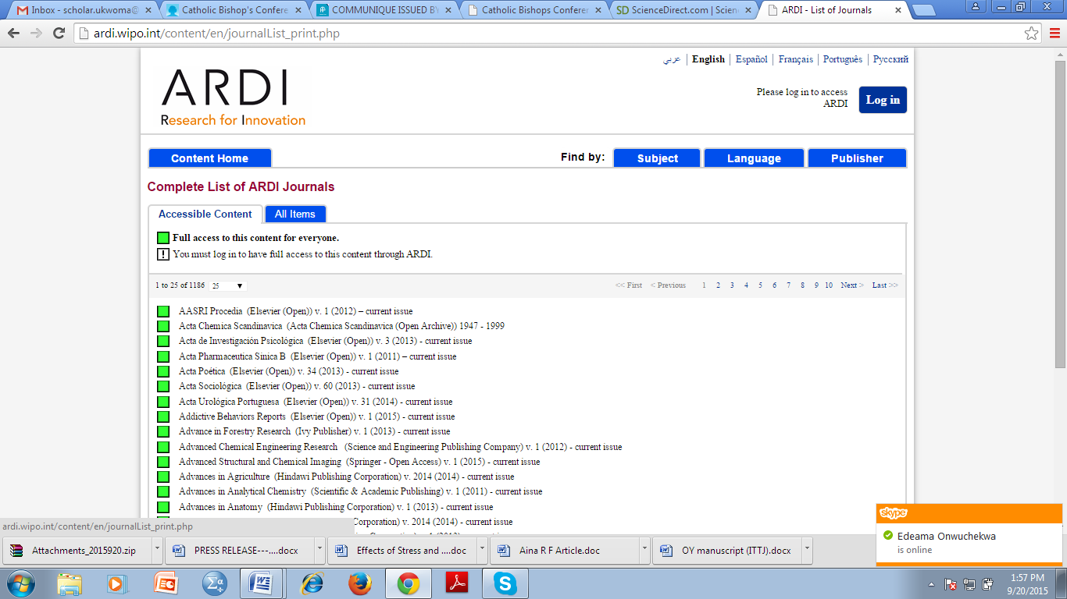
Available Scholarly Databases in the UNN Library.
ARDI

Slide 13
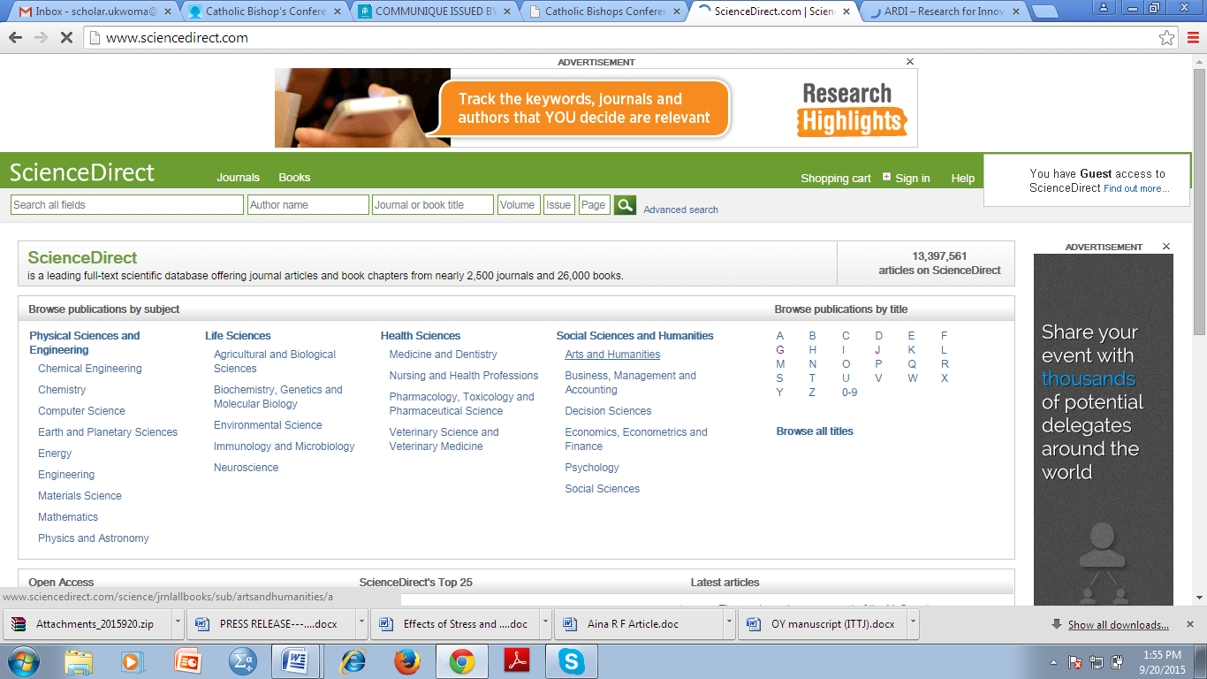
Available Scholarly Databases in the UNN Library.
SCIENCE DIRECT

Slide 14
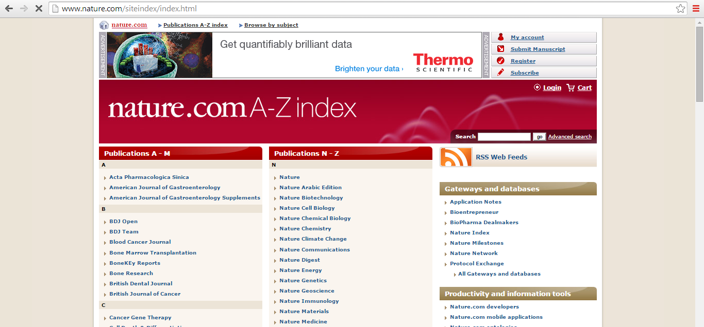
Available Scholarly Databases in the UNN Library.
NATURE PUBLISHING

Slide 15
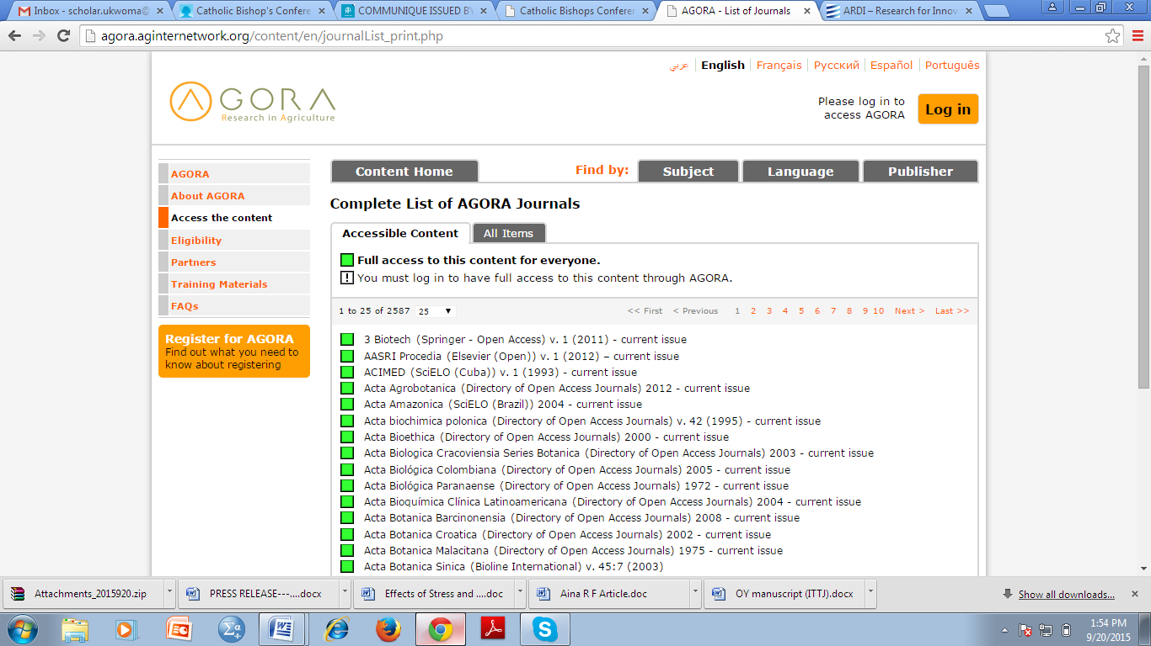
Available Scholarly Databases in the UNN Library.
AGORA

Slide 16
General Tips for Producing Excellent Scholarly Papers.
Mentorship is key if one intends to pursue a formidable career in one's chosen field of endeavor.
Keep abreast of the profession. Read a professional article every day. This saturates one with ideas that will help when one is writing. It keeps the mind fresh.
Maintain very good working relationship with senior professionals
Plan to buy all the gadgets that will make you excel. Buy Smart phones ( you could have two just to make sure that at no time are you cut off from the outside world and from information.)
Save to sponsor yourself for conferences especially conferences abroad. It helps one know what the global trends are and to meet colleagues from different areas of the world for possible networking
Have friends who share the same values and aspirations as you.
Use the library as often as possible.. Ask a Librarian when in doubt. We are paid to assist you.
Use our databases!!!.

Slide 17
Thank You for your time…

