Slide 1
KEYNOTE ADDRESS ON THE OCCASION OF THE 2016 RESEARCH METHODOLOGY WORKSHOP
BY
PROF. P.O. OSADEBE, FAS
DEAN, SCHOOL OF POSTGRADUATE STUDIES
UNIVERSITY OF NIGERIA, NSUKKA

Slide 2
Protocols
The Vice-Chancellor, Prof B.C. Ozumba
Deputy Vice-Chancellor, Prof J.C. Ogbonna
Other Principal Officers here present
Members of the University Governing Council
Deans of Faculty
Heads of various Departments
Other professors and members of University Senate
Our able Post-graduate Students
Lions and Lionesses

Slide 3
Welcome
It is with profound pleasure that I welcome everybody to the 2016 Research Methodology Workshop
I think it may be the first of its kind in the School
It will be a series that will come up every year

Slide 4
Appreciation & Acknowledgement
I want to thank the University Administration for its palpable support that has made today a success.
I would like to extend my thanksgiving to the Workshop Subcommittee of the Board of the School of Post-graduate studies, who worked assiduously to put things together to see the dream of this workshop become a reality.

Slide 5
Topic of the keynote Address
BUILDING YOUR CAPACITY TOWARDS GLOBAL COMPETENCY

Slide 6
Focus subtitles:
Capacity Building
Global Competency framework
Quality Assurance in Higher Education
World trends in higher education

Slide 7
Introduction
In recent years, there have been incessant criticisms of our higher educational institutions that they are turning out graduates that are unemployable; unemployment in the sense that they do not possess adequate training, knowledge, skills, etc, matching new global standards.
The new global trends were recently necessitated by breakthroughs in science, technology and innovations which include Information Communication Technology (ICT).

Slide 8
Introduction
The National Universities Commission (NUC) is the national agency charged with the responsibility among others, of overseeing and regulating Nigerian Universities with the noble purpose of assuring the quality of university products that are turned out yearly.
The quality of the graduates is a reflection of the knowledge, competencies and skills acquired in the process of their training in their various fields of specialisation.
NUC therefore, constantly carry out quality assurance exercises in form of regular accreditation visits.
Criteria set out to assure adequacy of individual, infrastructural and institutional capacities are assessed and/or reassessed periodically.

Slide 9
Quality Assurance in Higher Education
Quality has been described as a generic concept which is difficult to define in one simple generally acceptable way.
However, it has been defined as “the characteristics of a product or service that bear on its ability to satisfy stated or implied needs (American Society for Quality, 2008, Nwizu, 2016).
It is the state of a product or services being free of deficiencies. It has also been viewed as having implications of excellence, consistency, fitness for purpose, value for money and transformation (Harvey & Green, 1993).

Slide 10
Quality Assurance
This is defined as the process of defining and fulfilling a set of quality standards consistently and continuously, with a goal of satisfying all customers, producers and the other stakeholders (Tian & Amin, 2007).
It is also defined as the systematic monitoring and evaluation of the various aspects of systems, projects or programmes in order to maximise the probability of standard being achieved for specified performance (CommonWealth of learning, 2012) .
Quality Assurance has also been opined to mean the creation and operation of standards, procedures and management systems which guarantee the quality of a product (e.g drug) (Olaniyi,2005).

Slide 11
Quality Assurance in Education
It is a system for monitoring the entire education process from the point of acquisition of the educational raw material (newly admitted students) to its conversion into a finished product (graduate) to be made available for national development.

Slide 12
Quality Assurance in Education
Also viewed as a useful method of improvement, modernization and internationalization of higher education through procedures designed to assure and improve the quality of provision as it ensures the quality of academic (teaching-learning process & curriculum) and structural (building & physical facilities) provisions of courses and allow for an objective review of their quality ( Mackoww and Witkoski; 2005).

Slide 13
Quality Assurance
Quality Assurance can be:
Internal Quality Assurance
External Quality Assurance

Slide 14
Internal Quality Assurance
Is a self-regulatory and intra-institutional mechanism set up by various institutions themselves for the purpose of ensuring that their programmes are of desired quality.
Such mechanisms are course unit system with its structured lecture hours, committee examination system, research seminars, external moderation of questions and external examination, student supervision and university senate moderations of programmes and results, among others.

Slide 15
External Quality Assurance
External quality assurance represents all regulatory standards and frameworks set up by national and professional regulatory authorities. Such external assurances are usually periodic.
In Nigeria, NUC serves this purpose, plus the efforts of professional bodies like Pharmaceutical Council of Nigeira(PCN), Medical and Dental Council of Nigeria Legal Council of Nigerial etc.
The post-graduate courses (PGC 601- Research methodology and application of ICT in Research; and PGC 701-Synopsis and Grant writing) for which this workshop is organised to serve as the practical/interactive aspect, are part of the newly introduced benchmark for PG curriculum in Nigerian Universities).

Slide 16
…
Their introduction is the outcome of continuous efforts to ensure that knowledge and skills acquired by our post-graduate students are constantly improved to measure up with the constantly changing world’s multidisciplinary perception of modern education, knowledge and by consequence, competency.
These courses and seminars are designed to improve your versatility, impart new skills and broaden your knowledge base beyond your immediate discipline, thereby produce a multidisciplinary personality that will smoothly fit into our ever- changing inter-connected world and that can easily and efficiently deliver his professional services with desired outcomes.

Slide 17
Global Competency Framework
New global competency frameworks have been developed and are currently been applied for building the capacity of individual and community of individuals.
In the dynamic and changing world we find ourselves, no individual, system or institution can stand up at anytime and declare that it has arrived

Slide 18
…
Against this backdrop, it becomes imperative that capacity of individuals, infrastructure and institution will continue to be improved on to meet with emerging standards and cutting-edge concepts of competency as it relates to education, training, knowledge and skills.
The impact of adequate capacity on quality of service delivery and corresponding outcomes cannot be underscored.

Slide 19
Global Competency
Before you can render effective service in this changing world of the 21th century, you must be globally competent.
What does this mean?

Slide 20
Global Competency
This is defined as an individual’s readiness(preparedness) to participate in a complex interconnected world.
It is a measure of the individual’s willingness to explore how the world works.
Global competence is measured in terms of knowledge, Skills, values/attitudes, and behaviours.

Slide 21
Global Competency-skills
Research skills
Communication skills
Coping and resiliency skills
Critical and comparative-thinking skills
Creative –thinking and problem-solving skills

Slide 22
Global Competence- Values and Attitudes
Openness to new opportunities, ideas and ways of thinking
Self-awareness about identity and culture, and sensitivity and respect for differences
Empathy and valuing of multiple perspectives
Comfort with ambiguity and unfamiliar situations( calm in emergence of uncertain situations)

Slide 23
Global Competence-behaviours
Should be such as seek out multiple opinions and perspectives
Form opinion based on exploration and evidence
Taking informed actions on issues that matter to him or her
Sharing knowledge and encouraging discourse

Slide 24
WHO Global Competency Model -Core Competencies
Communicating in a credible and effective way
Knowing and managing oneself
Producing results.
Moving forward in a changing world.
Fostering integration and teamwork.
Respecting and promoting individual and cultural differences.
Setting example (Role model)

Slide 25
CAPACITY BUILDING

Slide 26
Definition - Capacity
This is defined by Merriam-Webster Dictionary as an individual’s mental or physical ability in which instance it is synonymous with skill or aptitude
It is also defined as the facility to produce, perform or deploy
It can also represent maximum output

Slide 27
Capacity Building
Capacity Building has also been defined as the process of assisting people to develop the technical and decision-making skills to address their own needs for improving the living standards and prosperity of their own people and building an environmentally sustainable society (Unknown source).

Slide 28
…
The building of human, institutional and infrastructural capacity to help societies to develop secure, stable and sustainable economies, government and other institutions through mentoring, training, education, physical projects, infusion of financial and other resources and most importantly the motivation and inspiration of people to improve their lives (General Henry Hatch, 2004).
Notes:
t

Slide 29
Capacity Building
This has four approaches:
Individual (Human) Capacity building
Institutional Capacity Building
Infrastructural Capacity Building
Professional Capacity building

Slide 30
Individual Capacity Building
This involves improving the competency of the professional individual through building the capacity criteria, namely
Knowledge
Education
Training
Skills

Slide 31
...
This is the building of the capacity of an individual to develop personal mastery, contributes their ‘gifts’ and find balance in their lives (life skills-e.g. taking care of whole selves).
The purpose of individual training is to enhance the functional knowledge, improve the job-related skills and change the attitude of municipal functionaries in an establishment.

Slide 32
Infrastructure Capacity Building
This involves-
Repairing and acquiring of new equipment
Building of new housing facility to accommodate new wards, units, operations and procedures
Guaranteeing of water, power and sanitation facilities appropriate for a 21st century institution.

Slide 33
Professional Capacity Building
This involves building one’s proficiency and propriety (suitability) in the areas of:
Knowledge(update knowledge of developments in one’s area of discipline
Skills
Values and attitudes
Appropriate behaviours (including moralities and ethics of your profession)
Lifestyle

Slide 34
Institutional Capacity Building
This involves extending and expanding the scope of services normally delivered by an institution
Introducing new services
Ensuring that competitive salaries are paid to minimize attrition more especially of staff already trained and experienced
Increasing the number of professionals in different professional units to cope with the expanded scope of services
Infusing additional funds calculated to match the proposed expansion

Slide 35
World Trends in Higher Education
1) Growing privatisation of tertiary education
In Nigeria, more and more private universities and higher institutions are approved. Some have already found their way up in the webometric rating of universities in Nigeria.
Government subventions to universities are becoming more and less adequate to pay even salaries. Most institutions are depending more and more on IGR to fund capital projects and day- to- day running of their affairs.
This development have being identified as a global trend. In USA, Michigan State University(MSU) used to receive 80-85% of its budget from Government. This has now drastically been reduced. (Collaboration Team to Faculty of Agric from MSU)

Slide 36
2) There is also the global paradoxical problem of rising demand for the higher education and less available job for employment of the products. This brings the need for entrepreneurship (self-employment) to be emphasized at the training level. Hands-on practical education and skills should be stressed in the curricula. There is currently the trend in Europe and America.
Higher education all over the world is experiencing big changes in university curricula to encourage research that support innovation and creativity, agricultural outreaches and extension services while historical theoretical knowledge are being curtailed.

Slide 37
3)There is also the trend of increasing use of ICT in teaching and research. The use of ICT in teaching serves a lot of teaching time and gives more time to the teacher for interactive sessions. It is amenable to easy multiplication and circulation.
In silico research, Bio-informatics, Computer-aided drug design (CADD) are all outcomes of innovative technology)

Slide 38
…
4)There is also a widening gap in the creation of new technologies between the universities in the west and those of developing countries. This calls for introspection with a view to set goals to retrain and re-position individual human (and hence institutional) capacities to achieve competency in innovative research and technology- based knowledge. These are inevitable for our societal advancement, otherwise we will continue to be slaves and compulsory consumers.

Slide 39
Our take
These developments call for astuteness and focus among persons admitted into Universities and other institutions of higher learning so as to ensure that there are sufficient return on individual and the nation’s investments on human capacity development.
Since learning is an issue of “garbage in , garbage out”, adequacy of imparted knowledge and skills must be assured through regular review of curricula and incorporation new global standards.

Slide 40
…
Multidisciplinary knowledge and skills-oriented education have become globally trendy.
This workshop, including the University Library-anchored training on Electronic library resources, introduction to online databases, use of Turnitin software and introduction to reference management, which are designed to run on annul basis, is intended to introduce you to and equip you with some research skills and hands-on training that will transform you into a new-age globally competent individuals and community of alumni

Slide 41
Repositioning of Post-graduate Studies: Revised Vision and Mission Statements:
In January, 2015, the Vice-Chancellor, Prof B.C. Ozumba set up a 16-man Committee (made up of about 95% professors drawn from different faculties), named, ‘Committee on the Repositioning of Post-Graduate Studies in UNN.
The Committee was charged with 13 terms of reference, notable among which are-

Slide 42
Investigate and recommend ways by which services and programmes at the UNN Post-graduate School can be improved to meet up with international best practices
To look into and make recommendation as to how to improve the capacity of the PG School with a view to meet the mandate of the first- generation University on 60:40 ratio of PG to undergraduate admission.
To formulate current vision and mission statements for the school and proffer strategies for realising them;

Slide 43
…
To work out modalities to facilitate prompt registration and graduation of postgraduate students of all levels;
To work out procedures to be adopted to implement the new National Universities Commission (NUC) guidelines (BMAS) on contents and progression of postgraduate programmes in Nigerian universities;

Slide 44
The Revised Vision and Mission Statements are as follow
Vision Statement
Through research and innovation, to become a globally reputed first-rate School of Postgraduate studies
Mission Statement
The School aims to attract, educate, train and transform qualified persons to high level manpower that are thoroughly equipped with adequate and update knowledge and specialized skills in research and innovation and deployable for first-rate development and improvement in all fields of human endeavour.

Slide 45
Since the submission of the report of the committee, the University Administration has been implementing the major points of the recommendations.
Some of the changes that have taken place in the post-graduate regulation and matters, including this workshop are outcomes from there.
I encourage you to pay attention, listen carefully to all the resource persons, and learn. Active listening is the first step towards effective learning. May God bless you all.

Slide 46
Quotation by Voltaire
The BEST is the enemy of the GOOD
-Voltaire

Slide 47
If you don’t know where you are going , any road will lead you to your destination.
Let us therefore be goal-oriented, team-spirited, focused and receptive to innovations and changes.

Slide 48
Bibliography
University of Leeds Global Competency Framework
WHO Global Competency Model under human resources services
Merriam Webster Dictionary: An encyclopedia of Britannica Company
General Henry Hatch, at March 29 2004 workshop sponsored by the office of Science and Technology Advisor to the US Secretary of State.

Slide 49
Nwizu, S. C. Higher Education programmes in Nigeria. 114th Inaugural lecture of the University of Nigeria, Nsukka, Oct, 2016
Nwizu S.C (2011) International Journal of Educational Research 11(1)
Speech of a collaboration team from Michigan State University with Faculty of Agriculture, September, 2016
Harvey L and Green, D(1993) Defining Quality Assessment and evaluation in higher Education

Slide 50
Olaniyi A.A. (2005). Drug Quality assurance and Pharmaceutical Analysis.
American Society for Quality (2008). Glossary on quality. Retrieved/20/07/2008.

Slide 51
THANK YOU ALL

Slide 53
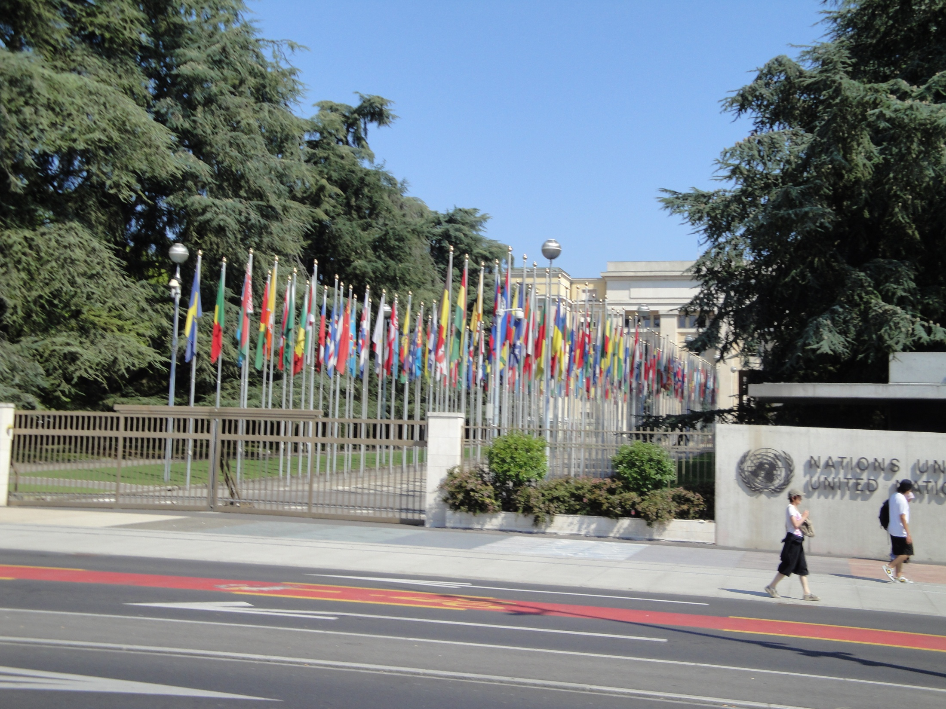

Slide 54
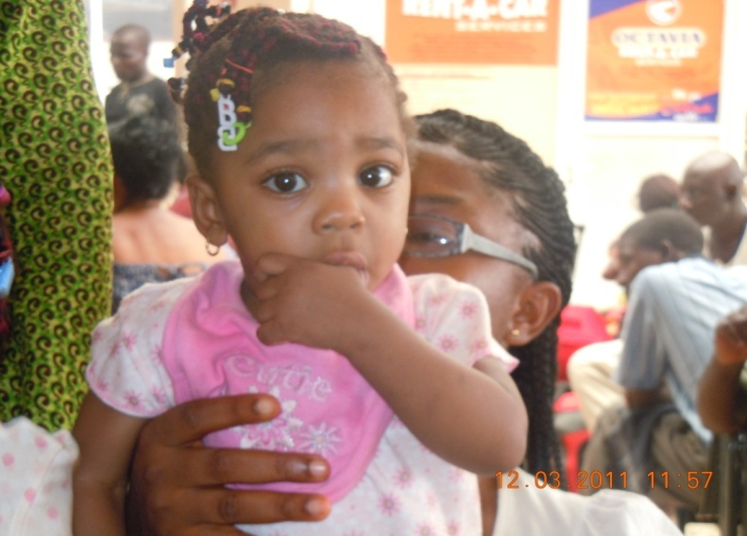
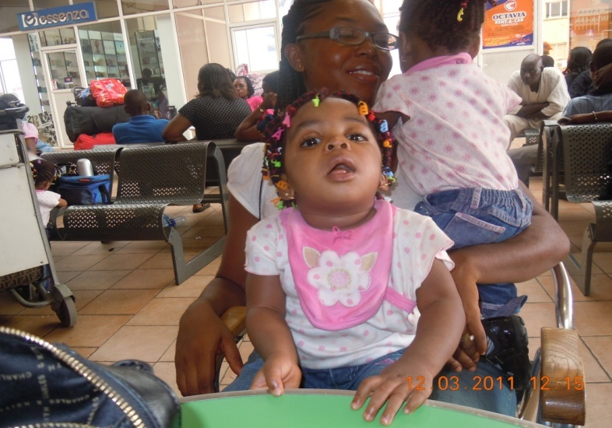
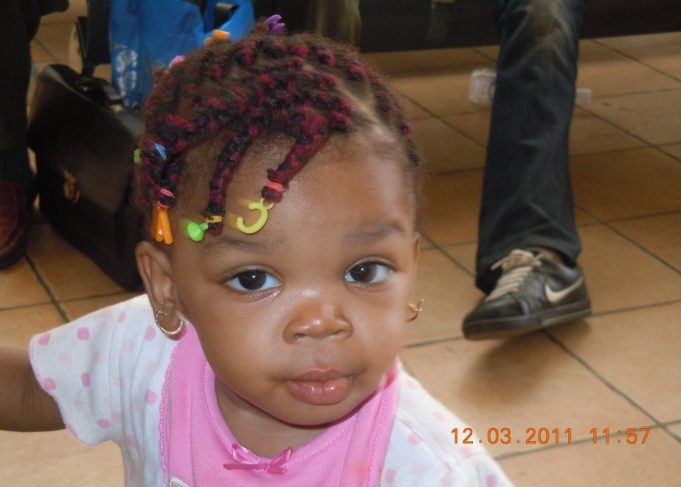
Products of God’s goodness and competent Healthcare service

