Slide 1
UNIVERSITY OF NIGERIA, NSUKKA
COLLEGE OF POSTGRADUATE
STUDIES
Course Title: PGC 601
Research Methodology In Medical Sciences/ Health Sciences / Environmental Sciences/Institutes/Centres
By
Professor F.E. Ejezie PhD
Dept. of Medical Biochemistry
Faculty of Basic Medical Sciences
College of Medicine fidelis.ejezie@unn.edu.ng; 08034069138

Slide 2


Slide 3
GOALS AND OBJECTIVES
At the end of the lecture, the students will be able to:
Define Research/Research Methodology
Distinguish between Research Methodology & Research Method
Outline the major stages of a research project
Outline the aims & objectives of a Research project
Write a research question for a research topic
Select a design and method for a research topic
Write a discussion & conclusion on a research topic
Write citations & references
Outline the Chapters of a research project report
Define Plagiarism

Slide 4
What is Research?
To research is to investigate systematically
Systematic investigation to find new facts, knowledge and information on a specific topic.
Research anchors on scientific reasoning
Research leads to new and creative outcomes
It involves a movement from known to unknown
Involves the identification of a problem
Is done through planned collection, analysis and interpretation of data
Research can be :
  Qualitative
  Quantitative
  Descriptive
  Mixed

Slide 5
Why do Research?
Research allows you to pursue your interests, to learn something new, to solve a problem and to challenge yourself in new ways
Research outcomes may be used:
To improve quality of human life and society
To develop different spheres of life
For academic exercises – eg. award of Degrees, Diplomas, Fellowships, Certificates
For promotion in offices (through publications)

Slide 6
Research Methodology
The various steps/stages adopted to carry out a research project.
A way to systematically solve a research problem.
Set of techniques used to carry out a research
Simply the scientific study of how research is done
In other words, research methodology is about the principles that guide research practices.

Slide 7
Research Method
The strategies, processes or techniques utilized in the collection of data in the course of a research
Different types of research methods use different tools for data collection
Experimentation
Surveys
Interviews
Observations
Questionnaires
Case studies
Mixed methods ………… etc
Research Methods may be carried out in the laboratory, clinic, field work, studio…..etc
Thus, Research Method is a sub-set (an aspect) of Research Methodology.

Slide 8
Three (3)Major Stages of a Research project
Planning/Introduction
Execution
Conclusion

Slide 9
Stage1. Planning (Introduction) Stage
Step 1: Identify the Problem by:
Identify & develop the research topic (professional and personal interests)
Background information on the topic after some preliminary literature search
Identify gaps in the current knowledge that your research can address
Develop the research question
Formulate the research hypothesis

Slide 10
Planning (Introduction) Stage cont’d
State the research aims & objectives.
Concise statements that describe what the research intends to achieve. Must be:
specific
Measurable (use action verbs - to determine, identify, verify, calculate, describe, reduce, compare, measure, correlate .......etc)
Non-ambiguous ( avoid such verbs as : to appreciate, understand ,believe, realise ........etc)
achievable
realistic
time-bound

Slide 11
Research Question
A research question is a question that a study or research project aims to answer
Is the focal point on which your entire research builds and unfolds in the subsequent Methods, Results, and Discussion
Must be answerable using quantitative and/or qualitative data, or by reading scholarly sources on the topic to develop your argument.
A research question can be refined or changed as the related literature is reviewed and framework for the study developed.
Avoid subjective words like good, bad, better and worse.

Slide 12
Research Question:
Research Topic: Assessment of antioxidant micronutrient minerals in pregnant women in Enugu Metropolis.
Research Question: What is the antioxidant micronutrient mineral levels (e.g., selenium, zinc & copper) in pregnant women in Enugu Metropolis, and how do these levels vary across different stages (trimesters) of pregnancy and socioeconomic factors?
This research question seeks to investigate the levels of antioxidant micronutrient minerals in pregnant women and explores potential variations based on the stages of pregnancy and socioeconomic factors.
It sets the stage for a study that could contribute valuable insights into the nutritional status of pregnant women in Enugu Metropolis and its potential implications for maternal and fetal health.

Slide 13
Research Question: cont’d
Research Topic: The Impact of Parental Academic Standard on Children's school performance.
Research Question: What is the influence of parental academic standard on the school performance of children?
Research topic: Determination of the effect of parity on obesity in pregnant women in south-East Nigeria.
Research Question: What is the relationship between parity (number of previous pregnancies) and the prevalence of obesity among pregnant women in the South-East region of Nigeria, and what are the potential contributing factors to this relationship?

Slide 14
Hypothesis Formulation
A hypothesis is a tentative statement about the relationship between two or more variables in a research topic.
Is a prediction of the result of the research problem
It is a specific, testable prediction about what you expect to happen in a study.
Researchers must be able to test whether a hypothesis is true or false at the end of the study.
Research Topic: The Impact of Parental Academic Standard on Children's school performance.
Hypothesis: Academic standard of parents has influence/impact on Children's school performance.
Alternative: Academic standard of parents has no influence on Children's school performance.

Slide 15
Planning (Introduction) Stage cont’d
Literature Review through (sources):
Journal articles (major)
Abstracts
Conference proceedings
Textbooks
Dictionaries and encyclopaedias
Museums & galleries
Electronic databases
Internet & intranet resources
Newspapers/magazines
Interviews
Technical reports …….. etc

Slide 16
Review of Literature cont’d
Main objectives of literature review include:
The content covers existing research reports, theories and evidences.
Prevents duplication
Identifies contested issues
Provides facts for the justification of research project
Helps in formulation of objectives and research questions
Provides a guide for choice of methods, sample size, & statistical analysis (design)

Slide 17
Stage2. Execution of Research
(Research Design)
Is a critical decision on the research methods and techniques to use (eg. Experiments, surveys, interviews, observations)
Develop an operational plan and timeline for the study
Arrange materials and equipment to be used
Determine your sample size
Available facilities /equipment/materials (Practicalities) and constraints - Lab, clinic, studio …….etc.)
A research design is a framework created to find answers to the research questions

Slide 18
Research Methods
The research method you use depends on the type of data to collect and need to answer your research question.
Gives your operational, logical plan for data collection
List of equipment to be used
Sample size and groups (test & controls)
Method of collection of sample
Gives data sources and collection method
State your Analytical Methods (Student’s t-test, SPSS etc.) – statistical or qualitative method
Obtain ethical clearance from appropriate authorities.

Slide 19
Sample Size Estimation
The size of the sample is very important for getting accurate, statistically significant results and running your study successfully. The higher the sample size the more reliable the research result.
Before you can calculate a sample size, you need to determine a few things about the target population and the level of accuracy you need:
Define population size or number of subjects
Designate your margin of error
Determine your confidence level
Estimate your standard deviation.

Slide 20
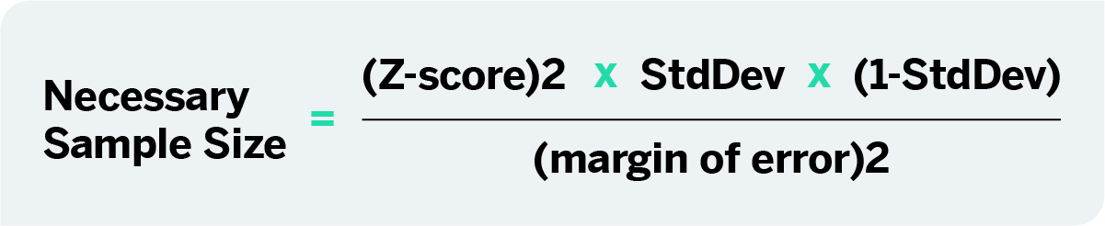
Sample Size Estimation
There are many formulas for calculation of sample sizes. The most common formula for unknown populations or populations of about 10,000 is:
Cochran Formula (Cochran, 1977)
n = Z²p(1 – p)/e²
Z is the Z-score corresponding to your desired confidence level (e.g., 1.96 for 95% confidence)
Choose the margin of error that is acceptable for your study (typically a small value like 0.05).

Slide 21
Research Results
Present the results logically showing how they provide answers to your research question and relate to your objectives
Analyse the results using appropriate computer programmes
Present your research findings using tables, figures, charts, and graphs as appropriate.

Slide 22
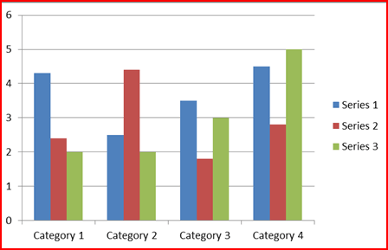
BAR-CHART

Slide 23
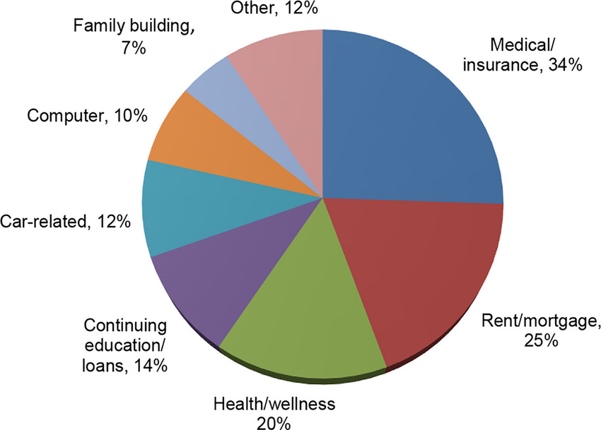
Pie Chart – Family fund expenditure

Slide 24
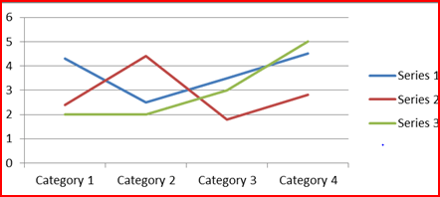
LINE-GRAPH

Slide 25
Conclusion Stage (3) : Discussion
Give a Summary of the key findings from your study
  Explain what the results mean in the context of your research questions and objectives.
  Highlight any patterns, trends, or relationships that emerged from the data.
  Discuss how your findings compare to what has been reported in the existing literature.
  Identify any consistencies or inconsistencies with previous research.
  Explain how your study contributes to the body of knowledge in your field.
  Acknowledge the limitations of your study. These may include issues related to data collection, sample size, methodology, or other constraints.

Slide 26
Conclusion
Summarize the most important points of your discussion/findings
Make Recommendations based on research results/data
State the implications of your research.
Suggest areas for future research based on the gaps or unanswered questions revealed by your study

Slide 27
References
There are different reference styles used in research reports:
APA (American Psychological Association) system - most popular
Harvard system
Vancouver system
MLA (Modern Languages Association) system
MHRA (Modern Humanities Research Association) system
Oxford
APA Style is the most popular citation style and used in UNN.
Generally, a reference will include authors' names and initials, date of publication, the title of the article, name of the journal, volume and issue, page numbers and DOI.

Slide 28
APA System of References
Authors’ names are written in alphabetical order
The authors' last names first followed by the initials ---from in-text citation
Publication year in parentheses
Title of the article
Title of Journal
Volume of Journal
Issue number of Journal
Page range of Journal
DOI - Digital Object Identifier (if available)
DOI is a set of numbers, letters and symbols used to uniquely identify an article or document, and to provide it with a permanent web address (URL).
Ejezie F.E., Nwagha U.I., (2011). Zinc concentrations during pregnancy and lactation in Enugu, South-East Nigeria. Annals of Medical and Health Sciences Research, 1(1): 69-76.
The phrase "et al." Latin, stands for "et alia" which means "and others." a Latin abbreviation that is commonly used in references to indicate that there are multiple authors of a work, and not all of them are listed in the reference.

Slide 29
Chapters of Research Project Report
The Preliminary pages (title, approvals, acknowledgement, dedication, abbreviations, tables & figures, abstract, table of contents……….etc)
Chapter 1 – Introduction (Justification/Statement of problem & objectives)
Chapter 2 – Literature review
Chapter3 - Materials & Methods
Chapter 4 - Results
Chapter 5 – Discussion
Chapter 6 - Conclusion & Recommendations
References
Appendix (optional)

Slide 30
Plagiarism (Intellectual Ownership)
Plagiarism is the act of copying someone else's words, ideas, research, or creative work (such as written text, images, music, or data) without giving them proper acknowledgement and presenting it as your own.
It is considered unethical and a breach of academic or professional integrity.
Consequences for plagiarism can include academic penalties, damage to one's reputation, and legal action in cases of copyright infringement
Plagiarism is taken very seriously in educational/ research institutions, journalism, and many professional fields.
Always give proper credit and citation to the original sources of information and ideas in your research.

Slide 31


