Slide 1
UNIVERSITY OF NIGERIA, NSUKKA
COLLEGE OF POSTGRADUATE STUDIES
Access to Electronic Resources and use of Turnitin for Similarity Check: A Vehicle for Expanding the Frontiers of Academic Integrity
Dr S C UKWOMA
scholar.ukwoma@unn.edu.ng

Slide 2
OUTLINE
INTRODUCTION
Sources of information
Academic Search engines
Access tools
ELECTRONIC RESOURCES AND SEARCH STRATEGIES
Simple search
Advanced search
Systematic search
Snowballing – following a thread
Refine your search
Evaluate your search
PLAGIARISM
Turnitin

Slide 3
GOALS AND OBJECTIVES
By the end of this presentation students should be able to:
1 identify the online resources available at Nnamdi Azikiwe library
mention the search strategies to adopt in searching for information resources
know how to analyze their Turnitin report
identify some steps to take to avoid plagiarism

Slide 4
INTRODUCTION
Literature search is very important for a good research work, this helps to identify relevant information to be used by the researcher. It also helps to know new areas that a researcher can delve into.
These can be achieved through Access to information resources, by knowing the available databases and how to navigate through them.
Therefore as a researcher, you should know how to use the information resources; know when to paraphrase, cite literatures used and reference the sources used in your research work.

Slide 5
Sources of information
Primary sources
Interviews
2
Secondary sources
Review articles
3
Tertiary sources
Encyclopedia
experiments
Academic books
Indexes
1

Slide 6
Academic search engines
Google Scholar
Microsoft Academic
Base
Core
Science .gov
Semantic Scholar
Baidu Scholar
RefSeek
(Williams, 2020)

Slide 7
Access tools
These are services and platforms used in locating different types of information resources-
Some access tools are not free while some maybe attached to a Database eg.
Library catalogues- covers library collections eg books, serials, any other materials the library subscribes to.
Repositories- contains institutions research output eg. Articles, conference proceedings research data etc.
Indexes- bibliographic citation index used in retrieving quality information resources
Abstracts-

Slide 8
These are resources that are accessed online. Some of them maybe open access while some are subscription based
Open access resources are those we can access without payment. Subscription based resources you can only have access to the resources through your institution or you can pay for it yourself
For some of these resources that are paid for there authentication is necessary in order to access them i.e username and password. Or it may be IP based
Electronic Resources

Slide 9
Examples
ProQuest; E-Library and Ebooks database https://www.proquest.com/?accountid=145055
Research4life; https://login.research4life.org/tacsgr1portal_research4life_org/
Directory of Open Access Databases; https://www.doaj.org/
FOR MORE INFORMATION VISIT; https://www.unn.edu.ng/libraries/online-resources-2/

Slide 10
What next ?
To have a grip of your research,
Knowledge overview of your research topic is important
You need to read through some tertiary sources of information like, encyclopedia, professional publications, book reviews, etc.
Then narrow your topic by asking yourself; what do I want to find out? Where? Who? Why do I want to do this work? And then how?
These questions will help to create a guide.

Slide 11
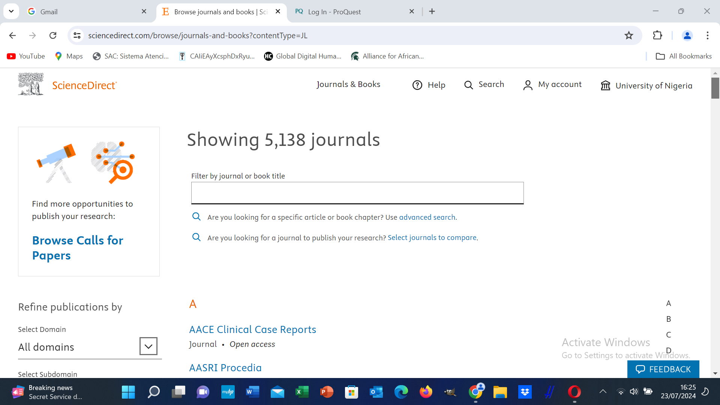
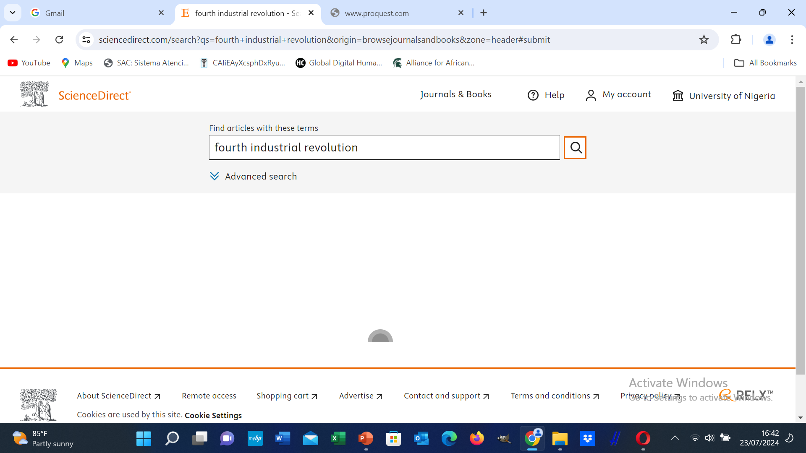
Search Strategies
Simple search using either the keyword, subject or title

Slide 12
Performing a simple search Simple search
Is a quick first search
Good when searching for broad topic
You can search by entering a single phrase
The title of the journal
Can search through library catalog, google scholar

Slide 13
Advanced search

Slide 14
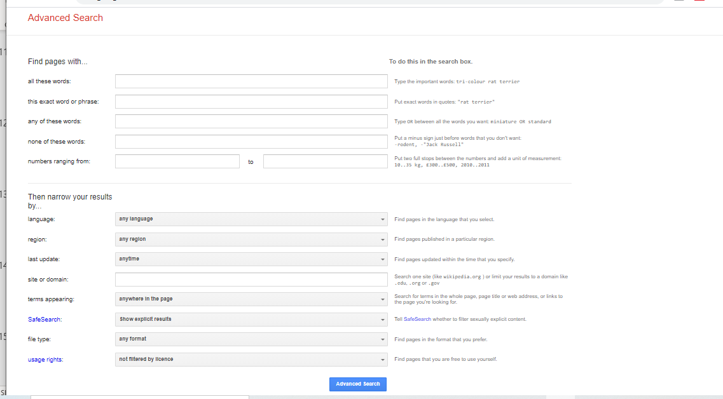

Slide 15
Systematic search
Is more comprehensive
To identify all relevant studies on your research topic
To organise and tackle the search process in a structured manner
Know the key concepts
You choose your, database, keywords or search terms and the search method which should reflect in the result.
You can build the research query, Boolean operators, advanced search techniques etc.
It enables you to identify gaps in the existing research.
In this way you also minimise the risk of reproducing already existing research.

Slide 16
Snowballing – following a thread
It helps you to retrieve information resources quickly
You can start with your key publication based on your research subject
The reference in that publication will lead you to other important information resources
With this method other related publications can be retrieved.

Slide 17
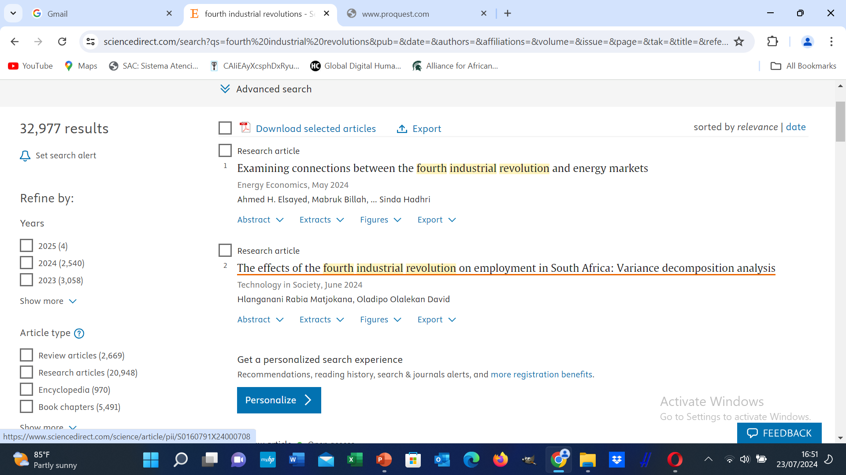
Refine your search

Slide 18
Refine search results
To refine your search results know that there is no perfect result therefore;
Think critically based on your research focus, the retrieved information are they relevant for my purpose
Will they answer my questions
Your can filter your results by using some search criteria, such as relevance, recency, geographical scope etc.
This helps to evaluate your search results and to retrieve appropriate information.

Slide 19
Improve your search or refine your result using search filters
Truncation
Enter the root word eg child* takes care of child, children, childlike, childhood,
It broadens your search by various word endings
Phrase searching -
Limiting search technique
The terms must be close to each other in the order its presented.
It is achieved by using quotation “Eze Jane”
Wildcat
It takes care of irregular plural or American and British spellings
N/B always check through the database help menu some may use different symbols*

Slide 20
Evaluate your information resources
Authority | Accuracy | Objectivity | Coverage | Currency
Who is the author | Is the information-based facts | How objective is the information | Is the coverage basic or comprehensive | The date of publication
Is the author affiliated to an institution or organization | Is it published in a peer reviewed journal | Is there any political under tune | Did they provide any link that explained the coverage | The last update on the website
Educational background or experience | When was the last update | Is it informing or persuasive | What is the depth of the information | What of the links are they up to date
Area of specialization | How accurate is the information on the web page | The tune of the language | Are you satisfied with the information | Do the links point to exiting links
Track record of research output | Any editor or reviewer
Visibility
https://www.research4life.org/training/

Slide 21
Some Tips
Form the habit of reading through literature you downloaded.
Use reference management tools eg Mendeley, Zotero etc.
Do not use copy and paste is not a good practice
Printing out the document could help you read the works properly.
Always acknowledge sources cited in your work, remember you are standing on the shoulders of giant.

Slide 22
Plagiarism
Plagiarism is a conscious and deliberate appropriation of an intellectual work that belongs to someone else.
(Leitão, H, Simões, M, De Almeida & Martínez-álvia, D, 2019)
Unethical use of information.
Students cheat fellow students.

Slide 23
Side effects of plagiarism
In some cases it affects your job.
Withdrawal of articles/publications.
Academic discipline (disciplinary committee).
Creates a bad record.

Slide 24
How to avoid plagiarism
Develop good writing practice.
Learn to cite properly and correctly.
Direct quotation/
Paraphrase.
Summarize.
Avoid copy and paste.
Ensure you reference all ideas you got from a book, internet source, etc.

Slide 25
Turnitin
Is a tool to check the originality of research works of students and academics.
It helps to stay away from plagiarism
Many universities in the world has adopted it to ensure academic integrity in their institutions and ensure researchers write original works
www.turnitin.com

Slide 26
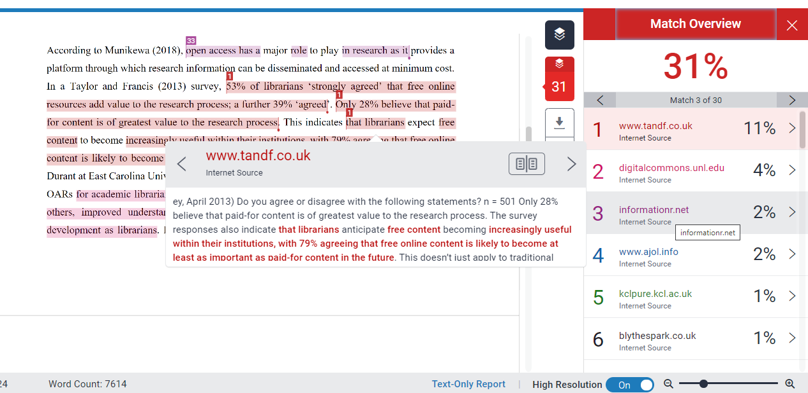
Overall similarity index showing material overlap
Individual source index- helps in interpretation
Source view showing overlap

Slide 27
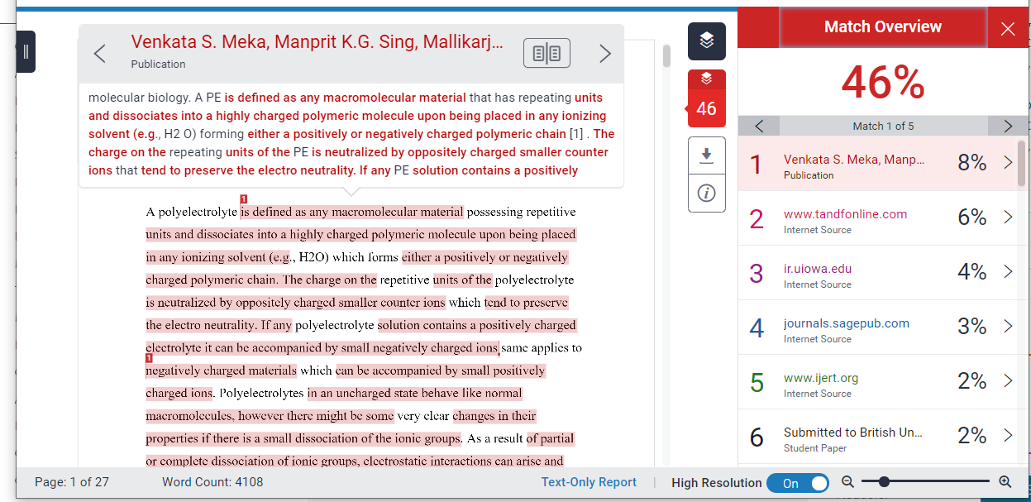

Slide 28
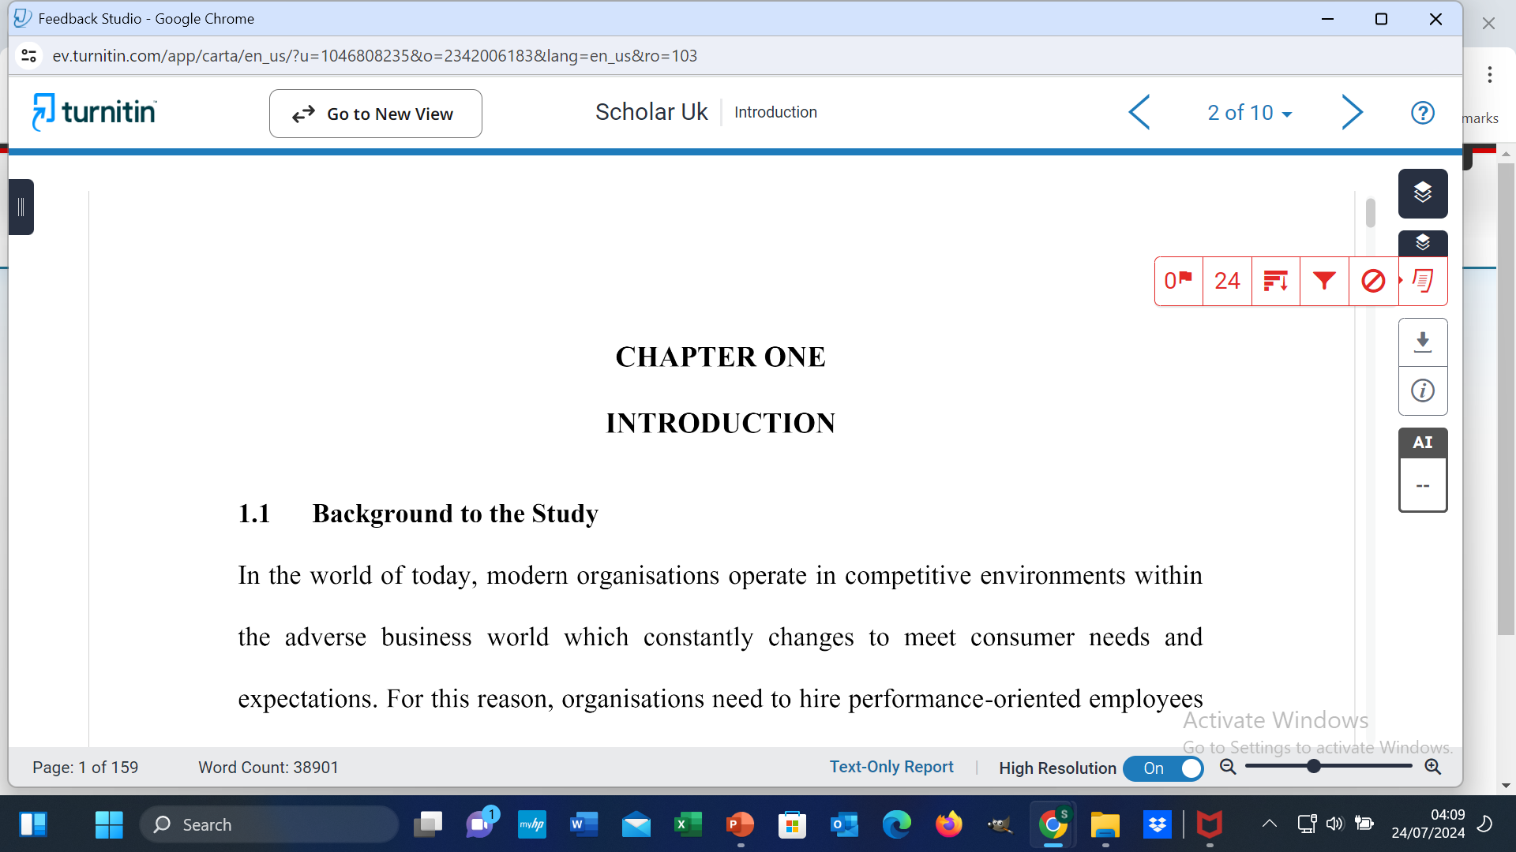

Slide 29
It is not who is right but WHAT is right that is important
Thomas Huxley
Wrong is wrong even if everyone is doing it and right is right even if no one is doing it
Develop a good research skills it will go a long way to help you not only for the successful completion of your programme but for lifelong learning.

Slide 30
Thanks for Listening
Time to Engage

Slide 31
Hands on
Create an account on google scholar and Research gate
Upload your articles or abstract to your Google scholar profile.

