Slide 1
UNIVERSITY OF NIGERIA, NSUKKA
COLLEGE OF POSTGRADUATE STUDIES
Opening Ceremony/Introduction to Graduate Research
Resource Person
Prof. James Conable-Nweke
CPGS RAW MENTORING UNIT
Email: james.conable@unn.edu.ng
WhatsApp:+234 81 6043 8899

Slide 2
OUTLINE
WORKSHOP GOAL & OBJECTIVES
PREPARATION KEYS FOR GRADUATE RESEARCH
ADVANTAGES OF GRADUATE RESEARCH
WHAT CPGS MENTORING UNIT CAN DO FOR YOU.
PARTICIPATION GUILDELINES
CONCLUSION.

Slide 3
GOAL
The primary goal is to equip graduate students with the essential knowledge and skills to conduct graduate research that aligns with the vision and mission of CPGS.

Slide 4
OBJECTIVES
Highlight smart and effective ways to conduct graduate research.
Identify the tools and resources that you would need to complete graduate research.

Slide 5
PREPARATION KEYS FOR GRADUATE RESEARCH
1. Critical thinking: Develop and enhance your ability to identify gaps, analyze and evaluate ideas, arguments, and evidence.
2. Seeking accurate relevant information: Prioritize finding and using precise and pertinent information to support your understanding and conclusions.
Continue|NEXT

Slide 6
3. Understanding the research methods: Gain a comprehensive understanding of various research methods to explore research questions effectively and validate your findings.
4. Pursue relevant research topics: Choose research topics that are essential for making informed decisions and engaging in meaningful discussions.
Continue|NEXT

Slide 7
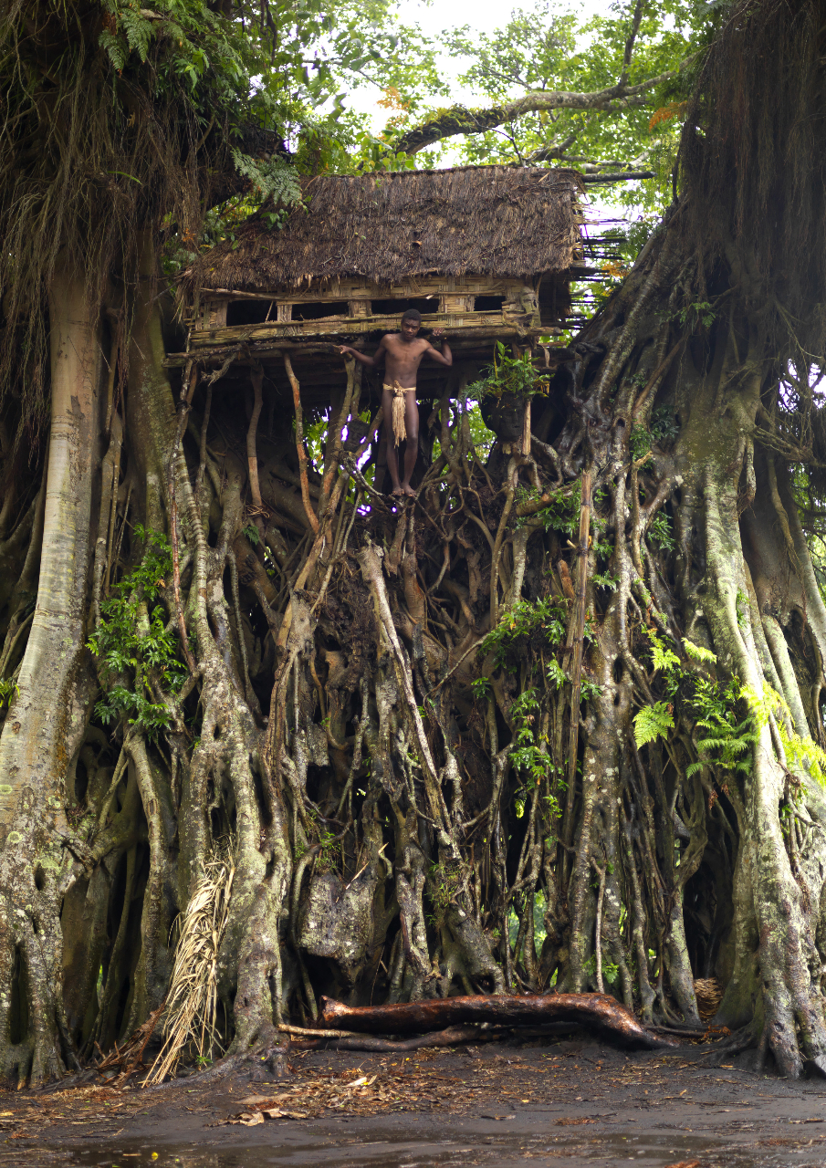
Question:
Do you presuppose there are places where people build houses in the treetops? If Yes Or No, Why?
The Treehouse
Notes:
The Treehouse: Do you presuppose there are places where people build houses in the treetops? If Yes Or No, Why?

Slide 8
ADVANTAGES OF GRADUATE RESEARCH
1. Facilitates Peer Review and Collaboration.
2. Permanent Record for Future Generations.
3. Skills Beyond Academia.
4. Informed Decision-making:
5. Broadens Perspective.

Slide 9
WHAT CPGS MENTORING UNIT CAN DO FOR YOU.
Help students to identify research problem.
2. Help students to understand how to measure and analyze research problem.
3. Help students to draft standard research paper.
4. Guide students in crafting research papers suitable in any high-impact-factor journals.
Continue|NEXT

Slide 10
How we do it:
Employ feedback mechanism.
2. Practice literature evaluation.
3. Guide to locate essential resources.
4. Facilitate academic & professional networking & collaboration.
5. Provides publication support.
6. Advise on stress and time management.

Slide 11
PARTICIPATION GUILDELINES
1. Browse the CPGS website and book an online appointment at the following link:
http://spgs.unn.edu.ng/pg-school-mentoring-unit/
2. Virtual Visiting Days: Monday to Friday.
3. Time: 13:00 to 18:00 pm.
4. Face-to-face Visiting: Tuesdays & Wednesdays (CPGS Main Building |Nsukka Campus, Room 106 between October-March when the Mentor is available ).
5.Time: 9:00 am to 2:00 pm.
Continue|NEXT

Slide 12
PARTICIPATION QUALIFICATION
Who Qualifies to participate in the RAW Mentoring?
You must have completed your course work and preparing to write a Master’s thesis or PhD Dissertation or Journal article.
Your have a course work relating to research that you think you need support to accomplish.
Continue|NEXT

Slide 13
PREPARATION FOR MENTORING VISIT
How do you prepare for your first mentoring session?
Before the Session, do the following:
Send the mentor your brief resume, i.e., two or three brief paragraphs describing your department or faculty, program, and personal data.
2. Give the mentor an idea of the research area you'd like to focus on.
3. Ask for the mentor’s WhatsApp number if you do not have it already.

Slide 14
CLOSING REMARK
Take advantage of all opportunities to learn and to network with faculty and student peers/colleagues
For RAW mentoring advising, please e-mail me at: Email: james.conable@unn.edu.ng
Thank you all for your participation!

