Slide 1
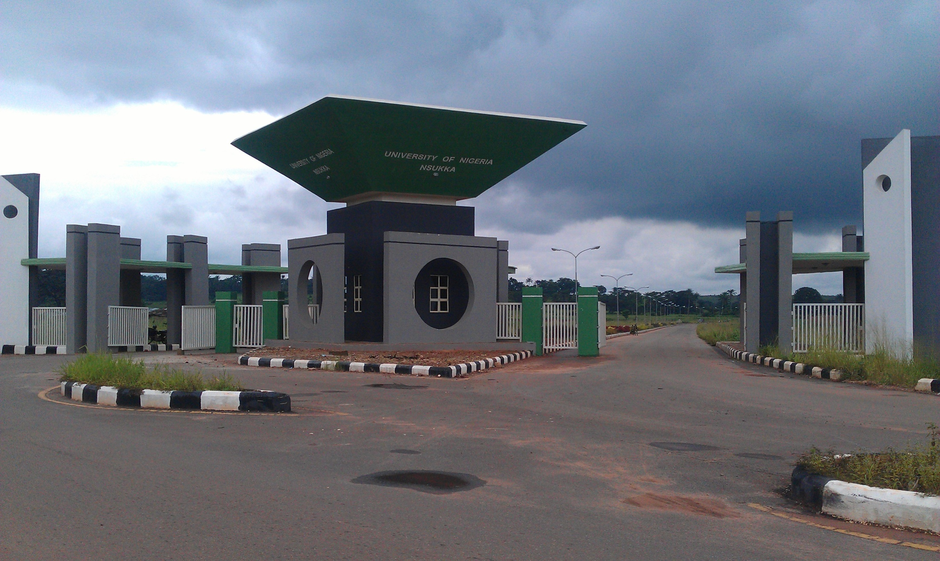
Research Methods in the Sciences
Prof. Anthony A. Attama
Drug Delivery and Nanomedicines Research Group
Department of Pharmaceutics, University of Nigeria, Nsukka
University of Nigeria Postgraduate Workshop, October 12-13, 2017

Slide 2
Outline
Introduction
Skills
Research methods
Data collection
Research designs
Design of experiment
Choosing the method
Conclusion

Slide 3
INTRODUCTION: Research
A systematic investigation of a subject in order to find something new¹- to create new knowledge!
The systematic and rigorous search for appropriate information on a specific subject.
Involves enunciation of the problem, developing a hypothesis, collecting and analyzing data and drawing conclusions, based on the facts and data collected².
Notes:
1. http://guides.library.ucla.edu/research-methods
2. http://keydifferences.com/difference-between-research-method-and-research-methodology.html

Slide 4
What Kind of New Knowledge?³
Form a typology of works, personalities, objects, etc.
Description
Correlation
Prediction
Categorization
Comparison
Evaluation
Explanation
Observe and write up what you consider typical, specific, or accidental
Make judgments and compare to a norm, scale,
Answer the question: why?
List the similarities and differences in order to better understand one or both of the compared things
Do two phenomena influence each other? How? Are there links between two things? Or, are they independent?
On the basis of past correlations, tell how probable a future event, action, outcome, etc. could be.
Notes:
3. Based on Nicholas Walliman: Research Methods: the Basics. Routledge, 2011

Slide 5
Different Kinds of Research⁴
Applied research: is used to answer a specific question that has direct applications to the world. This is the type of research that solves a problem.
Basic research: is driven purely by curiosity and a desire to expand our knowledge. Tends not to be directly applicable to the real world in a direct way, but enhances our understanding of the world around us.
Notes:
4. http://study.com/academy/lesson/basic-research-and-applied-research-definitions-and-differences.html

Slide 6
Qualitative and Quantitative Research Methods
Qualitative Research generates non-numerical data, e.g. interviews.
Quantitative Research uses measurable data to formulate facts and uncover patterns in research.

Slide 7
SKILLS AND ABILITIES⁵
Curiosity, creativity
Diligence
Passion, focus, interest, enthusiasm
Critical thinking
Strong analytic problem solving skills
Academic/Research integrity
Good communication skills
It is very important for everyone to know about his/her skills
Image credit: http://researchpedia.info/what-skills-and-abilities-do-you-have/
Notes:
5. http://whanauoraresearch.co.nz/news/method-or-methodology-whats-the-difference/

Slide 8
Critical thinking
Life Lessons from Albert Einstein⁶
“Insanity: doing the same thing over and over again and expecting different results.” ….Albert Einstein
Notes:
6. https://www.kaieteurnewsonline.com/2012/07/01/life-lessons-from-albert-einstein/

Slide 9
Research methodology vs methods
Methodology is the study of how research is done, how we find out about things, and how knowledge is gained⁷. It is about the principles that guide our research practices.
Research method is the 'WHAT did the researchers use for their study' part.
Notes:
7. McGregor, S. L., & Murname, J. A. (2010). Paradigm, methodology and method: Intellectual integrity in consumer scholarship. International Journal of Consumer Studies, 34 (4), 419-427.

Slide 10
Getting started⁸ – basic questions!
What should I research?
Where should I research?
Who can do research? – involving others!
How should I research?
Planning the research – timelines!
Notes:
8. https://www.nfer.ac.uk/schools/research-in-schools/what-should-i-research/

Slide 11
Research methods
Comprise of the tools, strategies or techniques that are used in research.⁹
Could be perturbations, questionnaires, surveys, interviews, photovoice, etc.
Different scientific disciplines utilize different kinds of methods.
Notes:
9. https://www.quora.com/What-is-the-difference-between-method-and-methodology-in-research

Slide 12
Research Methods in the Sciences
Many and varied but some questions are used to frame the exploration of each method¹⁰:
What is this method?
Who normally uses it and for what kinds of projects?
What sorts of data are collected using this method and how is it analysed?
How is knowledge made/created using this method?
What counts as ‘evidence’ and ‘rigour’ and how should these be interpreted?
Notes:
10. http://www1.rmit.edu.au/courses/049658

Slide 13
In addition one has to explore how to¹⁰:
Plan and scope a research project and write a research proposal.
Select the appropriate method(s) to use in the research project.
Search and select literature to support the research project.
Frame appropriate research questions
Use appropriate technology to support the collection and storage of research data and any relevant references.
Notes:
10. http://www1.rmit.edu.au/courses/049658

Slide 14
Defining a Research Problem¹⁰
The fuel that drives the scientific process, and is the foundation of any research method and experimental design.
Is one of the first statements made in any research paper and, as well as defining the research area, should include a quick synopsis of how the hypothesis was arrived at.
In a scientific paper, the research problem is written almost like a statement of intent.

Slide 15
Defining a Research Problem¹¹
Formulating the research problem begins during the first steps of the scientific process.
Many scientific researchers look at an area where a previous researcher generated some interesting results, but never followed up.
Notes:
11. https://explorable.com/defining-a-research-problem

Slide 16
A literature review and a study of previous experiments, and research, might throw up some vague areas of interest.
A scientist may even review a successful experiment, disagree with the results, the tests used, or the methodology, and decide to refine the research process, retesting the hypothesis.¹¹
Notes:
11. https://explorable.com/defining-a-research-problem

Slide 17
Data & data collection
Information in raw or unorganized form¹². Two types of data – primary and secondary.
Four basic ways to collect data for an analysis:
Obtain historical data
Run specific experiments by disturbing (exciting) the system being studied
Collect new data
Design experiments in a structured, mathematical way
Flask image credit: https://pixabay.com/en/photos/flask/
Notes:
12. http://www.businessdictionary.com/definition/data.html
Flask image: https://pixabay.com/en/photos/flask/

Slide 18
Research Design¹³
Refers to the overall strategy that integrates the different components of the study in a coherent and logical way to effectively address the research problem.
It constitutes the blueprint for the collection, measurement, and analysis of data.
Choice depends on the aim(s) of the study and the nature of the phenomenon.
The function of a research design is to ensure that the evidence obtained enables you to effectively address the research problem logically and as unambiguously as possible.
Notes:
13. http://libguides.usc.edu/writingguide/researchdesigns

Slide 19
Typical Experimental Designs¹⁴
To figure out an experimental design, one has to identify the variables, or measures that change.
Two main types of variables:
independent variables (also called factors), are variables whose values do not depend on the value of another variable; and
dependent variables are variables whose values depend on the independent variables.
Notes:
14. http://study.com/academy/lesson/what-is-factorial-design-definition-example.html

Slide 20
Why experimental design?¹⁵
Efficiency - Get more information from fewer experiments.
Focusing - Collect only the information that is really needed.
reduce time to design/develop new products & processes
improve performance of existing processes
improve reliability and performance of products
achieve product & process robustness, etc.
A well-designed experiment is as simple as possible - obtaining the required information in a cost effective and reproducible manner.
Notes:
15. http://www.camo.com/rt/Resources/design_of_experiment.html

Slide 21
Factorial Design¹⁶
When you have multiple independent variables in a single study, it is called factorial design.
A factorial design can have more than two independent variables - as many as you want, but…...
Is often used by scientists wishing to understand the effect of two or more independent variables upon a single dependent variable.
Notes:
16. http://study.com/academy/lesson/what-is-factorial-design-definition-example.html

Slide 22
Factorial design^{17,18}
Traditional research methods generally study the effect of one variable at a time - easier to manipulate statistically.
In many cases, two factors may be interdependent, and it is impractical to analyze them in the traditional way.
Factorial experiments allow subtle manipulations of a larger number of interdependent variables - powerful statistical methods highlight any correlations.
Notes:
17. https://explorable.com/factorial-design
18. Martyn Shuttleworth (Aug 10, 2009). Factorial Design. Retrieved Sep 29, 2017 from Explorable.com: https://explorable.com/factorial-design

Slide 23
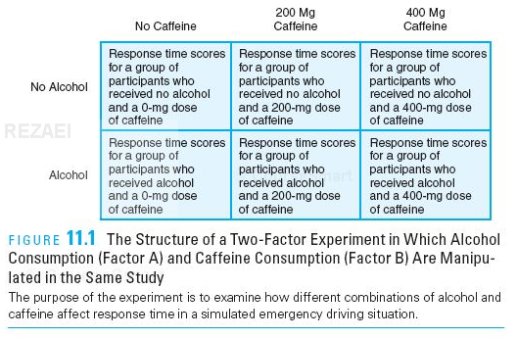
The basics of factorial design¹⁹
The structure of a Two-Factor Experiment in which alcohol consumption (Factor A) and Caffeine consumption (Factor B) are manipulated in the same study. The purpose of the experiment is to examine how different combinations of alcohol and caffeine affect response time in a simulated emergency driving situation.
Notes:
19. www.csulb.edu/~arezaei/EDP520/powerpoint/11-%20Factorial%20Designs-short.pptx

Slide 24
This example has two levels for the alcohol factor (factor A) and three levels for the caffeine factor (factor B), and can be described as a 2X3 (read as “ two by three”) factorial design
The total number of treatment conditions can be determined by multiplying the levels for each factor.

Slide 25
Design of experiments (DOE)²⁰
DOE is a systematic method to determine the relationship between factors affecting a process and the output of that process.
Gives information needed to manage process inputs in order to optimize the output.
Main concerns in experimental design include the establishment of validity, reliability, and replicability.
Notes:
20. https://www.isixsigma.com/tools-templates/design-of-experiments-doe/design-experiments-%E2%90%93-primer/

Slide 26
DOE²¹
DOE generates “structured” data tables, i.e. data tables that contain an important amount of structured variation.
When one has the possibility to actively perturb the system (experiment with the variables), chances of generating data tables become greater.
Notes:
21. http://www.camo.com/rt/Resources/design_of_experiment.html

Slide 27
DOE
In an experiment, we deliberately change one or more process variables (or factors) in order to observe the effect the changes have on one or more response variables.²²
The critical part is to decide which variables to change, the intervals for this variation, and the pattern of the experimental points.
Factorial DOE software is a notable tool that scientists, rely upon.
Notes:
22. http://www.itl.nist.gov/div898/handbook/pri/section1/pri11.htm

Slide 28
DOE Software
Design Expert®
JMP® software
Unscrambler® X

Slide 29
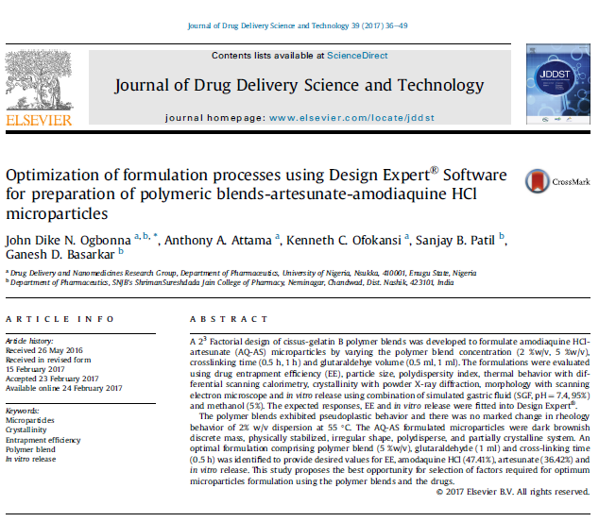
Practical application
http://dx.doi.org/10.1016/j.jddst.2017.02.011

Slide 30
Which Method to Choose?²³
Choice depends on different factors:
What information do you want? The aim(s) of the study.
The nature of the phenomenon - Is it feasible to collect the data, and if so, would it be valid/reliable?
Is it ethical to conduct the study?
The cost of the design
Is there little or much current scientific theory and literature on the topic?
Notes:
23. https://explorable.com/research-designs

Slide 31
Choosing the Research Method²⁴
The selection of the research method is crucial for what conclusions you can make about a phenomenon.
It is very important to choose a research method which is within the limits of what the researcher can do.
Time, money, feasibility, ethics and availability to measure the phenomenon correctly are other issues.
Some measurements might not reflect the real world, because they do not measure the phenomenon as it should.
Notes:
24. https://explorable.com/research-methodology

Slide 32
Results²⁴
Analysis
Significance Test – t-test (Student’s T-Test)
To test a hypothesis, quantitative research uses significance tests to determine which hypothesis is right.
The significance test can show whether the null hypothesis is more likely correct than the research hypothesis.

Slide 33
Drawing Conclusions²⁴
Drawing a conclusion is based on several factors of the research process, not just because the researcher got the expected result.
It has to be based on the validity and reliability of the measurement; how good the measurement was to reflect the real world and what more could have affected the results.
A common error is to think that correlation implies a causal relationship. This is not necessarily true.

Slide 34
Generalization²⁴
Generalization is to which extent the research and the conclusions of the research apply to the real world.
It is not always so that good research will reflect the real world, since we can only measure a small portion of the population at a time.

Slide 35
Validity and Reliability²⁴
Validity refers to what degree the research reflects the given research problem, while Reliability refers to how consistent a set of measurements are.
Research method(ology) lacking reliability cannot be trusted. Replication studies are a way to test reliability.
Notes:
23. https://explorable.com/research-methodology

Slide 36
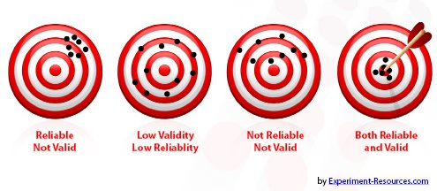
Validity and reliability²⁴
https://explorable.com/research-methodology
Both validity and reliability are very important aspects of research.
Notes:
23. https://explorable.com/research-methodology

Slide 37
Research Integrity²⁵
Active adherence to the ethical principles and professional standards essential for the responsible practice of research.
Honesty and fairness in proposing, performing, and reporting research
Accuracy and fairness in representing contributions to research proposals and reports
Proficiency and fairness in peer review
Collegiality in scientific interactions, communications and sharing of resources
Disclosure of conflicts of interest
Protection of human subjects in the conduct of research
Humane care of animals in the conduct of research
Adherence to the mutual responsibilities of mentors and trainees
Notes:
25. http://www2.le.ac.uk/offices/red/rd/research-environment-and-governance-1

Slide 38
How to present your results²⁶
This could be in a ‘presentation’, video or written report.
The audience will determine how to present the findings, the language, and the recommendations to be made.
Use charts or tables to help the reader understand the data and then highlight the most interesting findings.
Comment on the research findings across different methods used.
Analyse the data rather than just describing it - use it to tell a story that focuses on answering the research question.
Notes:
26. https://www.nfer.ac.uk/schools/developing-young-researchers/how-to-present-your-results/

Slide 39
There are endless ways of presenting research findings – be as innovative as you like! But follow established guidelines if available.

Slide 40
Conclusions
The seven steps of the scientific method²⁷:
observing an occurrence or asking a question,
researching the topic,
forming a hypothesis,
designing and conducting an experiment,
analyzing results,
drawing a conclusion and
reporting results.
Notes:
27. https://www.reference.com/science/seven-steps-scientific-method-740191e340239175

Slide 41
References
1. http://guides.library.ucla.edu/research-methods
2. http://keydifferences.com/difference-between-research-method-and-research-methodology.html
3. Based on Nicholas Walliman: Research Methods: the Basics. Routledge, 2011
4. http://study.com/academy/lesson/basic-research-and-applied-research-definitions-and-differences.html
5. http://whanauoraresearch.co.nz/news/method-or-methodology-whats-the-difference/
6. https://www.kaieteurnewsonline.com/2012/07/01/life-lessons-from-albert-einstein/
7. McGregor, S. L., & Murname, J. A. (2010). Paradigm, methodology and method: Intellectual integrity in consumer scholarship. International Journal of Consumer Studies, 34 (4), 419-427.
8. https://www.nfer.ac.uk/schools/research-in-schools/what-should-i-research/
9. https://www.quora.com/What-is-the-difference-between-method-and-methodology-in-research
10. http://www1.rmit.edu.au/courses/049658
11. https://explorable.com/defining-a-research-problem
12. http://www.businessdictionary.com/definition/data.html
13. http://libguides.usc.edu/writingguide/researchdesigns
14. http://study.com/academy/lesson/what-is-factorial-design-definition-example.html
15. http://www.camo.com/rt/Resources/design_of_experiment.html
16. http://study.com/academy/lesson/what-is-factorial-design-definition-example.html
17. https://explorable.com/factorial-design
18. Martyn Shuttleworth (Aug 10, 2009). Factorial Design. Retrieved Sep 29, 2017 from Explorable.com: https://explorable.com/factorial-design
19. www.csulb.edu/~arezaei/EDP520/powerpoint/11-%20Factorial%20Designs-short.pptx
20. https://www.isixsigma.com/tools-templates/design-of-experiments-doe/design-experiments-%E2%90%93-primer/
21. http://www.camo.com/rt/Resources/design_of_experiment.html
22. http://www.itl.nist.gov/div898/handbook/pri/section1/pri11.htm
23. https://explorable.com/research-designs
24. https://explorable.com/research-methodology
25. http://www2.le.ac.uk/offices/red/rd/research-environment-and-governance-1
26. https://www.nfer.ac.uk/schools/developing-young-researchers/how-to-present-your-results/
27. https://www.reference.com/science/seven-steps-scientific-method-740191e340239175

Slide 42
Thank you for your attention

