Slide 1
ENTERPRENEURSHIP PACKAGE
PROF.(MRS) IFEOMA STELLA MADUEME
HEAD, DEPARTMENT OF ECONOMICS
UNIVERSITY OF NIGERIA
NSUKKA

Slide 2
STYLIZED FACTS
The university is established for human capital development, research and technological innovation
This has resulted in increased number of universities and enrollment rates
Graduate turnout rates is about 500,000 yearly

Slide 3
Stylized facts contd
Unemployability of graduates is a perennial problem in Nigeria due to the disparity between the school curriculum and labor market requirements
Graduate unemployment rates has increased to approximately 47% in spite of government policies with attendant consequences
‘Unemployment is like a headache or a high temperature, unpleasant and exhausting ‘………….William Henry Beveridge
When you are unemployed, weekends are like
seven days long…..Mokokoma Mokhonoana

Slide 4
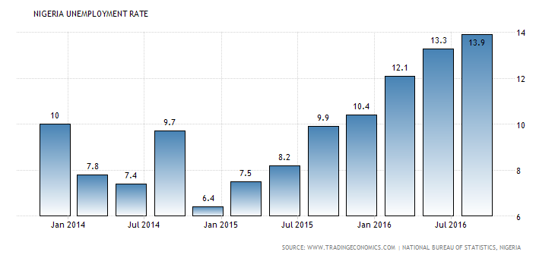
UNEMPLOYMENT STATISTICS

Slide 5
SOLUTION?
Equip graduates with skills
for self employment
For reduction of daily expenditures

Slide 6
UNN INITIATIVE: ON LINE ENTREPRENEURSHIP PACKAGE WITH VARIOUS ADVANTAGES
RECIPIENTS OBTAIN DIPLOMA CERTIFICATES
ACCESS TO MORE THAN 30 SKILLS
SUBSIDIZED FOR UNIVERSITY OF NIGERIA, STUDENTS
FIRST OF ITS KIND IN NIGERIA AND AFRICA

Slide 7
GENERAL COURSE CONTENTS
FUNDAMENTALS OF ENTREPRENEURSHIP, BUSINESS PLANS AND LOCATION DECISIONS, BUDGETING, FEASIBILITY AND PROFITABILITY STUDIES,
COMPONENTS OF THE INTERNET, UTILIZING SEARCH ENGINES, HOW TO INCREASE YOUR DIAL UP MODERM PERFORMANCE, HOW TO FIND TEXT BOOKS ONLINE, WEBSITES TO GET EBOOKS. ONLINE LIBRARIES AND RESEARCH DATABASES, SEARCH ENGINES
SCHOLARSHIP OPPORTUNITIES, TRAINING IN NETWORKING AND ON LINE BUSINESSES,

Slide 8
GENERAL COURSE CONTENTS
OVERALL COMPUTER CARE, 10 REASONS WHY PC'S CRASH. HOW DO I TEST MY VIRUS SCAN INSTALLATION, HOW TO REGAIN CONTROL OF YOUR COMPUTER WHEN IT FREEZES/HANGS, HOW TO SEE HIDDEN FILES USING DOS, HOW TO ADD AN OPTION TO PRINT THE CONTENTS OF A FOLDER, PRINTER PROBLEMS - PRINTER WON'T PRINT,
BROWSER PROBLEMS - WEBSITES WON'T OPEN, I GET 'THERE IS A PROBLEM WITH THIS WEBSITE'S SECURITY CERTIFICATE,
HOW TO SPEED UP A SLOW COMPUTER, 23 WAYS TO SPEED UP YOUR WINDOWS etc

Slide 9
SUBDIVISIONS: AGRICULTURE
ANIMALPRODUCTION:
Poultry production, Sheep and Goats Production, Fish Farming/Fish Culture, Snail farming , Pig Production, Grasscutter Production
Crop production methods, Production of Root and Tuber Crops , cereals and plantation crops
CROP PRODUCTION

Slide 10
SOFT WARE TRAINING
Microsoft word
Microsoft Excel
Power point presentations
LATEX software
Mathematica software
Eviews software
SPSS software
STATA software
Matlab software

Slide 11
COSMETOLOGY
Detergents, bar and toilet soaps
Liquid soap, shampoo and car wash
Hair and body pomades, and creams
Texcote, emulsion and oil paints
Shoe polish and perfumes
Insecticides and germicides
White and antiseptic powders
Balms
Tie and dye and batik production

Slide 12
CONFECTIONARIES
Nutrition and the kitchen
Cakes, Icing and muffins
Peanuts, Chin- chin, Buns and puffs
Biscuits, cookies and bread
Sausage rolls and fish pies
Shawarma and Ice creams
Beverage, Custard etc

Slide 13
Don’t bring your need to the market place, bring your skills…..Jim Robin (1930 – 2009) Your earning ability today is largely dependent upon your knowledge, skill and ability to combine all in such a way that you contribute value to which customers are going to pay…Brian Tracy (1944)
And if your years in school were bad or boring you can still educate yourself now by Henrik Edberg

Slide 14
CONCLUDING REMARKS!!!
GOD BLESS YOU
AND
HAVE A WONDERFUL DAY
*************************

